Slide 1

Reducing Australian First Nations Youth Justice Contacts
A case for raising the age of criminal responsibility based on Queensland birth cohort data

Slide 3
Disclaimer & Acknowledgements
We gratefully acknowledge the contributions and support of the Queensland Government Statistician’s Office; Queensland Police Service; Queensland Department of Justice and Attorney-General; the Department of Youth Justice, Employment, Small Business and Training; the Department of Child Safety, Seniors and Disability Services; the Queensland Registry of Births, Deaths and Marriages; Queensland Health; Queensland Department of Premier & Cabinet; Queensland Corrective Services; and the Griffith University Social Analytics Lab. The opinions discussed within this presentation are those of the authors and do not represent the opinions of the above Departments.
Please note that the results provided in this presentation are preliminary.

Slide 4
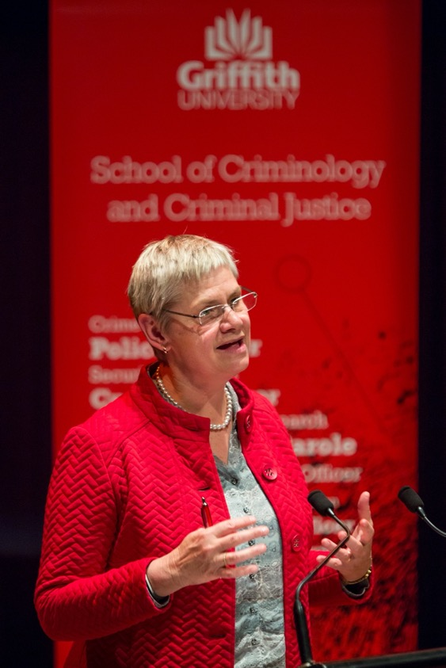

Slide 5
Age of criminal responsibility
Variation in minimum age of criminal responsibility (MACR) internationally – 6 to 16
United Nations Committee on the Rights of the Child (UNCRC) – 14 years as benchmark for MACR and anything below 12 years unacceptable
Most Australian jurisdictions MACR set at 10 years
Increasing calls to increase MACR:
  Low MACR discriminates against First Nations children
  Most children who encounter the criminal justice system come from disadvantaged backgrounds
  Criminalising children maintains cycle of disadvantage
  Entrenchment in the criminal justice system
Ensuring community safety from offences perpetrated by children?
Notes:
Variation in age of criminal responsibility from 6 in North Carolina (US) through to 16. Very arbitrary. In England and Wales and most of Australia, the age is 10. In the Netherlands and Canada, it is 12. In Nordic countries (Sweden, Finland and Norway) the age is 14 – under which the offence is mostly viewed as a symptom of problems with the child’s development.
UNCRC – set at 14 years – arguments due to brain development – not yet mature
Brain development and other biological factors in children are slow to develop, such as executive functioning relevant to judgement and decision making. This process of development continues into the 20s.
Typically arguments for a minimum age are based on the inability of children and young people to make rational informed decisions:
Brain development and other biological factors
Heightened reward seeking and risk taking
Australia has one of the lowest ages of criminal responsibility in the world.
Low MACR discriminates against First Nations children - The criminalisation of children in Australia is a nationwide problem that disproportionately impacts Aboriginal and Torres Strait Islander children.
Most children in prison come from backgrounds that are disadvantaged. These children often experience violence, abuse, disability, homelessness, and drug or alcohol misuse.
Criminalising the behaviour of young and vulnerable children creates a vicious cycle of disadvantage and forces children to become entrenched in the criminal justice system.
Children who are forced into contact with the criminal justice system at a young age are also less likely to complete their education or find employment, and are more likely to die an early death.

Slide 6
Early onset offending
Small group (<5% of general population) who begin offending early in life
Early onset offending typically has a longer duration, higher frequency and involves more serious offending than later onset offending (in the long-term).
Early onset offending is related to negative outcomes:
  Serious youth justice contacts
  Disadvantage and remoteness
  Child maltreatment and mental health challenges
Changing nature:
  Small group of early onset offenders appears to be increasing over time
  Higher proportion of younger people are entering the system over time
Notes:
What do we know about children who have early contact with the CJS?
Early-onset offending behaviour is a strong predictor of longer duration, higher frequency and serious offending in later adolescence and adulthood

Slide 7
Current study questions
Using Queensland birth cohort data:
Who are the young people having finalised contacts with the criminal justice system at the earliest ages of criminal responsibility?
What are the offending and sentencing outcomes at onset?
What are the long-term offending and sentencing outcomes?
Notes:
What do we know about children who have early contact with the CJS?
Early-onset offending behaviour is a strong predictor of longer duration, higher frequency and serious offending in later adolescence and adulthood

Slide 8
Data for current study
Queensland Cross-sector Research Collaboration 1990 birth cohort
  45,331 individuals (excluding deaths > 10 years)
  2,868 (6.3%) First Nations
  21,998 (48.5%) female
Offending
  Police – diversions (cautions and conferences 10-17 years)
  Courts (child and adult) – proven/finalised offences (10-24 years)
  QASOC coded; classified by sexual, violent, non-violent, minor categories
  Sentencing outcomes
Notes:
Offences reflect the combination of police diversion and court finalization data. Guilt is admitted/proven for all offences included.

Slide 9
Analytic approach
Prevalence of offending 10-24 years
Youth offending prevalence 10-16 years
Age of first contact
Classification by age of first contact
  10-11 years
  12-13 years
  14-16 years
Offences at onset
Overall offending outcomes up to 24 years
Trajectories of accumulated offences

Slide 10
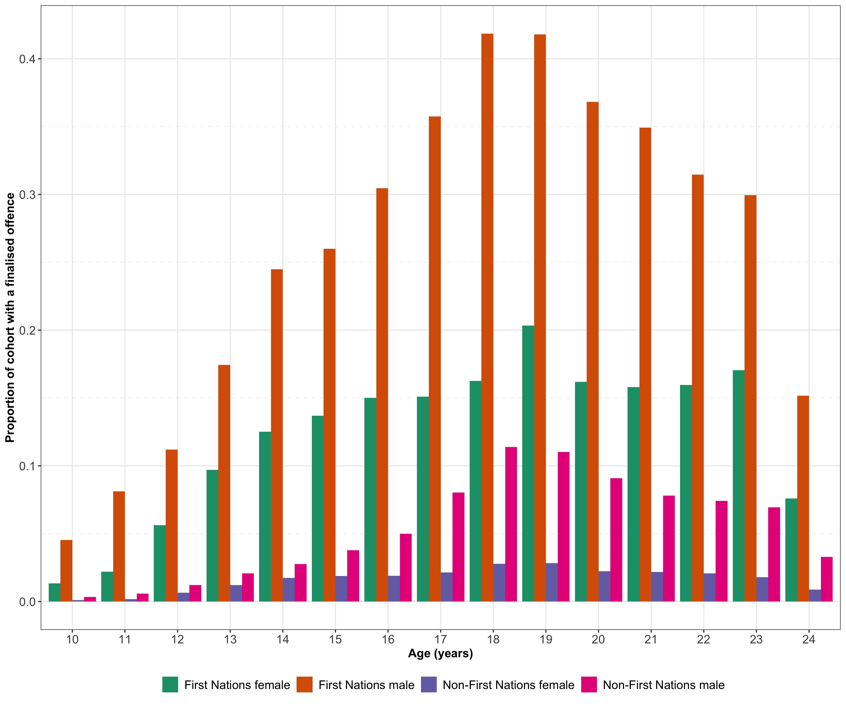
Prevalence of offending by age
28.0% of cohort (n = 12,688) had a finalised diversion or court appearance by 24 years
  58.7% First Nations female
  81.9% First Nations male
  14.9% non-First Nations female
  34.7% non-First Nations male

Slide 11
Youth offending prevalence
10.8% of the cohort (n = 4,883) had at least one proven offence from a police diversion or court finalisation between 10 to 16 years
Despite only constituting 6.3% of the cohort, First Nations individuals comprised 24.8% of the sample with a proven youth offence
Demographic group | Total cohort |  | Police diversion |  | Court finalisation |  | Police diversion or court finalisation
 | N | % | N | % | N | % | N | %
First Nations females | 1,279 | 2.8% | 372 | 8.0% | 336 | 10.0% | 408 | 8.4%
First Nations males | 1,589 | 3.5% | 754 | 16.3% | 758 | 22.1% | 805 | 16.5%
Non-First Nations females | 20,719 | 45.7% | 1,232 | 26.6% | 557 | 16.2% | 1,272 | 26.1%
Non-First Nations males | 21,744 | 48.0% | 2,273 | 49.1% | 1,787 | 52.0% | 2,398 | 49.1%
Total† | 45,331 | 100.0% | 4,631 | 10.2% | 3,438 | 7.6% | 4,883 | 10.8%
† Percent of total individuals within the cohort
Notes:
Despite only constituting 6.3% of the cohort, First Nations individuals comprised 24.8% of the sample with a proven youth offence.

Slide 12
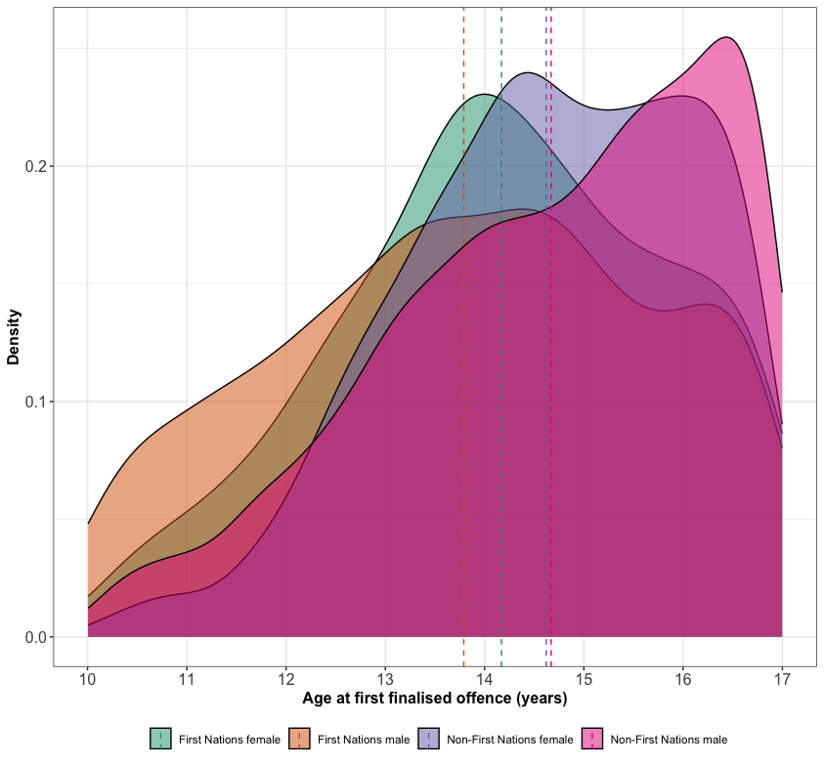
Age of first contact
Mean age at first youth contact was 14.47 (SD = 1.68) years
Significant difference by demographic group
First Nations males significantly younger compared to First Nations females
No significant difference between non-First Nations males and females

Slide 13
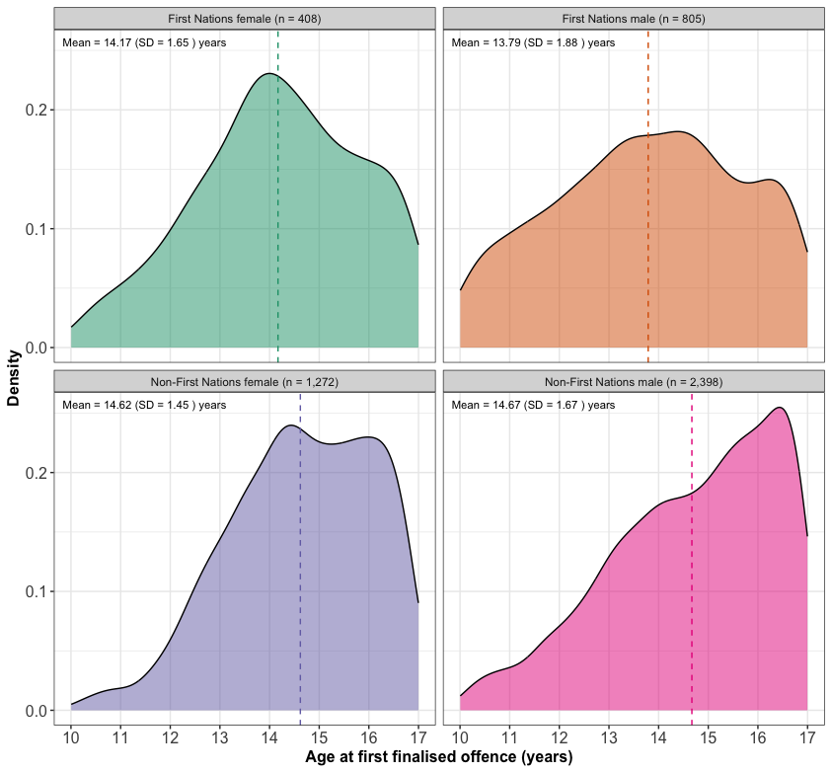
Age of first contact
Mean age at first youth contact was 14.47 (SD = 1.68) years
Significant difference by demographic group
First Nations males significantly younger compared to First Nations females
No significant difference between non-First Nations males and females

Slide 14
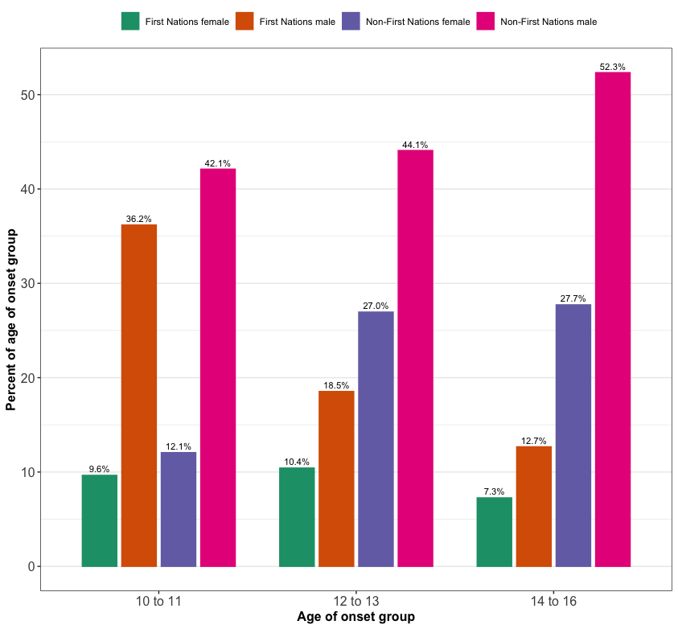
Age of onset groups
Age of onset (n = 4,883)
  10-11: 9.3% (n = 456)
  12-13: 27.5% (n = 1,343)
  14-16: 63.2% (n = 3,084)
First Nations males
  36.2% 10-11 group
  16.5% of YJ sample
  3.5% cohort
Notes:
Majority of individuals have first contact with YJ system at 14-16 years
Only a small number have contact at 10-11 years
10-11 onset group overrepresented with First Nations males (36.2%), despite making up only 16.5% of YJ sample and 3.5% of cohort population

Slide 15
Offending at onset: 10-11
Rank | Offence | n | %
1 | Theft (except motor vehicles)ª | 403 | 34.7%
2 | Unlawful entry with intent/burglary, break and enter^{b} | 244 | 21.0%
3 | Property damage | 189 | 16.3%
4 | Trespass | 51 | 4.4%
5 | Common assault | 33 | 2.8%
6 | Theft of motor vehicle parts or contents | 26 | 2.2%
7 | Receiving stolen property | 21 | 1.8%
8 | Graffiti | 20 | 1.7%
9 | Indecent treatment of a child | 20 | 1.7%
10 | Assault occasioning bodily harm | 19 | 1.6%
Total |  | 1,160 | 100.0%
ª Combines all subdivision 082 “Theft (except motor vehicles)” offences, QASOC codes 08211 to 08299.
^{b} Combines all division 07 “Unlawful entry with intent/burglary, break and enter” offences, QASOC codes 07111 to 07118.

Slide 16
Offending at onset: 12-13
Rank | Offence | n | %
1 | Theft (except motor vehicles)ª | 1,135 | 38.1%
2 | Unlawful entry with intent/burglary, break and enter^{b} | 399 | 13.4%
3 | Property damage | 379 | 12.7%
4 | Trespass | 117 | 3.9%
5 | Common assault | 79 | 2.7%
6 | Possess and/or use illicit drugs | 79 | 2.7%
7 | Theft of motor vehicle parts or contents | 67 | 2.2%
8 | Assault occasioning bodily harm | 66 | 2.2%
9 | Graffiti | 53 | 1.8%
10 | Receiving stolen property | 51 | 1.7%
Total |  | 2,981 | 100.0%
ª Combines all subdivision 082 “Theft (except motor vehicles)” offences, QASOC codes 08211 to 08299.
^{b} Combines all division 07 “Unlawful entry with intent/burglary, break and enter” offences, QASOC codes 07111 to 07118.

Slide 17
Offending at onset: 14-16
Rank | Offence | n | % offences
1 | Theft (except motor vehicles)ª | 2,067 | 21.6%
2 | Unlawful entry with intent/burglary, break and enter^{b} | 1,044 | 10.9%
3 | Property damage | 914 | 9.6%
4 | Trespass | 433 | 4.5%
5 | Graffiti | 392 | 4.1%
6 | Resist arrest, incite, hinder, obstruct police | 364 | 3.8%
7 | Liquor and tobacco offences | 342 | 3.6%
8 | Possess and/or use illicit drugs | 269 | 2.8%
9 | Assault occasioning bodily harm | 252 | 2.6%
10 | Possession of drug utensils | 216 | 2.3%
Total |  | 9,571 | 100.0%
ª Combines all subdivision 082 “Theft (except motor vehicles)” offences, QASOC codes 08211 to 08299.
^{b} Combines all division 07 “Unlawful entry with intent/burglary, break and enter” offences, QASOC codes 07111 to 07118.

Slide 18
Nature of offending and outcomes at onset
Offending and outcome | 10-11 (n = 456) | 12-13 (n = 1,343) | 14-16 (n = 3,084) | Total (n = 4,883)
Serious offence (NOI 1-30) | 56 (12.3%) | 189 (14.1%) | 514 (16.7%) | 759 (15.5%)
Diversion | 446 (97.8%) | 1,310 (97.5%) | 2,851 (92.4%) | 4,607 (94.3%)
Supervised order | 17 (3.7%) | 37 (2.8%) | 157 (5.1%) | 211 (4.3%)
Youth detention | 0 | 0 | 12 (0.4%) | 12 (0.2%)
Notes:
What is NOI 30

Slide 19
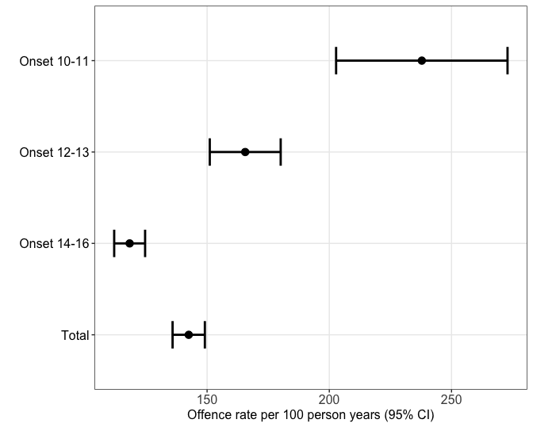
Offending outcomes up to 24 years
Rate of offences per 100 person years
Onset group | Offence rate | Lower | Upper
10-11 | 237.84 | 202.78 | 272.92
12-13 | 165.61 | 151.10 | 180.11
14-16 | 118.32 | 112.00 | 124.64
Total | 142.49 | 135.88 | 149.09

Slide 20
Offending outcomes up to 24 years
Finalised appearances – how many times do individuals appear by onset group?
Finalised appearances | 10-11 (n = 456) | 12-13 (n = 1,343) | 14-16 (n = 3,084) | Total (n = 4,883)
Once | 66 (14.5%) | 308 (22.9%) | 898 (29.1%) | 1,272 (26.1%)
Two to five | 134 (29.4%) | 470 (35.0%) | 1,303 (42.3%) | 1,907 (39.1%)
Six to ten | 75 (16.5%) | 260 (19.4%) | 562 (18.2%) | 897 (18.4%)
More than ten | 181 (39.7%) | 305 (22.7%) | 321 (10.4%) | 807 (16.5%)

Slide 21
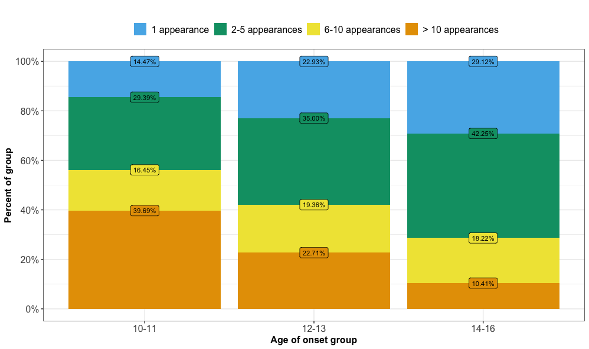
Offending outcomes up to 24 years
Finalised appearances – how many times do individuals appear by onset group?

Slide 22
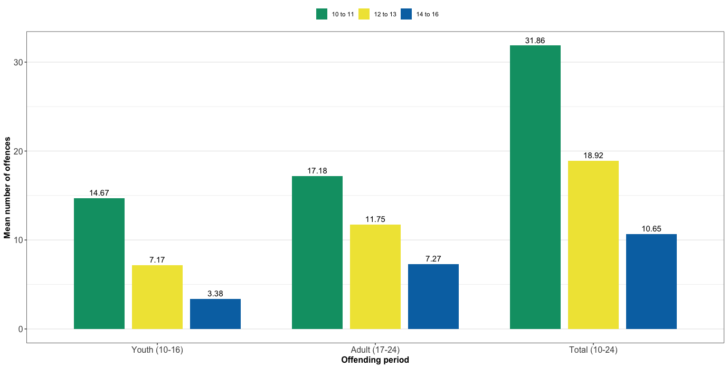
Offending outcomes up to 24 years
Youth, adult and total mean offences by onset group

Slide 23
Offending outcomes up to 24 years
Offence types
Offence type | 10-11 (n = 456) | 12-13 (n = 1,343) | 14-16 (n = 3,084) | Total (n = 4,883)
Violent | 183 (40.1%) | 404 (30.1%) | 721 (23.4%) | 1,308 (26.8%)
Non-violent | 445 (97.6%) | 1,311 (97.6%) | 2,910 (94.4%) | 4,666 (95.6%)
Sexual | 38 (8.3%) | 89 (6.6%) | 132 (4.3%) | 259 (5.3%)
Other minor | 336 (73.7%) | 790 (58.8%) | 1,708 (55.4%) | 2,834 (58.0%)

Slide 24
Offending outcomes up to 24 years
Sentence outcomes
Sentence outcome | 10-11 (n = 456) | 12-13 (n = 1,343) | 14-16 (n = 3,084) | Total (n = 4,883)
Youth detention | 26 (5.7%) | 11 (0.8%) | 13 (0.4%) | 50 (1.0%)
Adult incarceration | 107 (23.5%) | 178 (13.3%) | 236 (7.7%) | 521 (10.7%)
Community-based supervised order | 223 (48.9%) | 448 (33.4%) | 740 (24.0%) | 1,411 (28.9%)

Slide 25
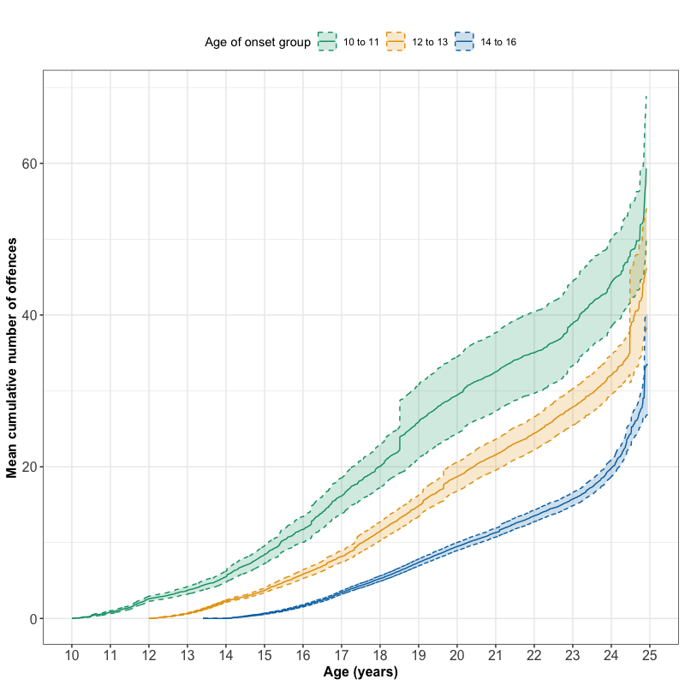
Mean cumulative offences
Mean cumulative offence trajectories up to 24 years
10-11 > 12-13 >14-16
10-11 accumulated more offences over time
Convergence toward end of observation period

Slide 26
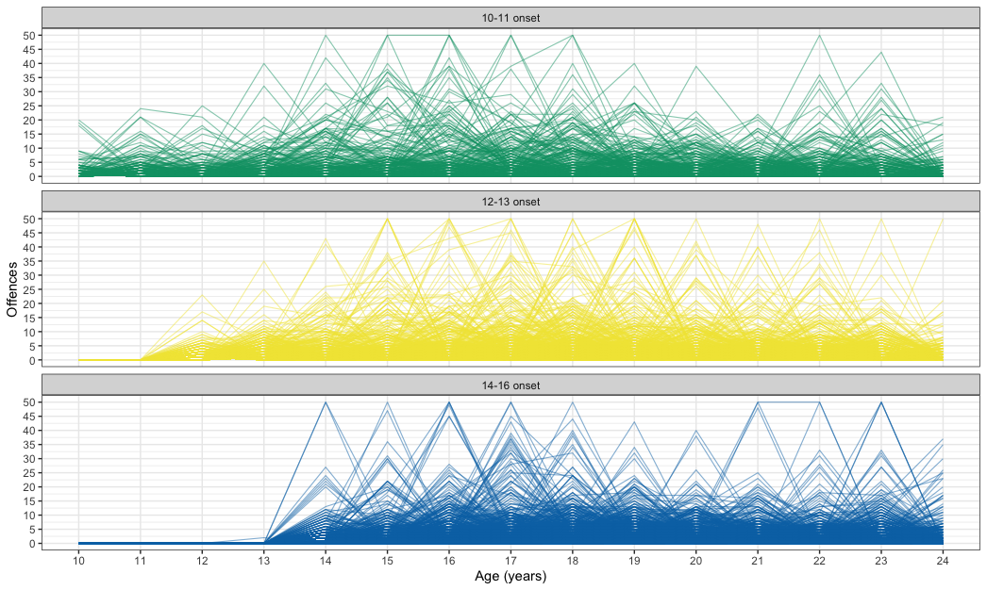
Individual trajectories are variable

Slide 27
Summary of findings
Small number of individuals have contact at very early (10-11) and early (12-13) ages of criminal responsibility
First Nations males significantly overrepresented in 10-11 onset group (36.2% but only 3.5% of cohort)
Offences at early ages of contact predominately property-related, mean number of offences typically low during these early years, and almost all are diverted, BUT
The 10-11 onset group have poorest offending outcomes by all indicators up to 24 years
  237.84 offence rate per 100 person years
  39.7% have more than 10 court appearances
  23.5% experience adult incarceration
Notes:
FOR JAMES: Offences at early ages of contact predominately property-related, and mean number of offences typically low during these early years, and almost all are diverted ---While not minimizing the seriousness of these offences, does dispel argument that these young children require justice system response to protect community safety from serious offending AND ALSO MEANS THAT WE CAN INTERVENE IN ALTERNATIVE WAYS BEFORE THINGS GET TOO SERIOUS

Slide 28
Implications
Consistent with DLC: early contact predictive of worse offending outcomes
  Likely partly due to effects of system contact & partly due to underlying risk and vulnerability factors (McAra & McVie, 2007; Malvaso et al., 2023)
    BOTH point to the need for an alternative response
Justice system responses do not address the root causes of offending
  NEED: Pathways into early intervention services addressing wider criminogenic needs
    Small numbers of early-onset = opportunities for holistic supports to address needs
Justice system responses can make things worse
  NEED: Delay contact with justice system to minimise potential for adverse outcomes associated with such contact
Notes:
complex needs better addressed outside the criminal justice system

Slide 29
Implications
Early justice system responses unequally affects First Nations people
  NEED: Culturally appropriate services in remote locations to address needs, as alternatives to justice system contact (and/or prior to justice system contact)
BUT ALSO…. Vulnerability begins before contact with the justice system
  NEED: Investment in earlier prevention – multifaceted, cross-sectoral supports
  NEED: Place-based, community-focused, culturally safe prevention

Slide 30
Limitations
No information about criminogenic risk profiles across groups – factors leading to early onset
Groups likely differ by underlying vulnerabilities associated with offending risk
Use of court finalisation dates inflates ages for offending
Cohort effects
Population-based, longitudinal birth cohort
Strengths
Notes:
No information about criminogenic risk profiles across groups – factors leading to early onset
Groups likely differ by underlying vulnerabilities associated with offending risk
(but we have a wealth of existing research to draw inferences from that suggest vulnerability and disadvantage and the need for holistic supports, as opposed to retribution)
Use of court finalisation dates inflates ages for offending
(but most cautioned first time?)

Slide 31

Contact
James Ogilvie
j.ogilvie@griffith.edu.au
QCRC project leaders
Carleen Thompson
c.thompson@griffith.edu.au
Troy Allard
t.allard@griffith.edu.au
https://www.griffith.edu.au/criminology-institute/our-research/major-research-projects/qld-linkage-project

