Slide 1

Inside the brotherhood of the bikie: Research into outlaw motorcycle gangs
Anthony Morgan
Serious and Organised Crime, Cybercrime and Radicalisation Research
www.aic.gov.au

Slide 2
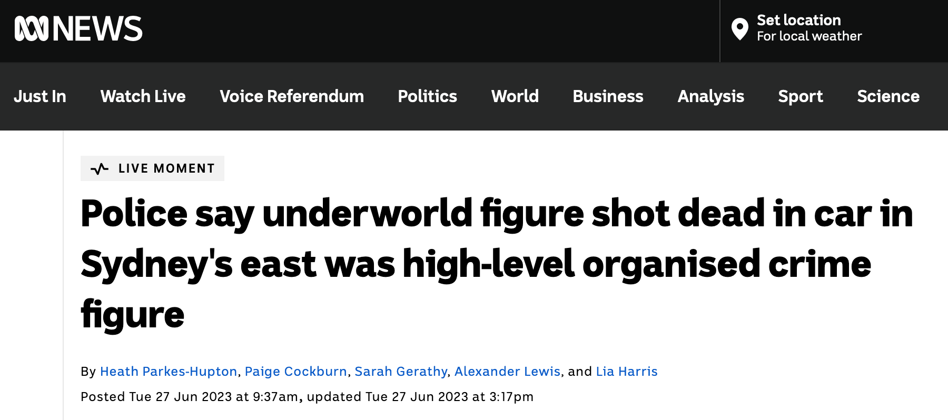

Slide 3
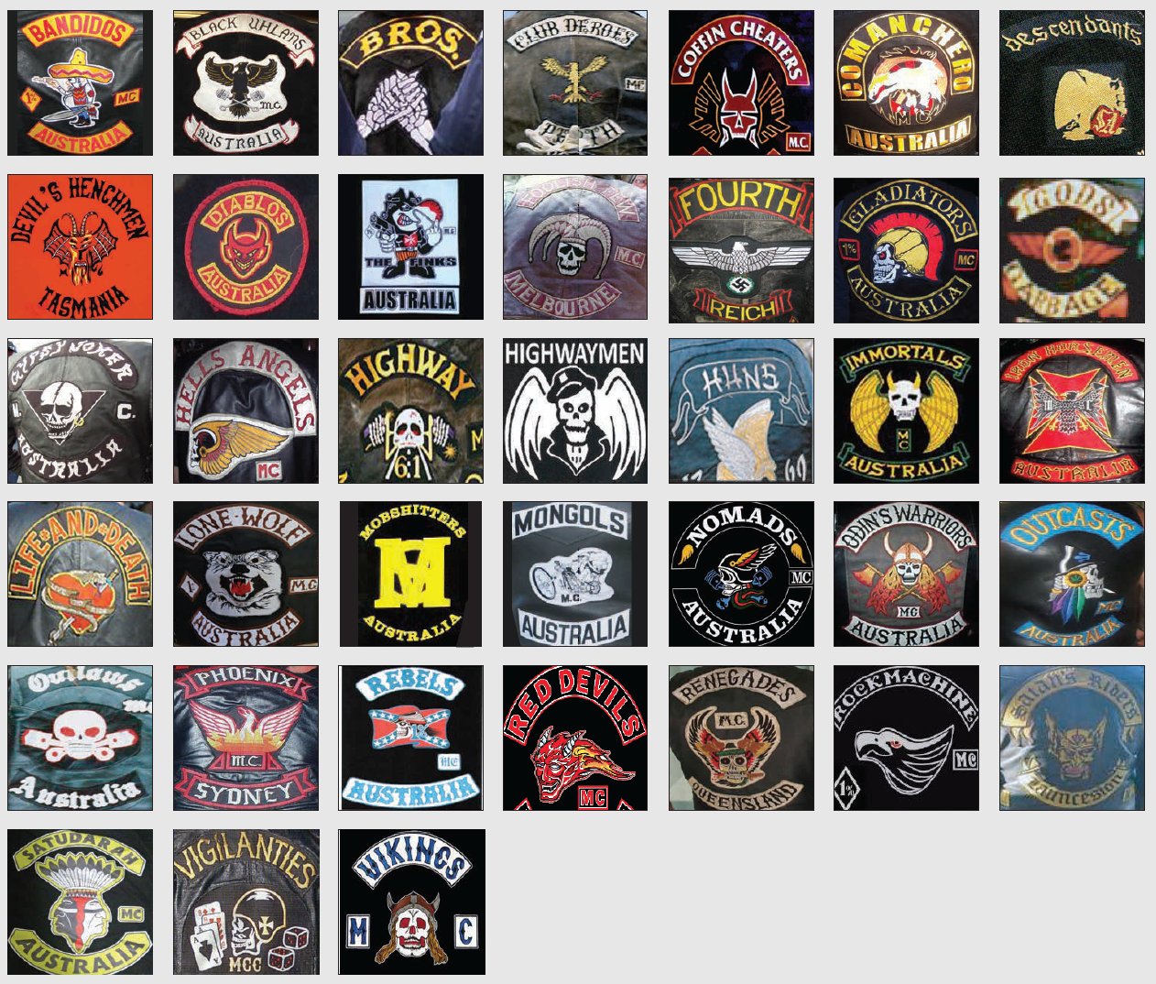

Slide 4
Visa cancellations
OMCG involvement in violence & org. crime
Early career offending trajectories of OMCG members
Individual & group-level correlates of org. crime involvement
Criminal mobility of OMCG members
International comparison of OMCG crime
Systematic review of offending by OMCGs
Updated review of OMCG legislation
Changepoint detection analysis of offending by OMCGs
Tax evasion by OMCG members
Changing culture & effects of OMCG membership
Recruitment & disaffiliation from gangs
Dutch approach to OMCGs
Predicting high-harm offending by OMCGs
National replication of high-harm risk assessment
Crime during club conflict
OMCGs and domestic violence
Victorian high-harm risk assessment

Slide 5
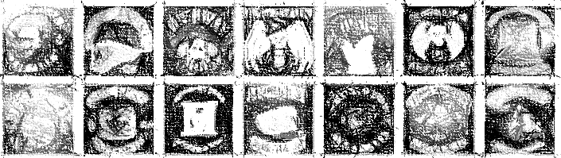
48 years
6.6 years
25
66
0.2
17
Age
Joining
Membership
13
7+
Leaving
Clubs
Office bearers

Slide 6
Australian Institute of Criminology:
Dr Christopher Dowling, Isabella Voce & Dr Timothy Cubitt
Queensland Police Service:
Det. Sergeant Dominic Boland, Dr Julianne Webster, Dr Yi-Ning Chiu & Det. Chief Superintendent Roger Lowe
New South Wales Police Force, Australian Criminal Intelligence Commission, BOCSAR (+ others)
Research partners from NSCR, Deakin, Uni. of Sydney and ANU

Slide 7
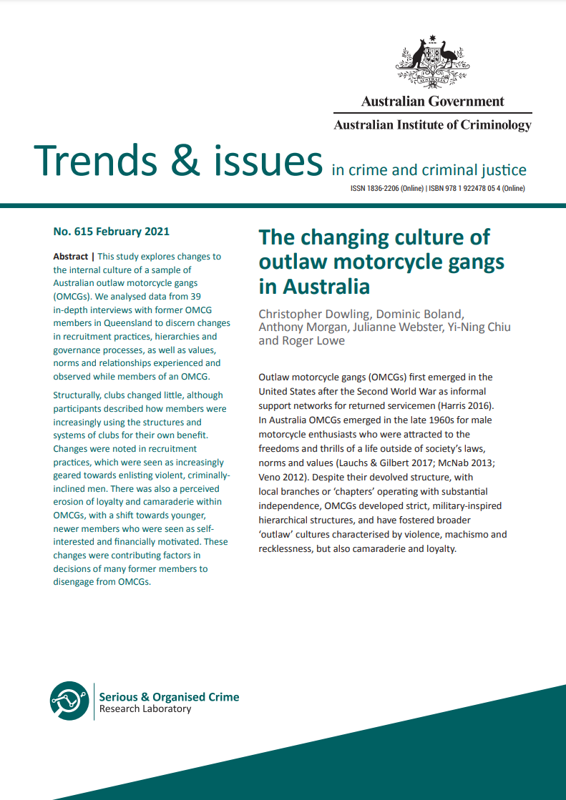

…they talk about camaraderie, brotherhood, that’s not real anymore.

Slide 8
1
Change in who is being recruited into OMCGs
They’re wannabes, think it’s all about tough boy image, whole image man, thug life image, gangster, gold, gelled hair, steroids, drugs, hot pussy on their arms, that’s the enticement.

Slide 9
2
Increasing use of club structures and systems for profit
These days it’s nothing more than a criminal enterprise, it’s not like the old man’s riding clubs, it’s just a criminal enterprise now, it’s nothing but extortion, anything in there, you name it, it’s going on…

Slide 10
3
Erosion of loyalty and camaraderie
...seeing all the treacherous shit over the years, seeing guys [other members] get set up over drugs and money, get fucking bashed and flogged and thrown out, and having bikes and cars taken to cover drug debts

Slide 11
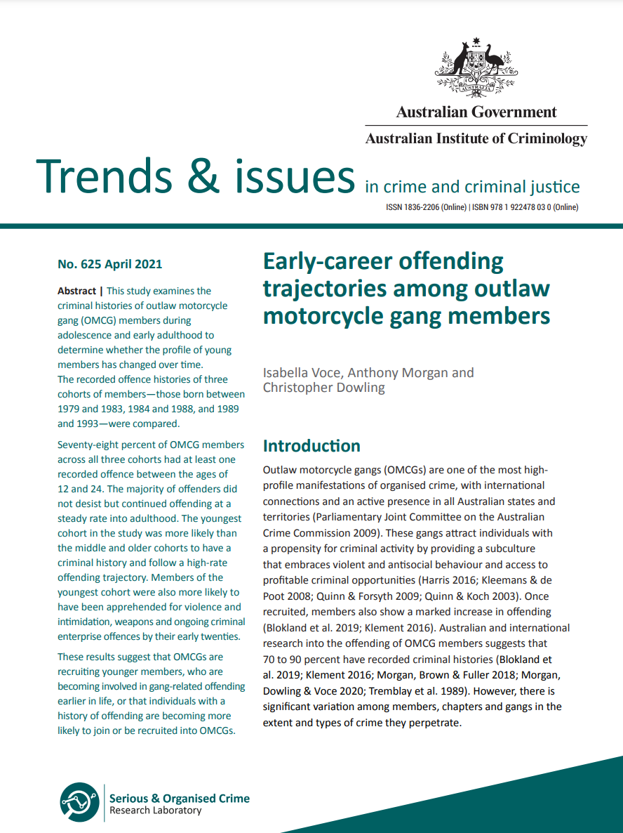
Profile of individuals joining OMCGs has changed over time
Cumulative prevalence of violent and intimidation offences (%)

Slide 12
Organised crime involvement is more common in clubs with higher recruitment activity
Probability of organised crime offence

Slide 13
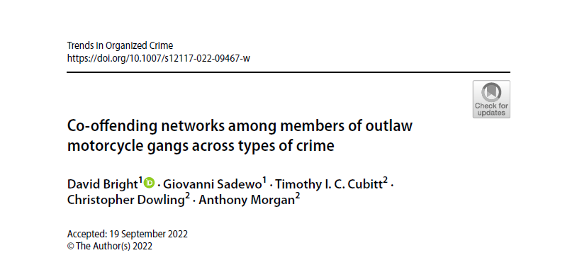
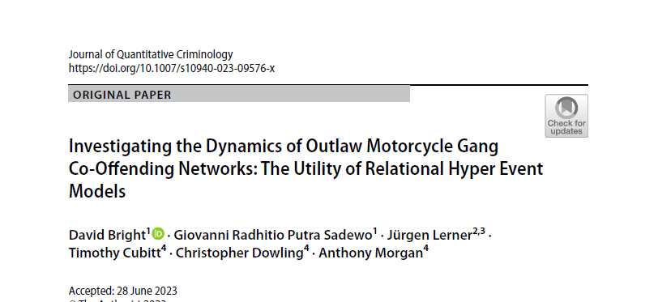

Violent offending, by member status (%)
Violent co-offending with other OMCG affiliates, by member status (%)

Slide 14
Correlation between violence and organised crime offending (n=39)
Gang members with recent violent offence (%)
Gang members with recent ongoing criminal enterprise offence (%)

Slide 15
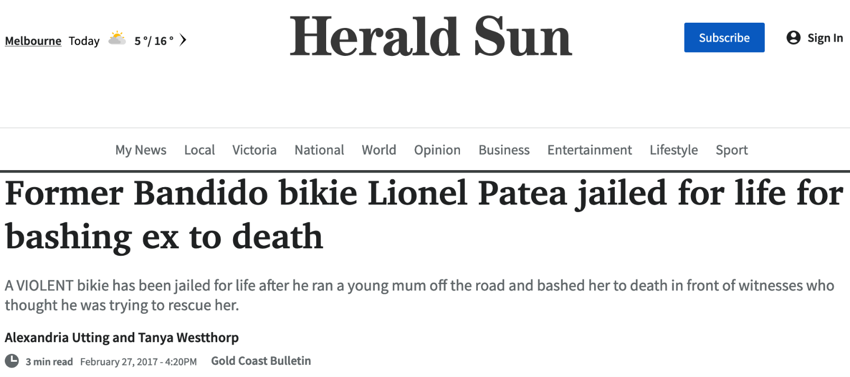
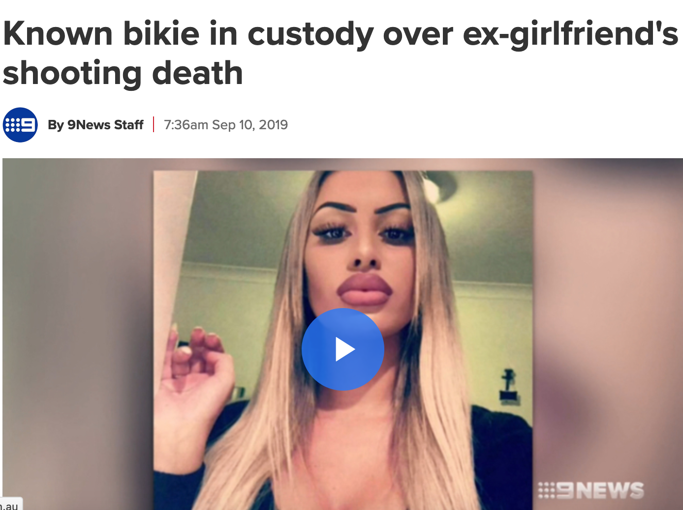
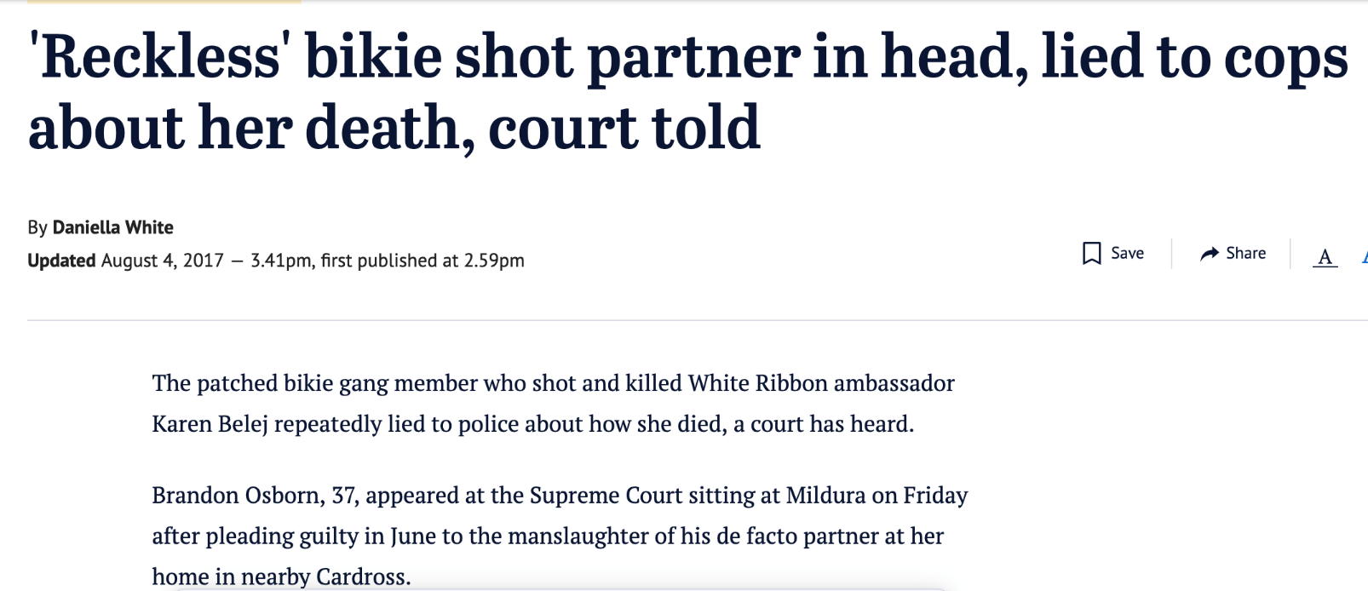
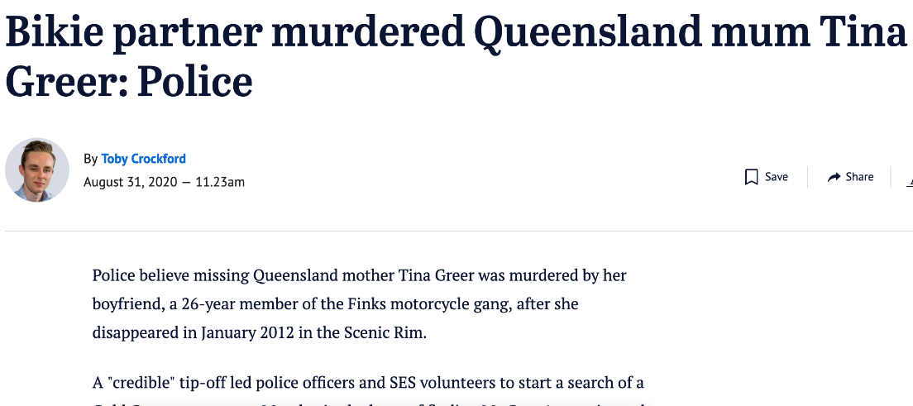

Slide 16
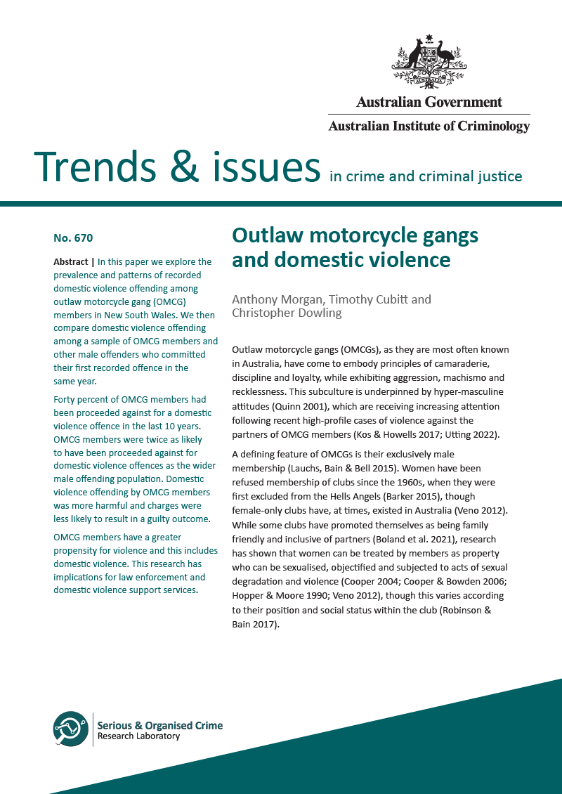
40%
OMCG members with a criminal history proceeded against for at least one domestic violence offence

Slide 17
More common
(prevalence)
More frequent
(offences)
More harmful
(harm score)
5.4
OMCG member
OMCG member
3.7
Non-OMCG offender
Non-OMCG offender

Slide 18
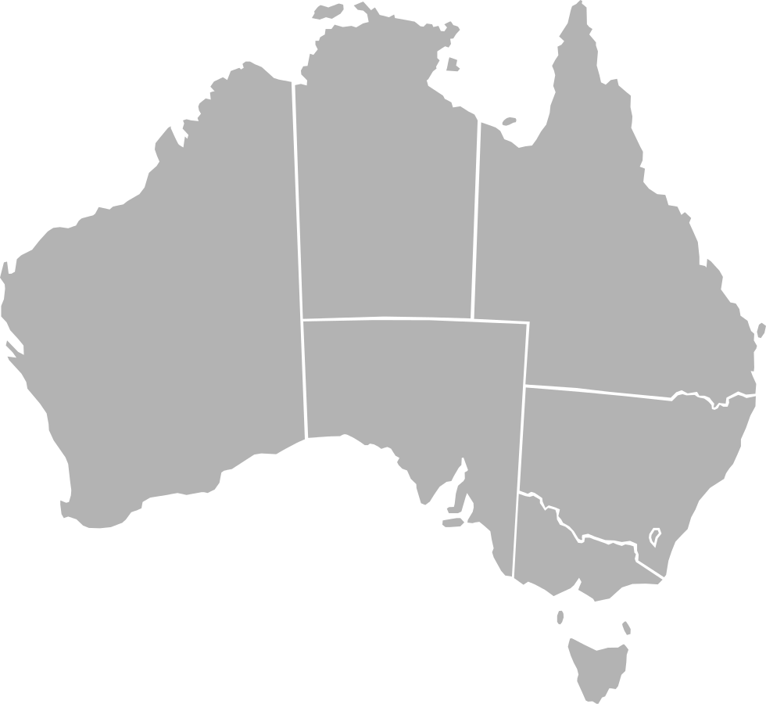
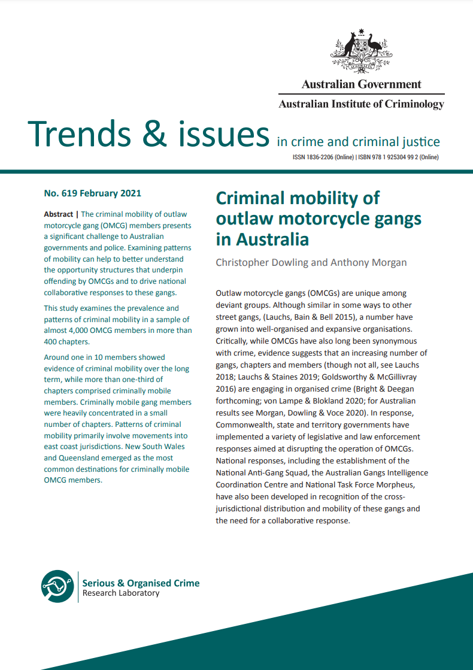
OMCG crime is attracted to national hubs and illicit markets and supply routes
Proportion of criminally mobile members based outside of that jurisdiction who have offended within it
3%
43%
6%
13%
48%
10%
15%
3%

Slide 19
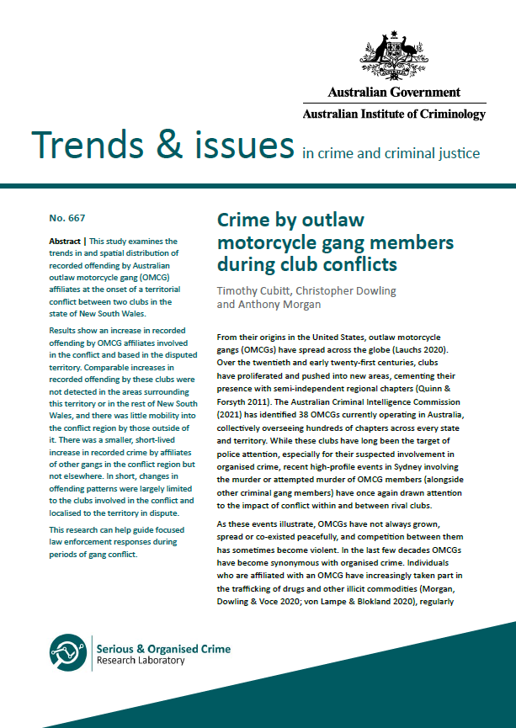
Conflict between gangs leads to significant changes in gang-related crime
1
Gang-related crime by OMCG members moved and clustered nearer to the conflict region
2
Gang-related crime involving members of gangs involved in the conflict went up in the conflict region

Slide 20
A greater proportion of offences in the conflict zone (%)
Lower mean distance of offences from centre of the conflict zone
Clubs involved in conflict
32
150km
Pre-conflict period
18
12
113km
Conflict period
11
Clubs not involved in conflict

Slide 21
Increase in gang-related crime involving members of conflict clubs in the conflict zone
65
more gang-related offences in the 12 months following onset of the conflict than expected

Slide 22
Involvement in serious crime is not evenly distributed across clubs
Recent ongoing criminal enterprise, by club (%)
Recent violence and intimidation, by club (%)

Slide 23
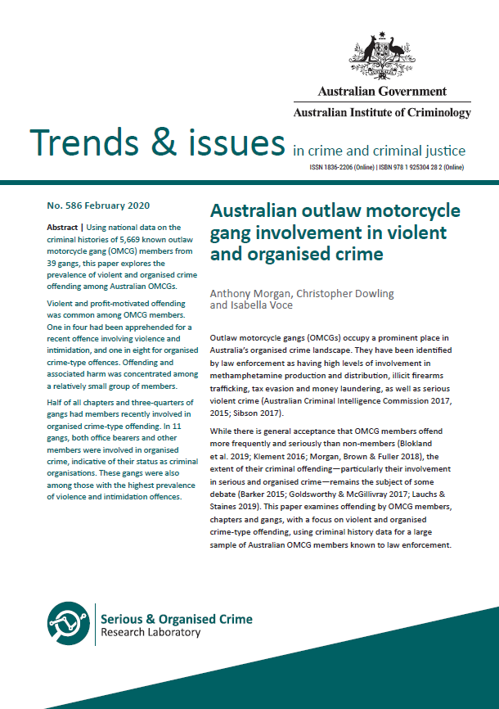
Total harm from offending is heavily concentrated among a small number of members and chapters
Cumulative distribution of harm among OMCG members and chapters
5% (n=285) of members responsible for around 70% of the total harm
5% (n=24) of chapters responsible for around 40% of the total harm
Harm (%)
Population (%)

Slide 24
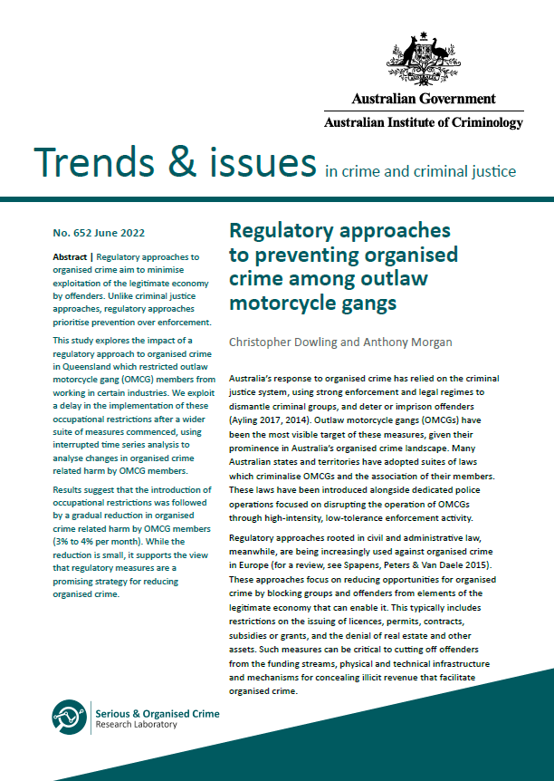
Restricting employment in high risk industries for OMCG members is associated with a small but significant reduction in monthly organised crime related harm
3%

Slide 25


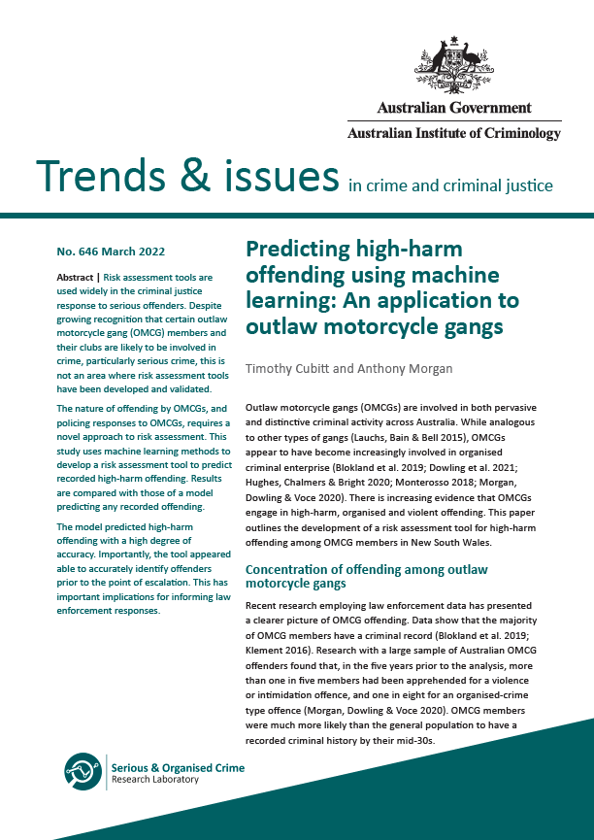
accuracy in predicting high-harm offending
Gangs
Individuals
Machine learning to train and test prediction model
Identify high risk targets
Criminal history
91%

Slide 26

PUSH FACTORS
PULL FACTORS
Adverse childhood experiences
Brotherhood and comradery
Social ties
Social isolation, disconnection from family and friends
Notoriety and profit
Criminal background and skills
Club culture and processes
Protection
Family and peer associations

Slide 27
Clubs are evolving, with an increasing focus on criminal enterprise
OMCG members are involved in serious criminal activity, but the extent of that involvement varies between members, chapters and clubs
1
2
We need to continue to build an evidence base on what works in responding to OMCGs
3
4
There are opportunities to intervene to prevent recruitment, disrupt offending and encourage members to leave clubs

Slide 28


E: anthony.morgan@aic.gov.au
P: +61 422 211 383
Hear more about why people leave gangs on CrimPod: https://crimpod.buzzsprout.com/

