Slide 1
Investments in Policing and Community Safety
Aaron Chalfin
University of Pennsylvania
Applied Research in Crime and Justice Conference
Sydney, NSW
August 14th, 2023

Slide 2
Game Plan
Do investments in policing ultimately lead to an improvement in public safety?
Can we maximize the benefits of policing while minimizing the costs?

Slide 3
Game Plan
Do investments in policing ultimately lead to an improvement in public safety?
Can we maximize the benefits of policing while minimizing the costs?
Tell a story about a city that was forced to find a better way

Slide 4
Some Context:
How much do we spend on police?

Slide 5
Police Spending
Australia: ~ $14 billion or ~ $560 per capita
  $2,200 for a family of four
US: $215 billion or ~$650 per capita
Adjusting for GDP differences, about the same

Slide 6
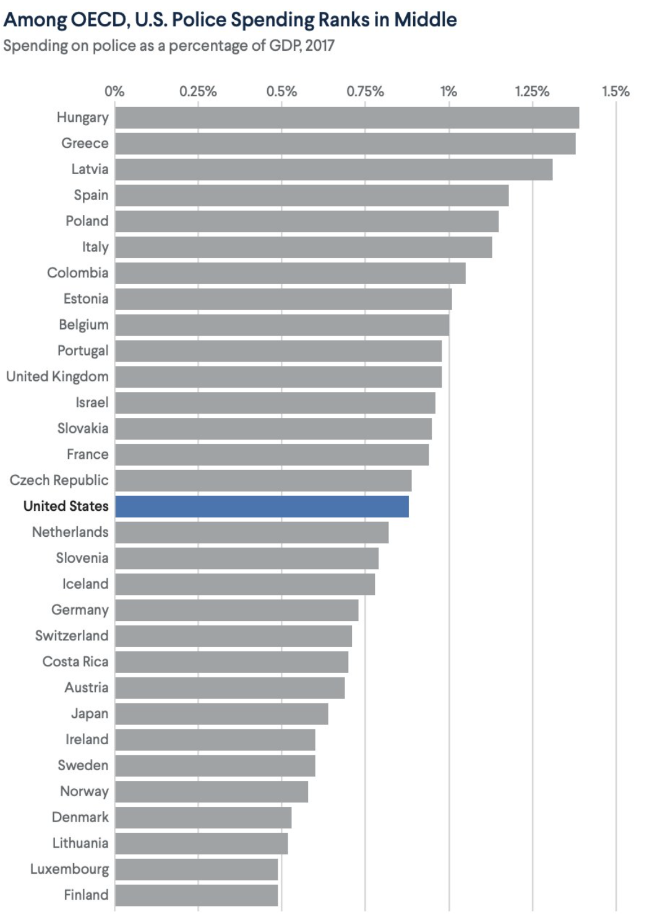

Slide 7
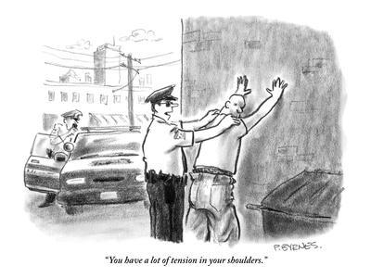
Do police, in fact, reduce crime?

Slide 8
Why might police not reduce crime

Slide 9
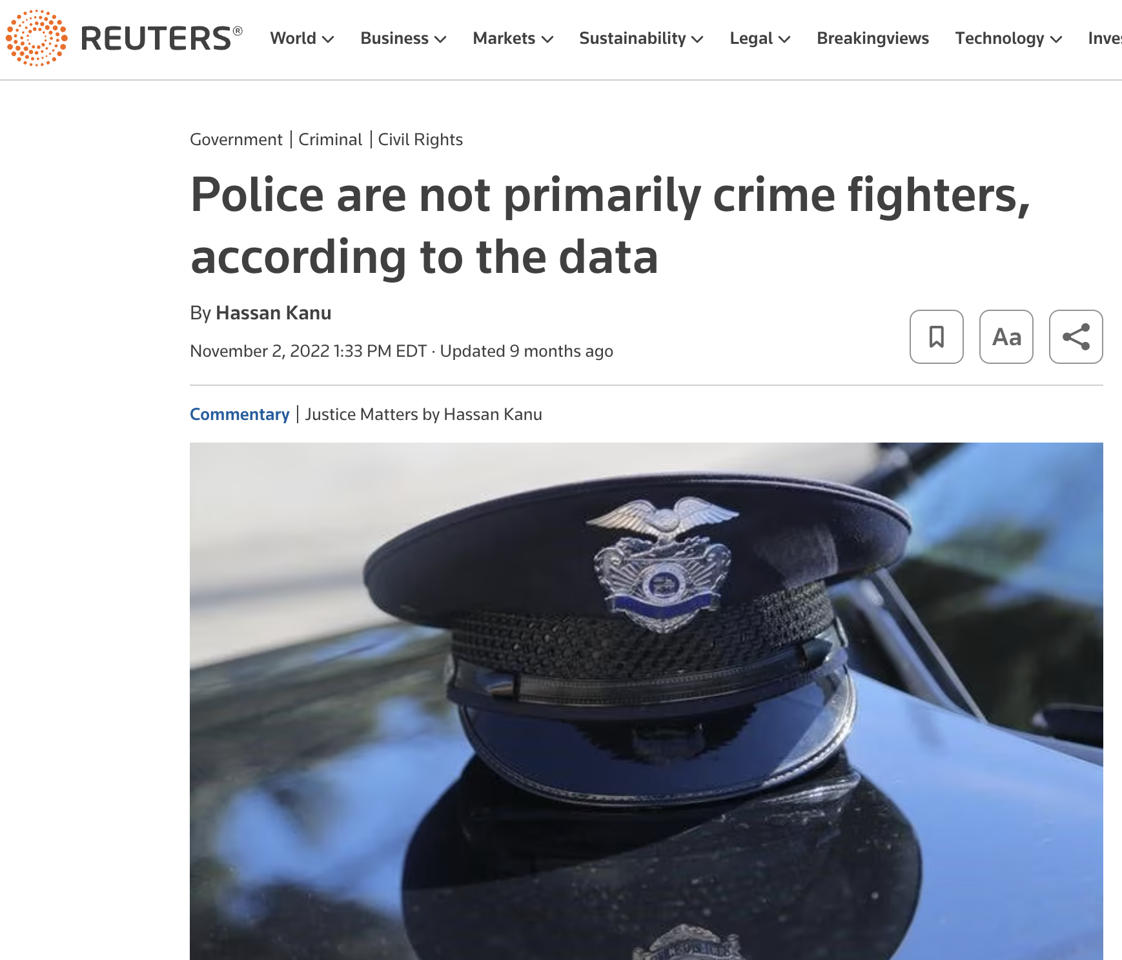

Slide 10
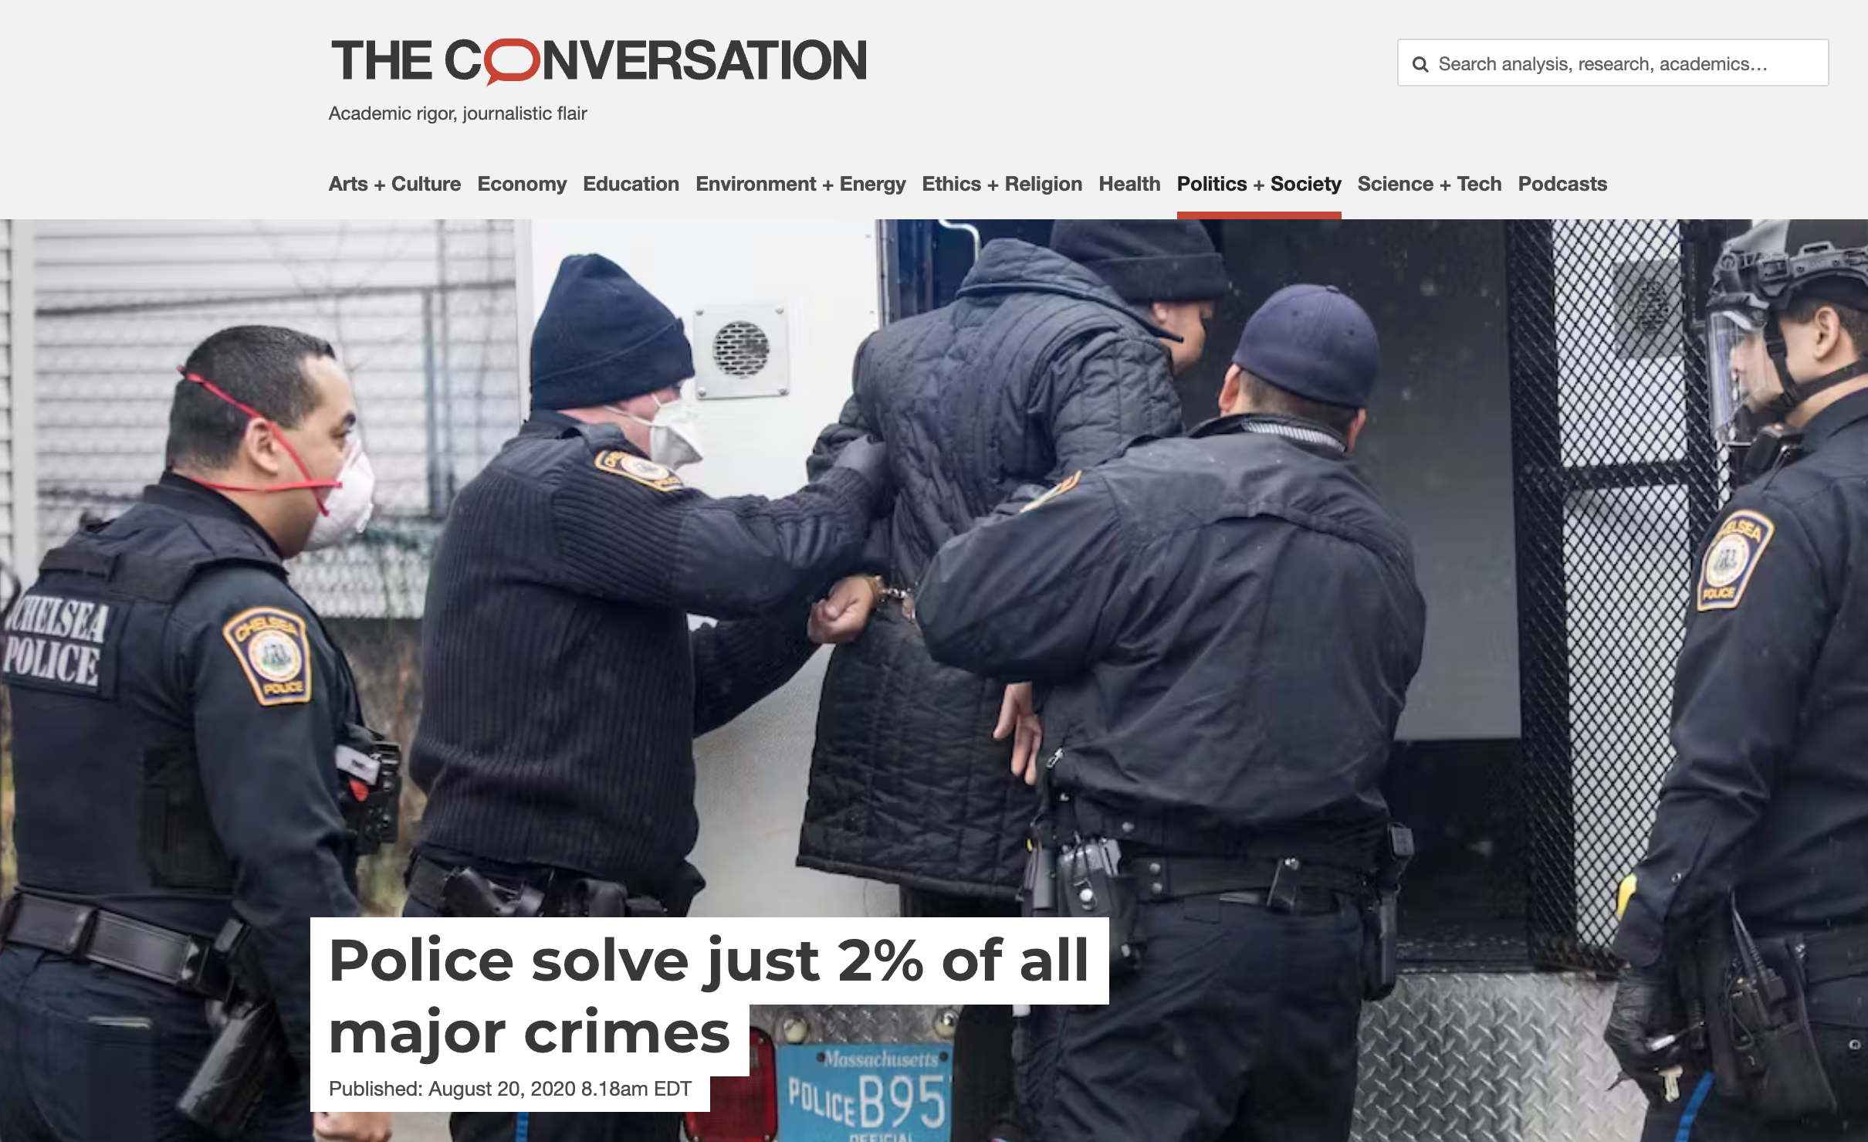

Slide 11
Other reasons why the police may not reduce crime
A lot of crimes are impulsive and therefore aren’t easily deterrable
Many crimes occur indoors where police don’t patrol
Doesn’t address the root causes of crime and violence

Slide 12
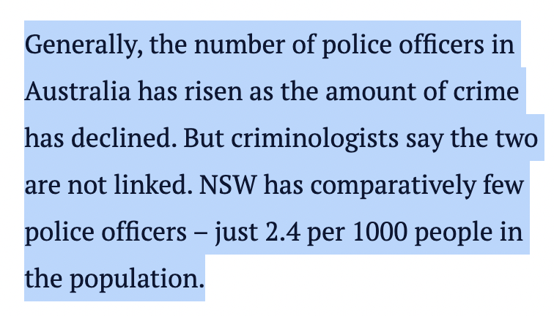

Slide 13
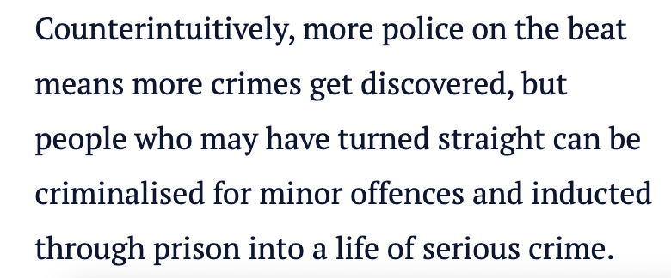

Slide 14
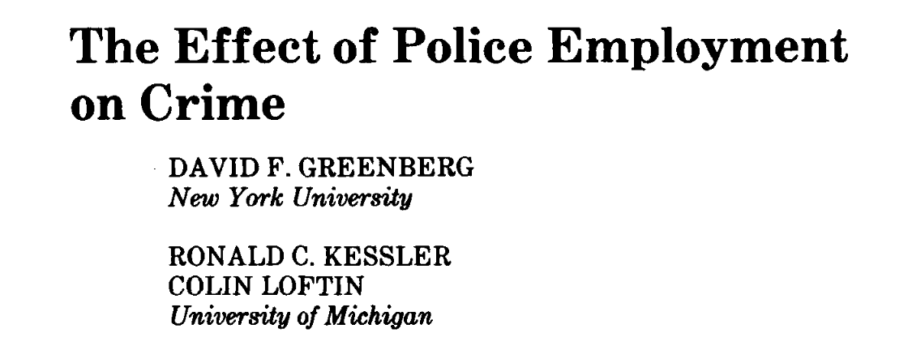

Slide 15


Slide 16
A surprisingly difficult question to answer….

Slide 17
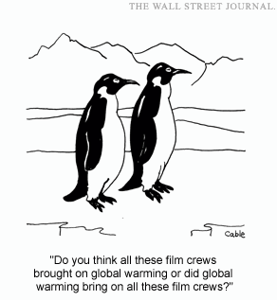

Slide 18
More Cops, Less Crime?

Slide 19
Strategy
Identify something that leads to a change in police employment but which doesn’t directly affect crime

Slide 20
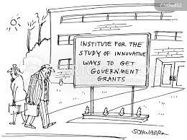
Policing Hiring Due To Federal Grants
1994 US Violent Crime Control Act authorized $8.8 billion in funds for local law enforcement
Paid for 75% of new police hires among agencies that successfully applied for funds

Slide 21
Consensus
On average, 10% more police →
  6% reduction in homicide
  4% reduction in overall crime
  Bigger effect on violent crimes than property crimes
One life saved per year for every 15 additional police officers hired
Holding constant other spending
Caveat: Backward looking!

Slide 22
Consensus
On average, 10% more police →
  6% reduction in homicide
  4% reduction in overall crime
  Bigger effect on violent crimes than property crimes
One life saved per year for every 15 additional police officers hired
Holding constant other spending
Caveat: Backward looking!
Sources: Evans and Owens (2007), Chalfin and McCrary (2018), Mello (2019), Weisburst (2019), Chalfin et al (2022)

Slide 23
More Police, More Enforcement?
How about enforcement?
  More police means more arrests for low-level crimes like drug possession and liquor law violations
  More police means fewer arrests for serious crimes

Slide 24
Police Presence

Slide 25
Focus on Natural Experiments
Changes in police presence due to some reason that has nothing to do with crime concerns

Slide 26
Focus on Natural Experiments
Changes in police presence due to some reason that has nothing to do with crime concerns
  Terrorism threats
  Changes in a predictive policing algorithm algorithm
  Traffic accidents
Randomized experiments

Slide 27
London Tube Bombings

Slide 28
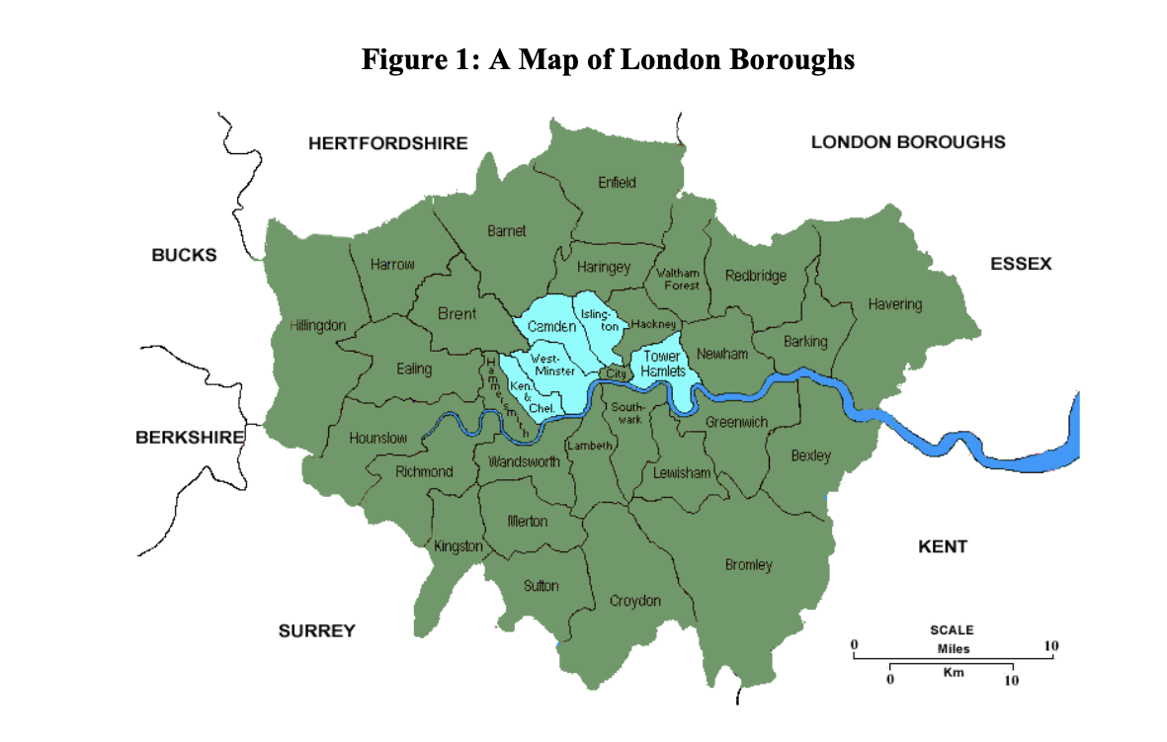
Source: Draca, Machin and Witt (2011)

Slide 29
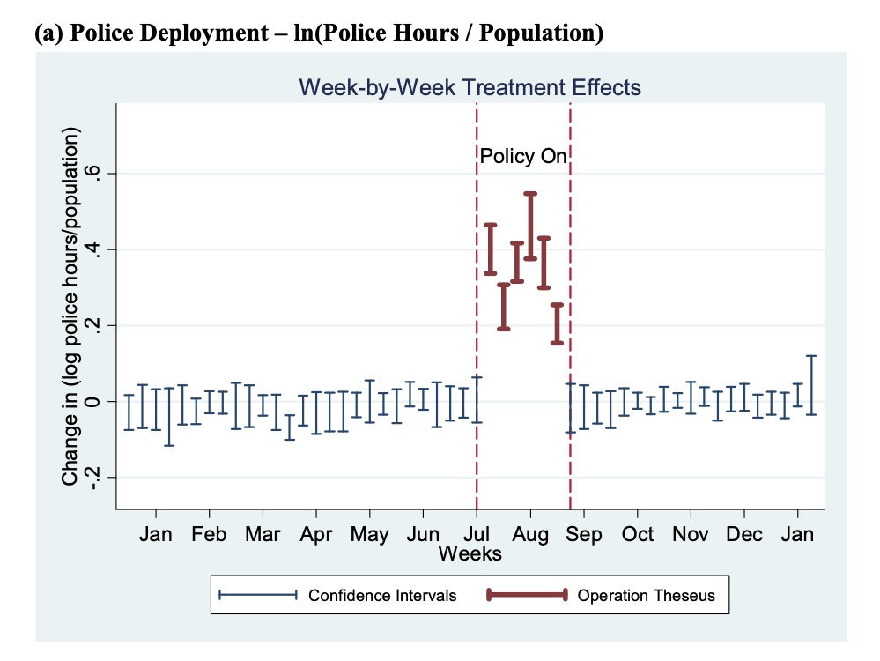
Source: Draca, Machin and Witt (2011)

Slide 30
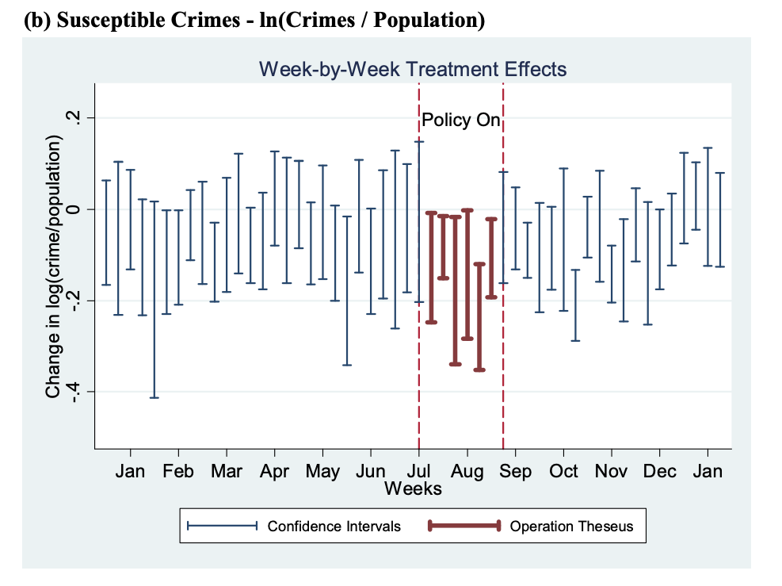
Source: Draca, Machin and Witt (2011)

Slide 31
+ 30%
- 10%

Slide 32
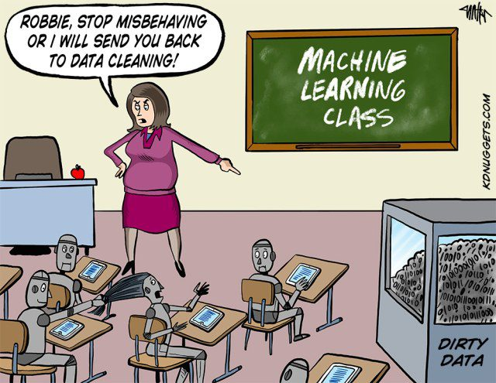
Algorithmic Policing
Source: Jabri (2022)

Slide 33
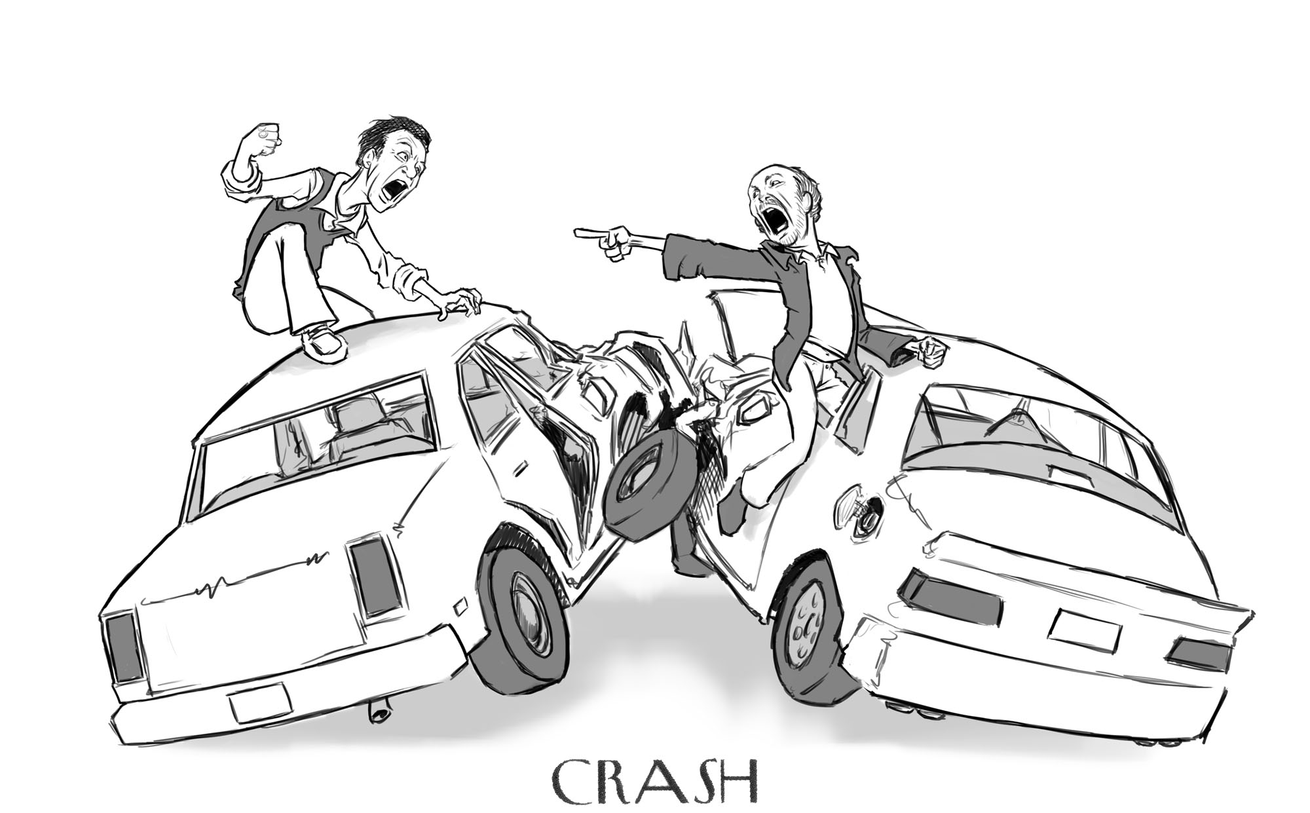
Traffic Accidents
Police patrol assigned beats in Dallas
Serious traffic accidents pull officers out of their assigned beats
What happens to crime when they leave?
A 10% decrease in patrol strength → 4% increase in crime
Source: S. Weisburd (2021)

Slide 34
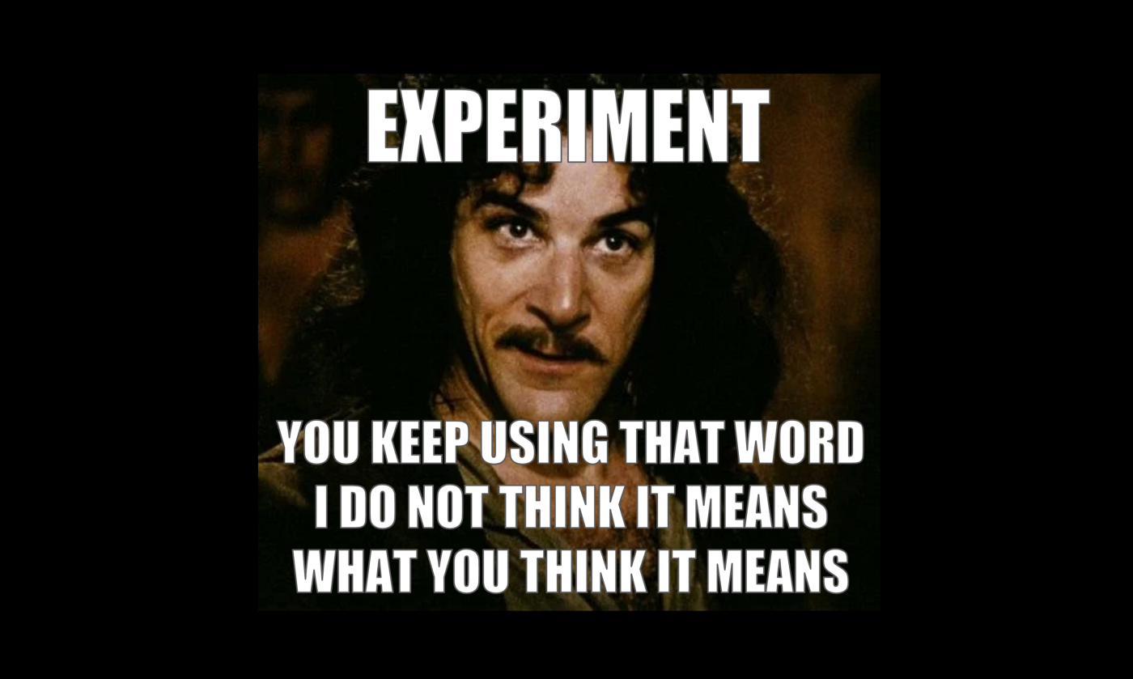
Randomized Experiments
Source: Braga et al (2019)

Slide 35
Consensus
Greater police presence and visibility usually reduces crime, including serious violence
Does it matter what the police actually do in crime hot spots?

Slide 36
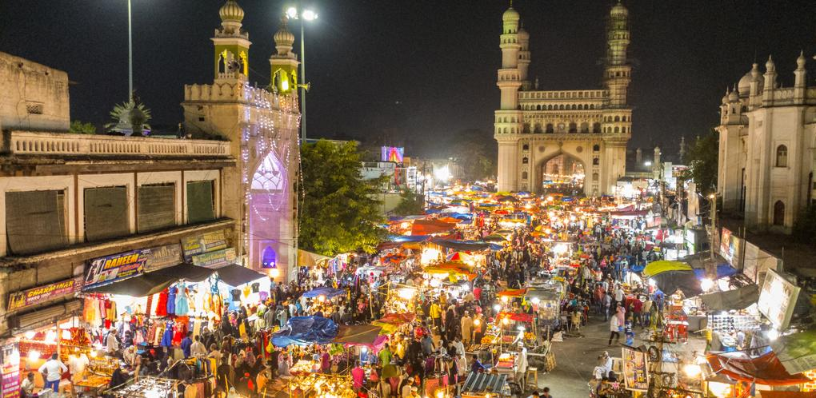

Slide 37
Direct Patrols to Reduce Sexual Harassment
Uniformed patrols reduced serious sexual harassment by 1/3
Undercover patrols had no effect
Potential lesson: Police presence has a deterrent effect; not really about incapacitation
Source: Amaral et al (2023)

Slide 38
Police Strategies

Slide 39
Two Broad Strategies
Mass enforcement
  Deal with small issues today, disrupt major issues tomorrow
  Appeal to “broken windows”
  Focus on deterring illegal behavior through widespread proactivity (high numbers of stops, arrests)

Slide 40
Two Broad Strategies
Mass enforcement
  Deal with small issues today, disrupt major issues tomorrow
  Appeal to “broken windows” – today’s small things become tomorrow’s major problems
  Focus on deterring illegal behavior through widespread proactivity (high numbers of stops, arrests)
Precision Policing
  Focus police resources intensively on the “power few”
  Emphasis is on long-term investigations
  Lighter touch for most, much heavier touch for some

Slide 41
Does mass enforcement work?

Slide 42
Police Slowdowns
For 6 weeks in December 2014 and January 2015, NYPD officers reduced their number of stops and low-level arrests by more than 50%
Some neighborhoods affected more than others
What happened to major crimes?
Source: Chalfin, Mitre-Becerril and Williams Jr. (2022)

Slide 43
A New Commander in Town
Area commanders change over frequently in large city police departments
Bring with them different approaches to crime reduction
What happens to major crime when a new commander brings a new approach to proactivity?
Source: Bacher-Hicks and de la Campa (2021)

Slide 44
The Aftermath of the Killing of a Police Officer
After a police officer is shot and killed, there is a temporary decline in the number of stops and low-level arrests made by police officers
Does this have an effect on crime?
Source: Cho, Goncalves and Weisburst (2022)

Slide 45
Are these shifts too subtle?

Slide 46
The Aftermath of a Viral Incident
What happens to crime when there is a “viral incident”?

Slide 47
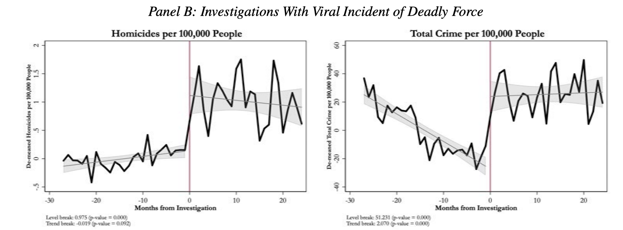
The Aftermath of a Viral Incident
Source: Devi and Fryer (2020)

Slide 48
Consensus
Shifts in enforcement, in the short term, often do not lead to appreciable changes in public safety
  But sustained and highly salient de-policing might have very big effects at certain times

Slide 49
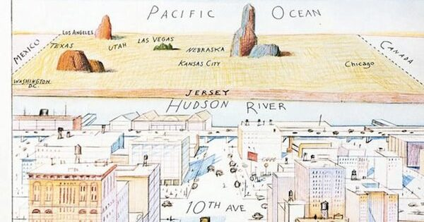
NYC

Slide 50
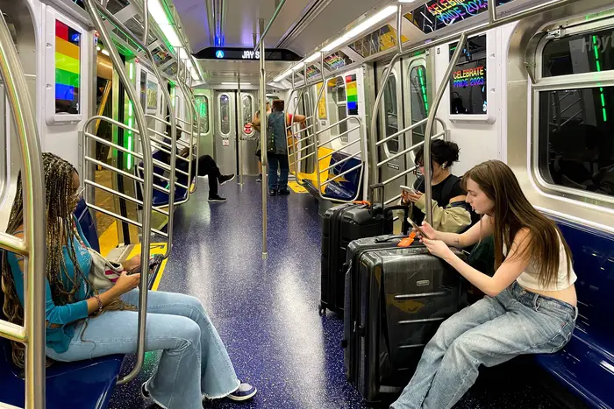

Slide 51
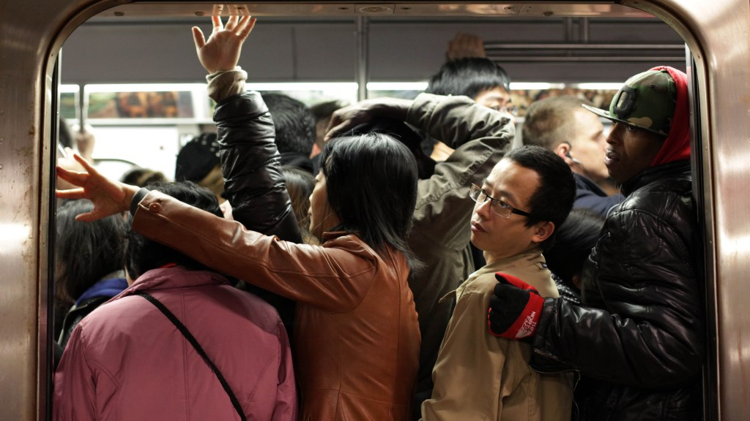

Slide 52
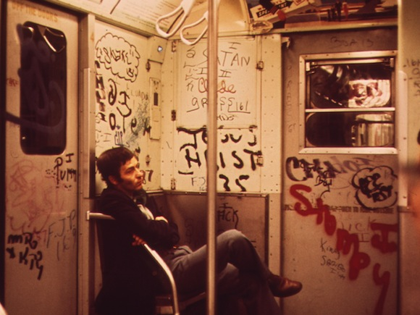

Slide 53
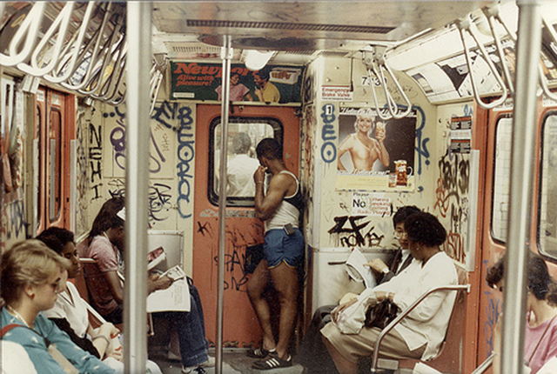

Slide 54
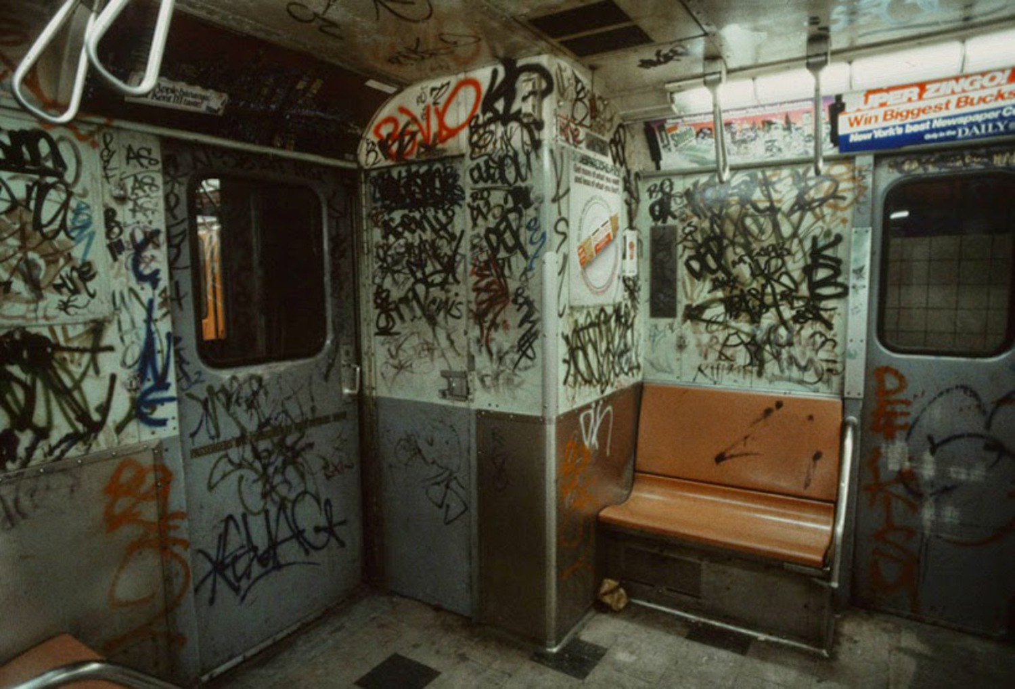

Slide 55
It is widely known that crime in NYC fell during the 1990s….

Slide 56
Less well-known: From 2010-2019, NYC experienced a “second great crime decline”

Slide 57
Notes:
What is appreciated by everyone in this room but not necessarily by many outside observers is that, during the last decade, there has been a second great crime decline. In fact, this crime decline is, in some ways, way more impressive than the crime drop during the 1990s. In the 1990s crime was declining everywhere and 1990 was the year that homicides peaked in NYC in the wake of the crack epidemic. After 2010, crime was flat elsewhere in the U.S. and 2010 had already been a near-record setting year. So it’s incredible that murders and shootings fell by an additional 50% after 2010.

Slide 59
What caused NYC’s second great crime decline?

Slide 60

Gentrification?

Slide 61
More police?

Slide 62
A dramatic shift in the policy regime…

Slide 63

David Floyd vs. City of New York
Listen here: https://www.youtube.com/watch?v=NTLNwt6kD8k

Slide 64
Notes:
But one thing has changed. In anticipation of the Floyd decision, NYPD dramatically tamped down street stops and ramped up enforcement around criminal gangs. In addition to Operation Crew Cut and expanding the size of the gang unit, large increase in the number of gang takedowns during this period.

Slide 65
Initial Reaction
"This is a dangerous decision made by a judge that I think just does not understand how policing works”
- Michael Bloomberg, Former NYC Mayor

Slide 66
What replaced mass enforcement?

Slide 67
The regime shifts
Operation Crewcut: doubled the size of NYPD’s anti-gang unit
Re-introduction of NYPD gang database
Gang takedowns

Slide 68
The regime shifts
Operation Crewcut: doubled the size of NYPD’s ant-gang units
Re-introduction of NYPD gang database
Gang takedowns

Slide 69
Notes:
But one thing has changed. In anticipation of the Floyd decision, NYPD dramatically tamped down street stops and ramped up enforcement around criminal gangs. In addition to Operation Crew Cut and expanding the size of the gang unit, large increase in the number of gang takedowns during this period.

Slide 70
Communities that experienced a gang takedown saw shootings decrease by more than 1/3 in the next 18 months

Slide 71
Violence declined without a sustained increase in law enforcement presence…

Slide 72
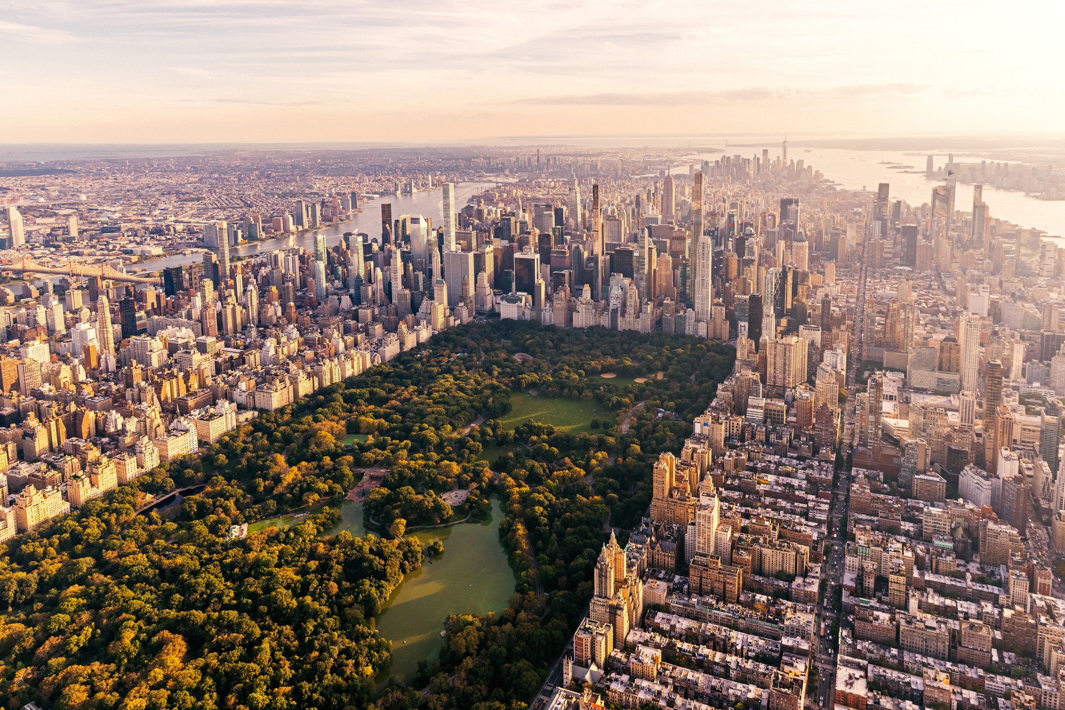

Slide 73
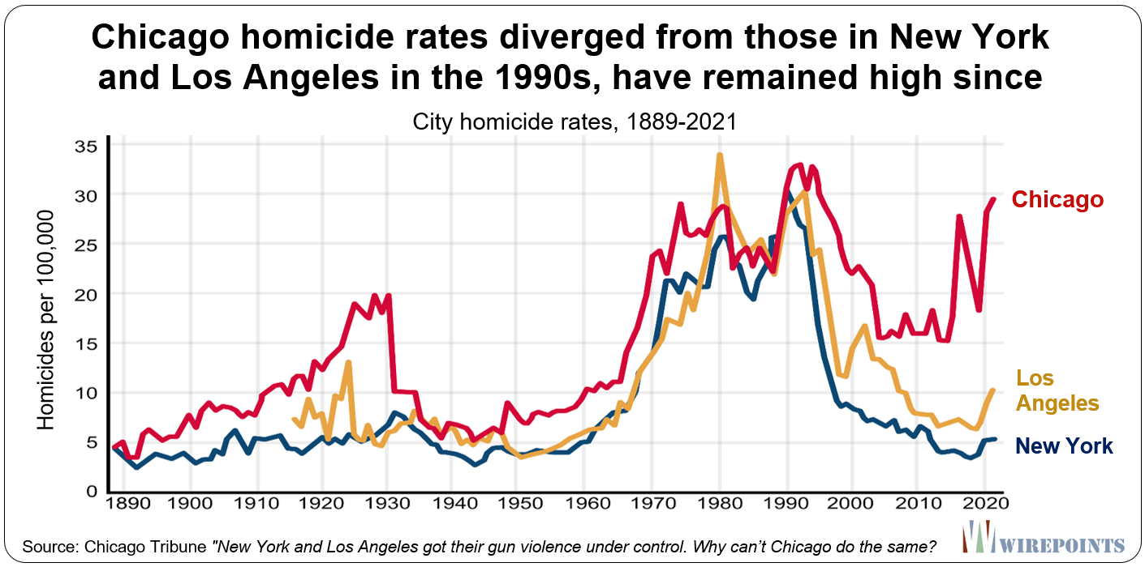
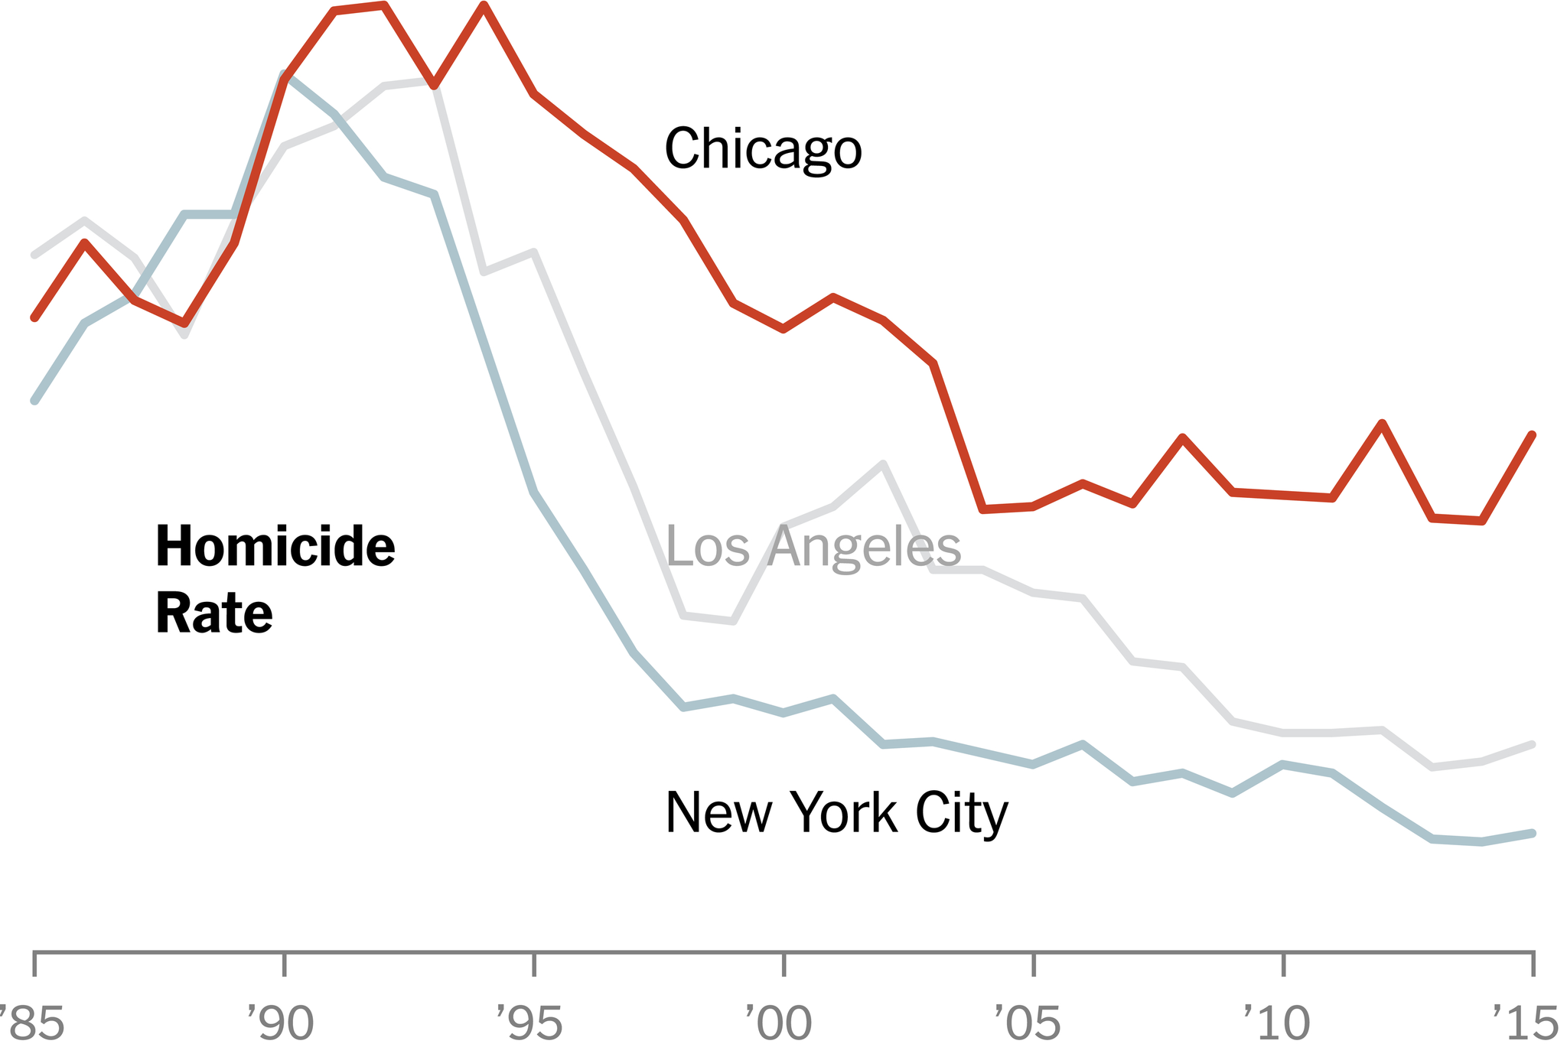
Root Causes?

Slide 74
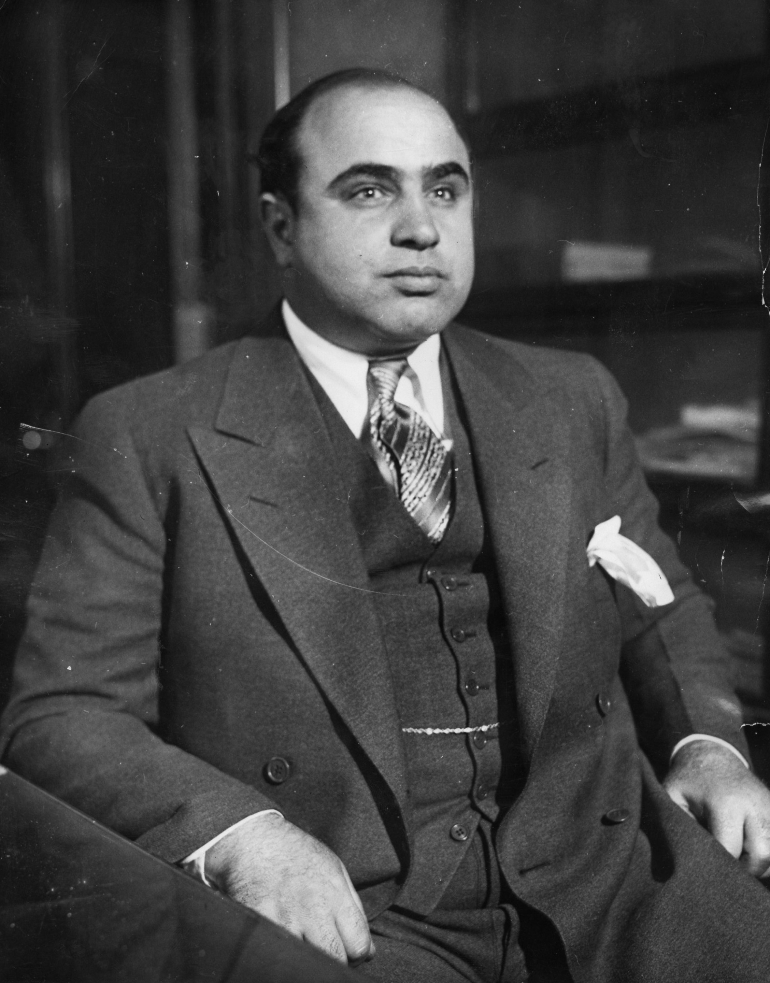
Nothing new….

Slide 75
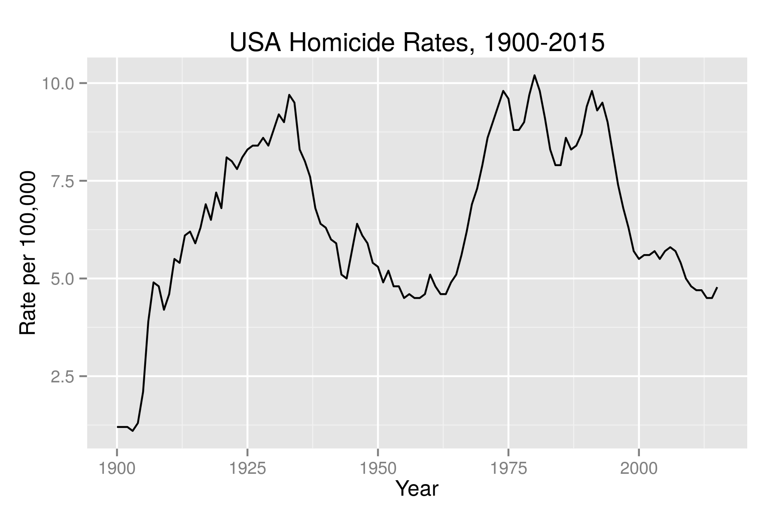

Slide 77

Nothing new….

Slide 78
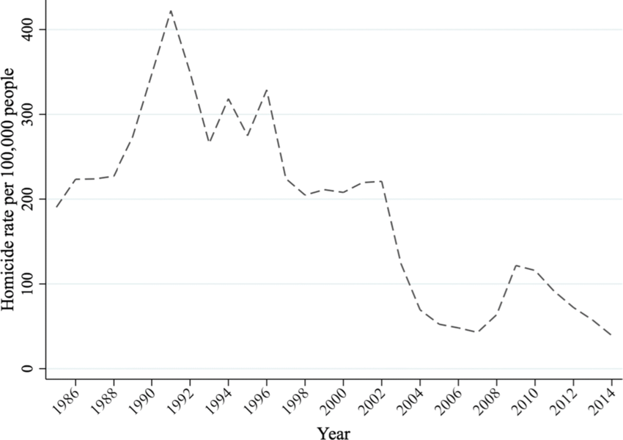

Slide 80
Thanks! achalfin@sas.upenn.edu

Slide 81
Misc.

Slide 82
Should we defund the police?

Slide 83
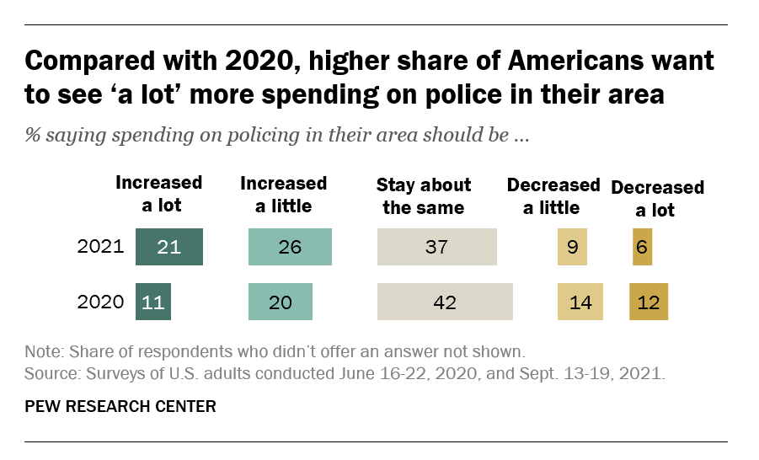
Defund?

Slide 84
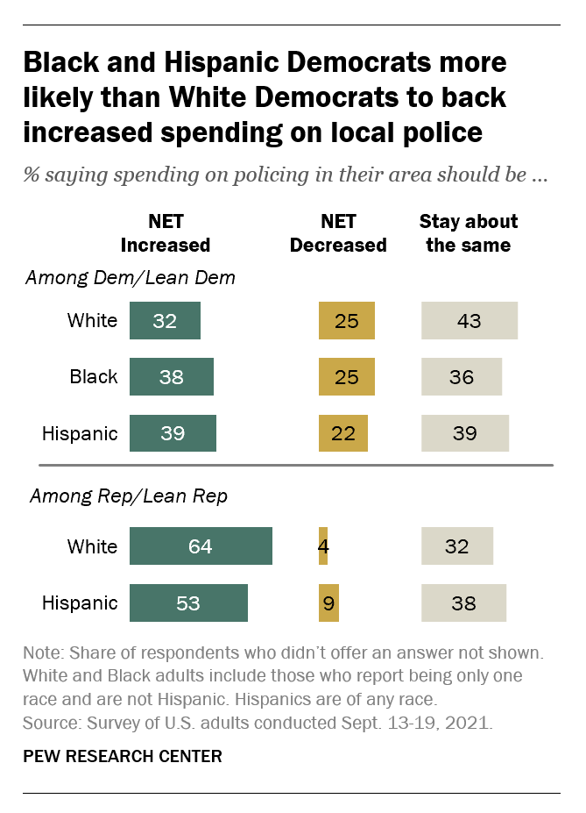
Defund?

Slide 85
Defund?
Police reduce crime but so do other approaches
  Social services
  Investments in the build environment
Which is more effective?
  10% increase in cops → 5% reduction in crime
  Some social service programs have reduced crime by 30% or more
Key Question: Scalability?

Slide 86
Defund?
Research is inherently backward-looking
We have no research that tells us what has happened when cities have re-allocated substantially away from police and towards social services
Mix of approaches may need to be different during periods of rising/falling crime

Slide 87
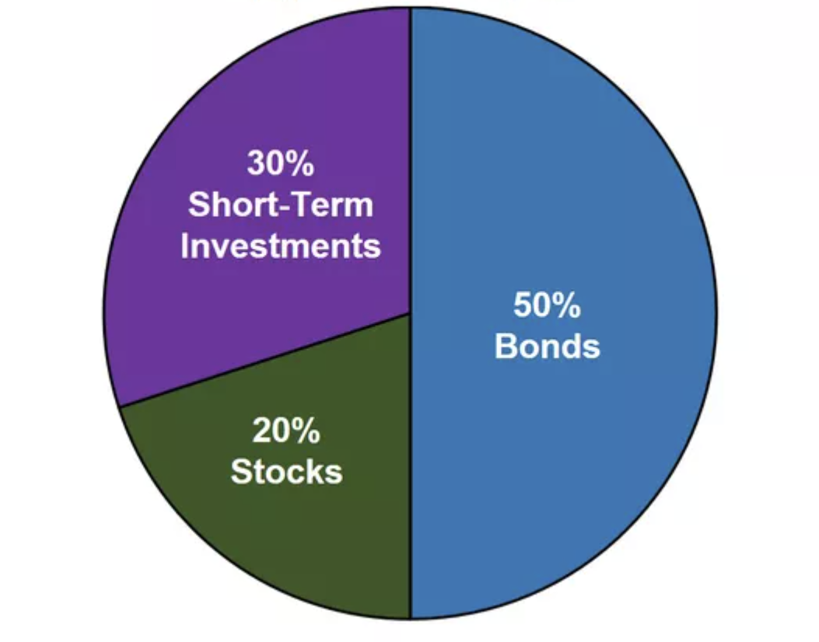
Crime Reduction as a Portfolio of Strategies

Slide 88
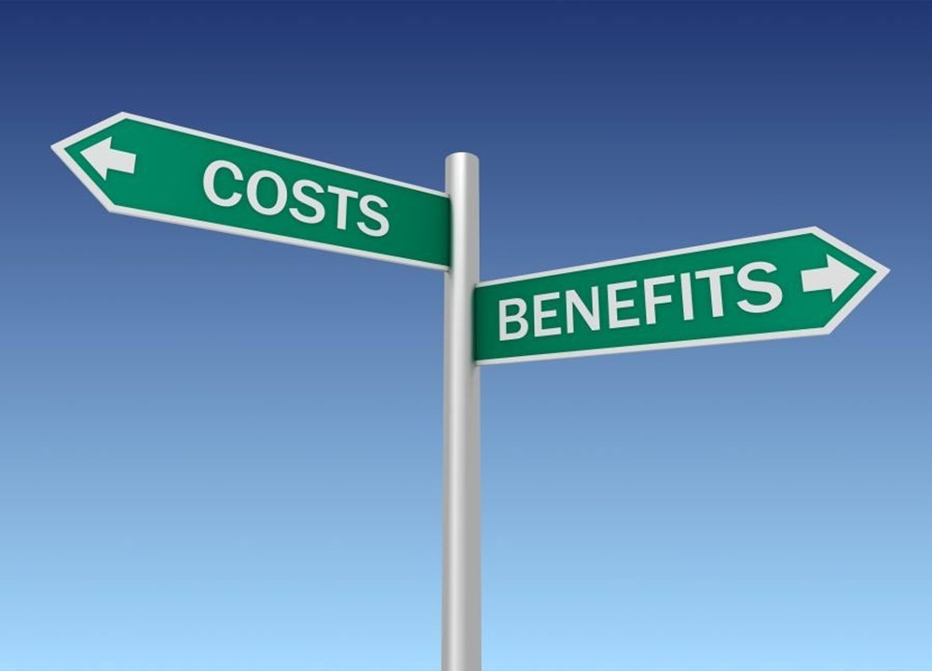

Slide 89
How Might Police Reduce Crime?
Deterrence: Potential offenders are less likely to commit crimes because they perceive a higher risk of arrest and capture
Incapacitation: By arresting and incapacitating offenders, police can abate crimes that otherwise would have committed
Deterrence is cheap relative to incapacitation

Slide 90
A Double Dividend?
If (i) police reduce crime and (ii) deterrence is the primary mechanism then police can potentially reduce both crime and incarceration

Slide 91
Terror Alert Levels

Slide 92
Terror Alert Levels in Washington DC
March 11, 2002: Office of Homeland Security introduced the Home- land Security Advisory System (HSAS) to inform the public and other government agencies about the risk of terrorist attacks
Terror Threat “High” on:
  September 10-14, 2002
  February 10-27, 2003
  March 17-April 16, 2003
  May 20-30, 2003
Changes in the terror alert level set by the Department of Homeland Security provide a shock to police presence in Washington, D.C.

Slide 93
Washington DC By Police District

Slide 94
Washington DC By Police District
District 1

Slide 95
Terror Alert Levels in Washington DC
The level of crime decreased by around 5% in Washington, D.C., during high-alert periods
Decrease in the level of crime is especially large in the National Mall -- around 15%
Thefts of vehicles and burglaries were the crimes that are most sensitive to police presence
Source: Klick and Tabarrok (2005)

Slide 96
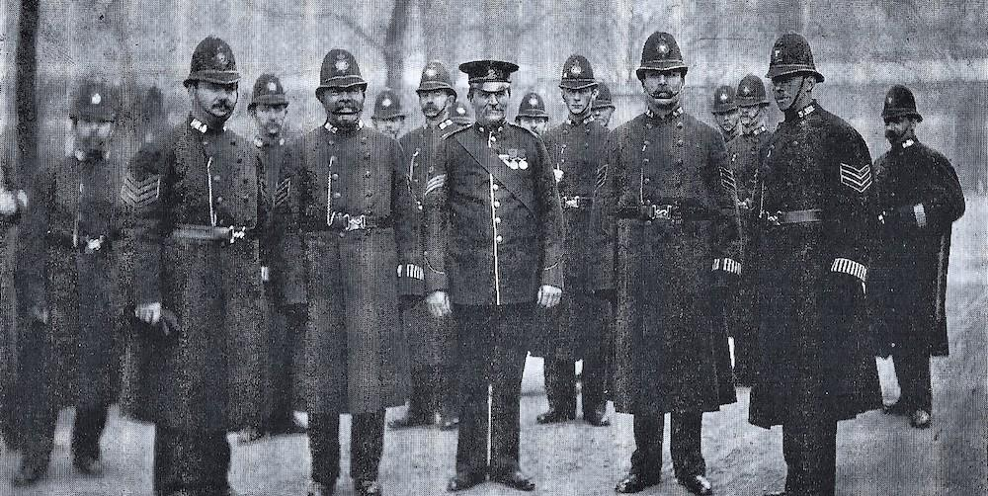

Slide 97
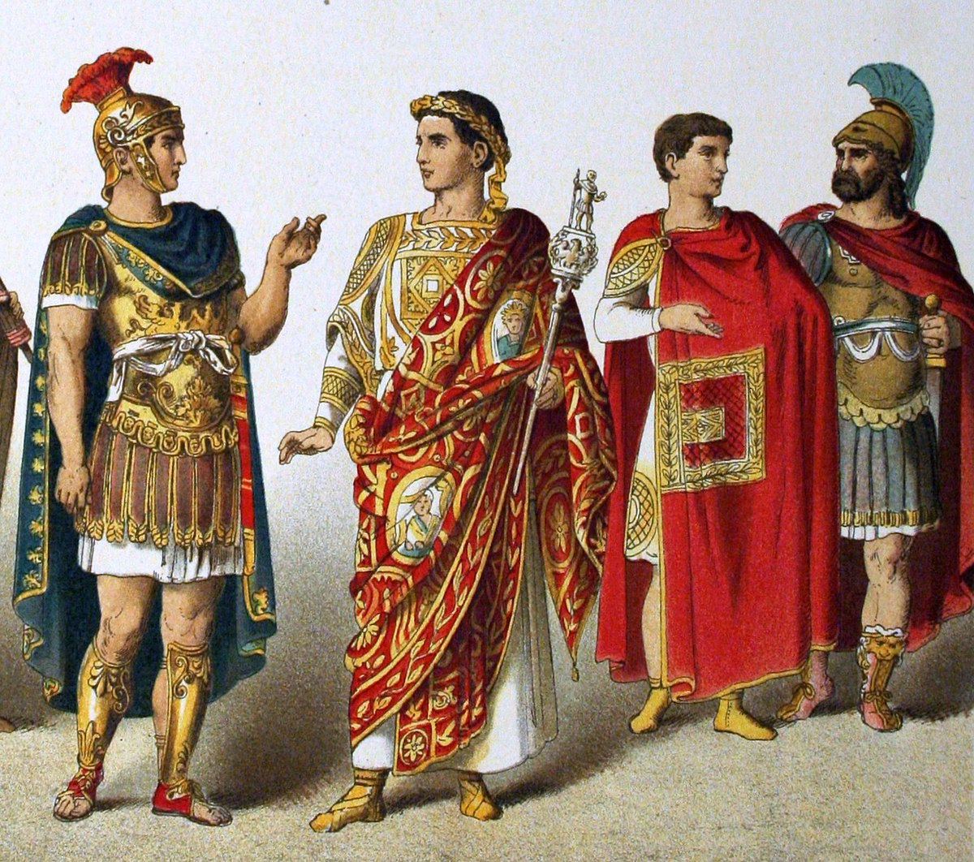


Slide 98
Gang Takedowns
Colloquial expression that captures large-scale gang raids, centered disproportionately around NYC’s public housing communities
Partnership between NYPD and the city’s five district attorney’s offices
Collective punishment of a gang, using conspiracy charges to link as many gang members as possible to underlying criminal acts committed by specific gang members
Large numbers of arrests simultaneously (or close)

Slide 99
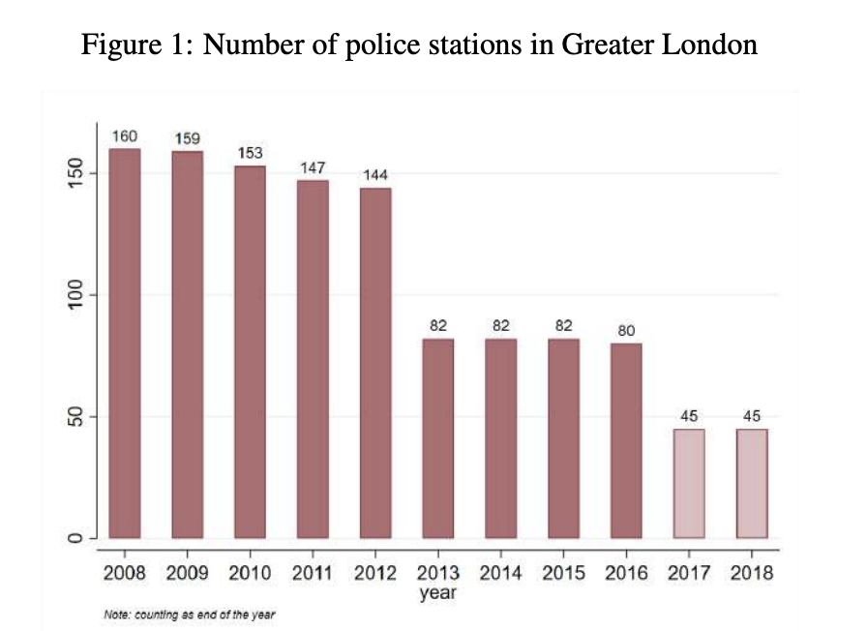
Austerity Cuts in London

Slide 100
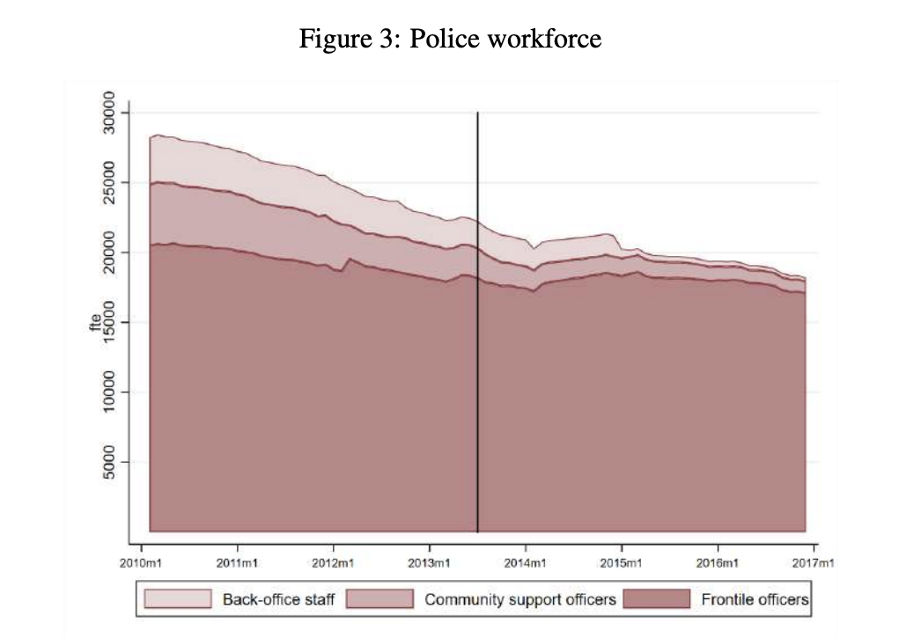
Austerity Cuts in London

Slide 101
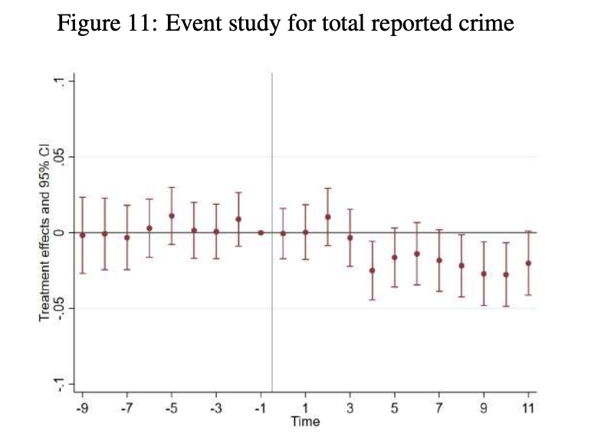
Austerity Cuts in London

Slide 102
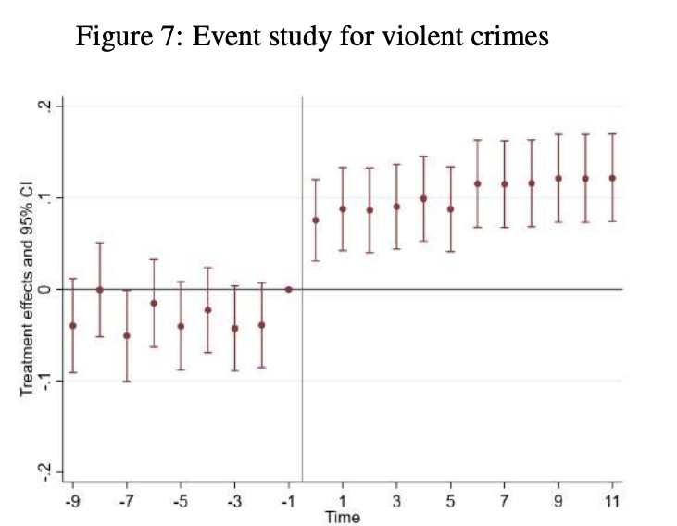
Austerity Cuts in London
Source: Fachetti (2022)

Slide 103
Austerity Cuts in London
+ 11%
Source: Fachetti (2022)

Slide 104
Intentional Shifts in Police Presence

Slide 105
University Police Departments

Slide 106
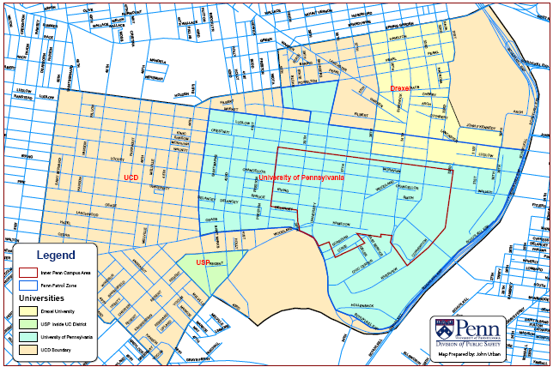
The primary role of the Penn police is crime prevention within and around the Penn campus

Slide 107
Estimated Effect of Penn Police
Source: MacDonald, Klick and Grunwald (2016)

Slide 108
Estimated Effect of Penn Police

Slide 109
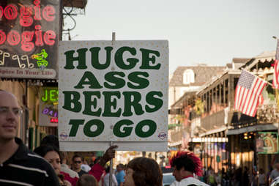
Police Surge in the French Quarter

Slide 110
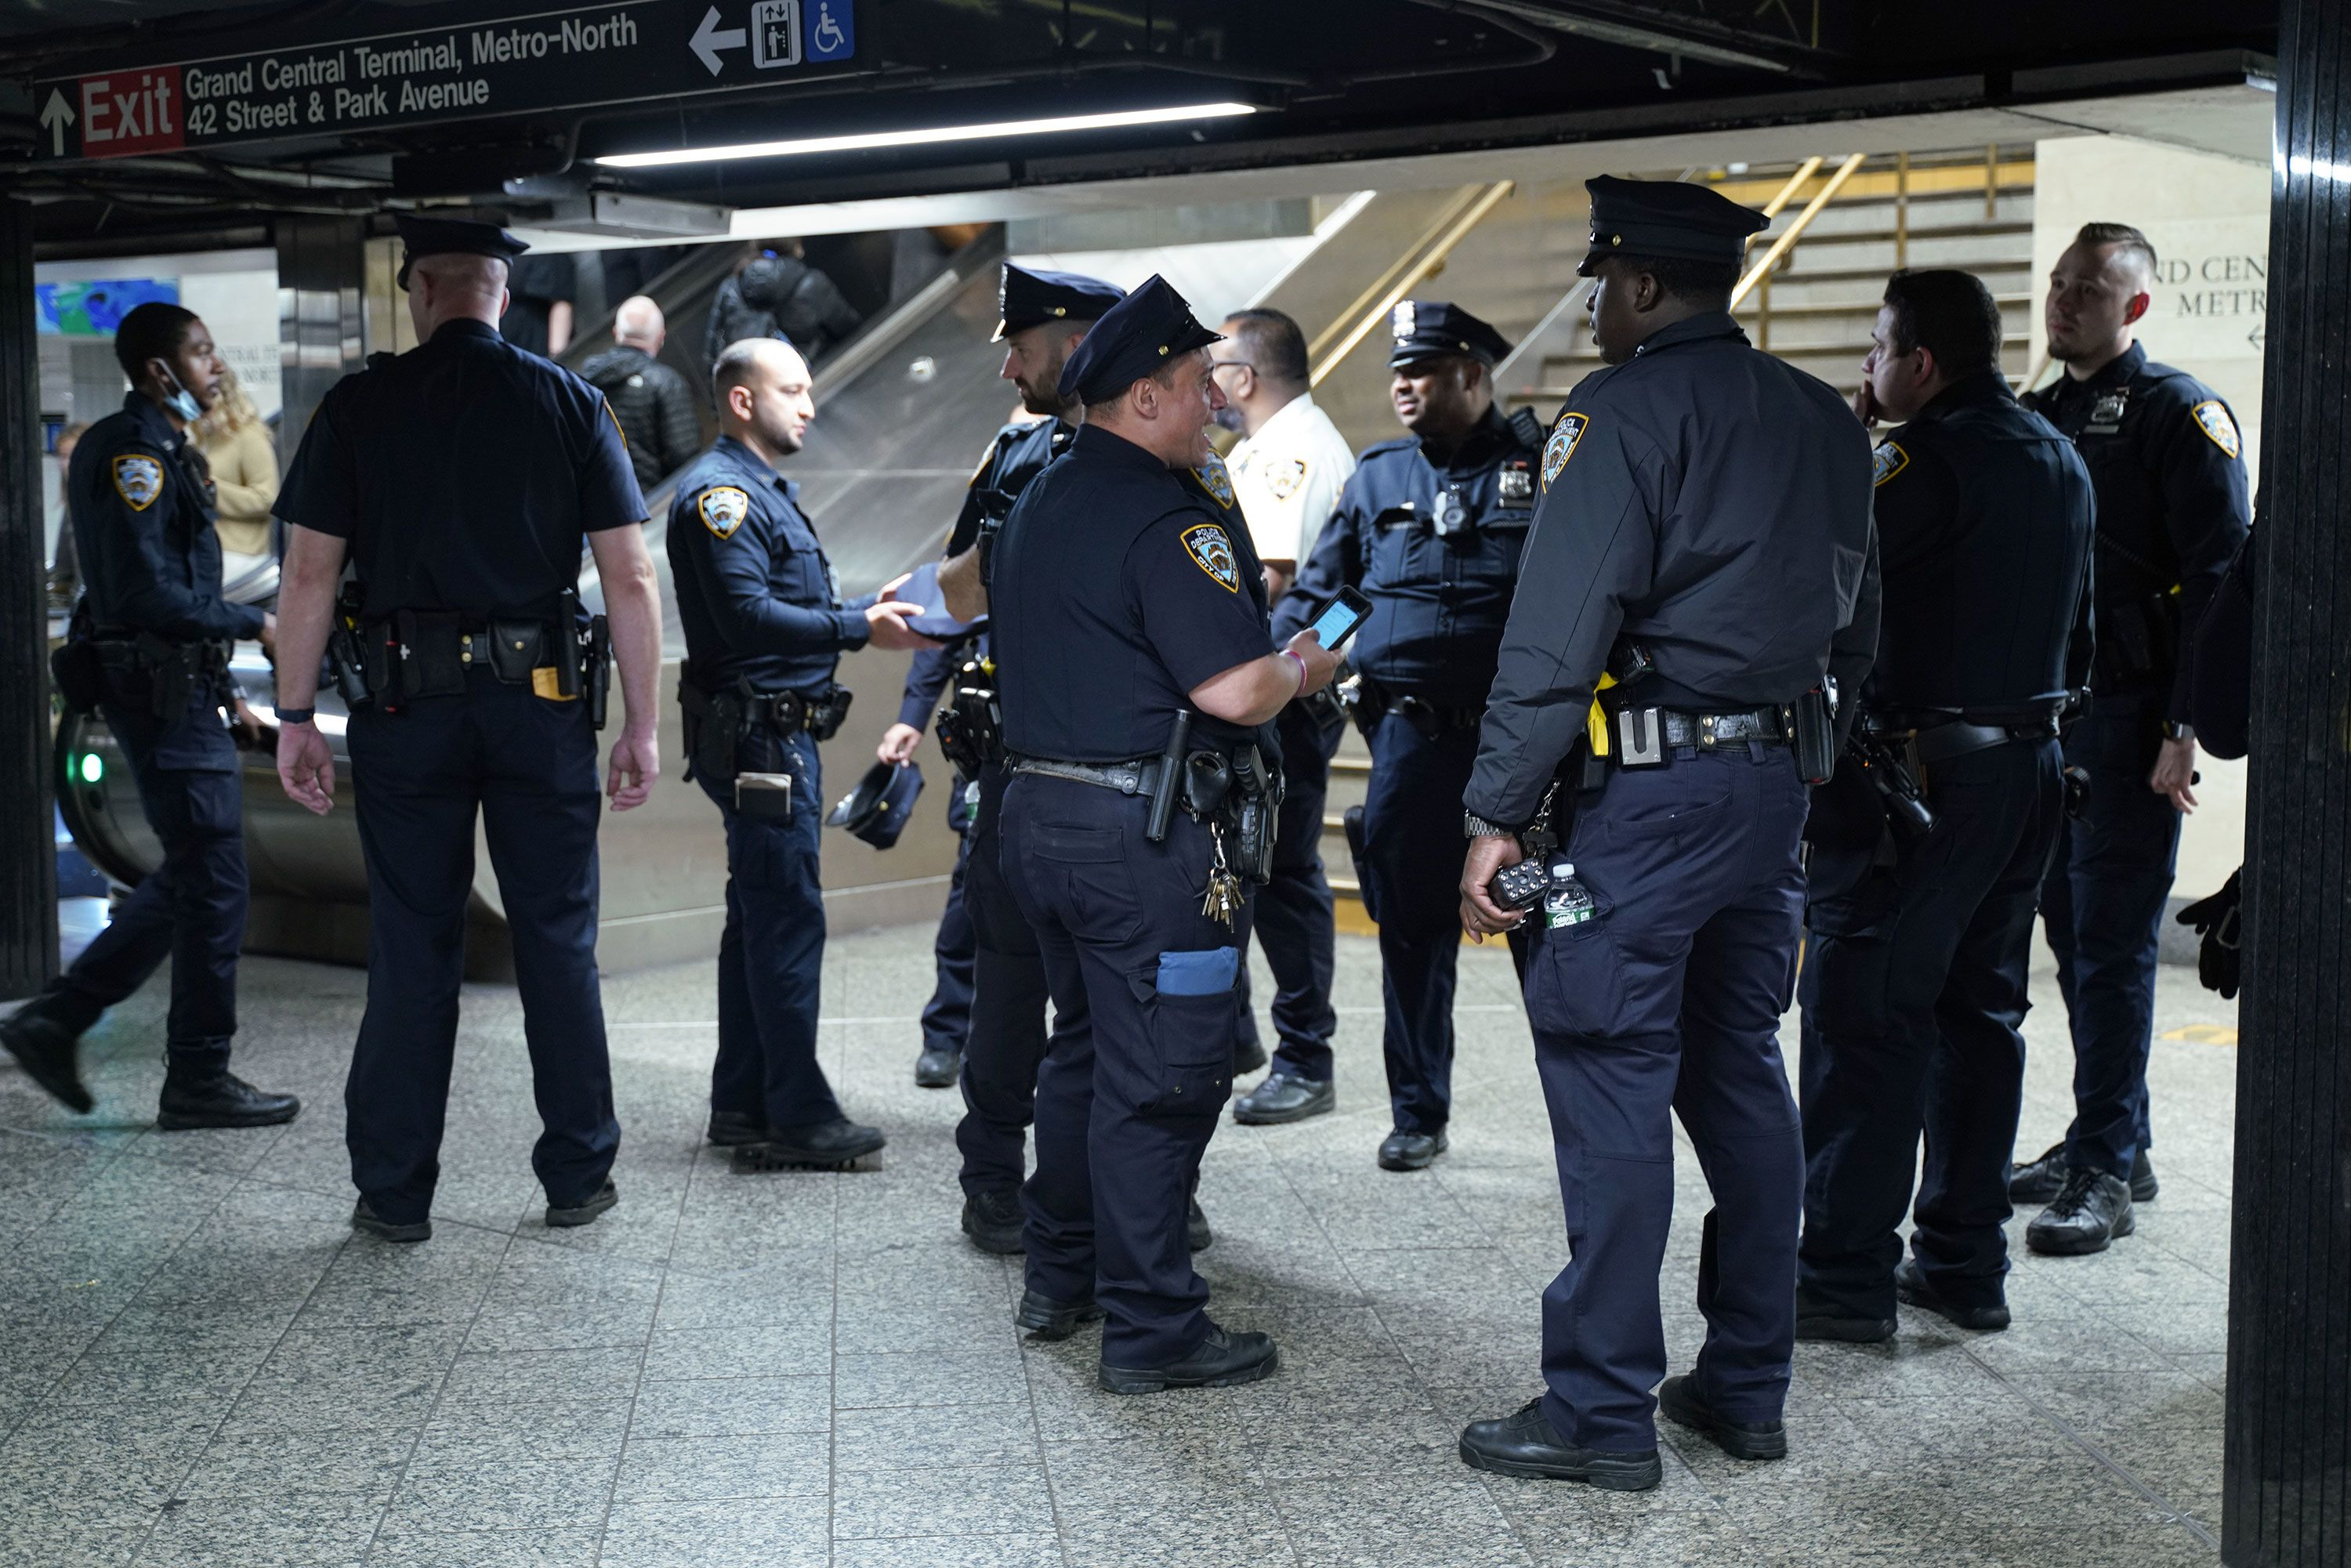
Operation Impact in NYC
Source: MacDonald, Fagan and Gellar (2016)

Slide 111
Focus on Natural Experiments
Police deployment changes for some reason that has a lot to do with crime concerns

Slide 112
Focus on Natural Experiments
Police deployment changes for some reason that has a lot to do with crime concerns
  Police surges
  University police
  Randomized experiments

Slide 113
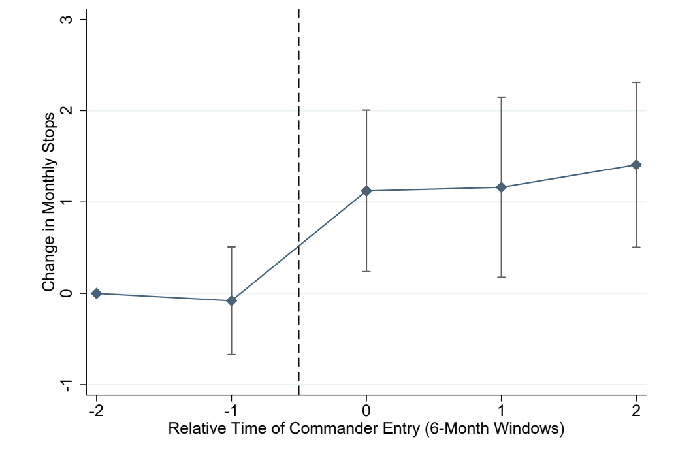
A New Commander in Town
1 SD increase in stops → 1.3% decrease in misdemeanor crimes
No notable effect on violent crimes
Source: De la Campa and Bacher-Hicks (2020)

Slide 114
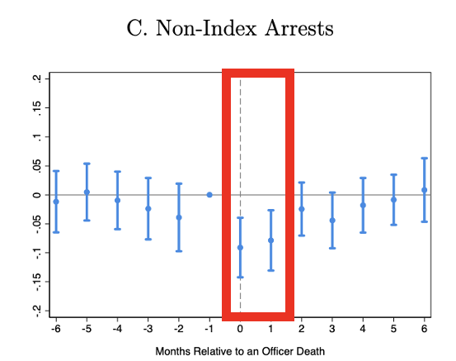
The Aftermath of the Killing of a Police Officer
Source: Cho, Goncalves and Weisburst (2022)

Slide 115
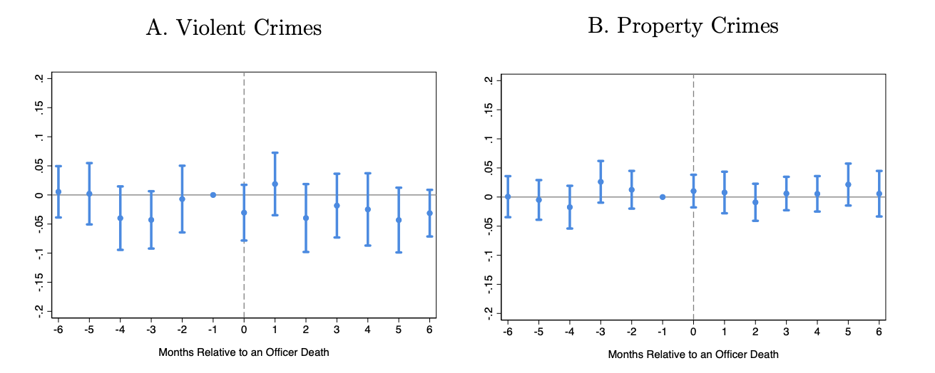
The Aftermath of the Killing of a Police Officer
Source: Cho, Goncalves and Weisburst (2022)

Slide 116
The Aftermath of the Killing of a Police Officer
Source: Cho, Goncalves and Weisburst (2022)

Slide 117
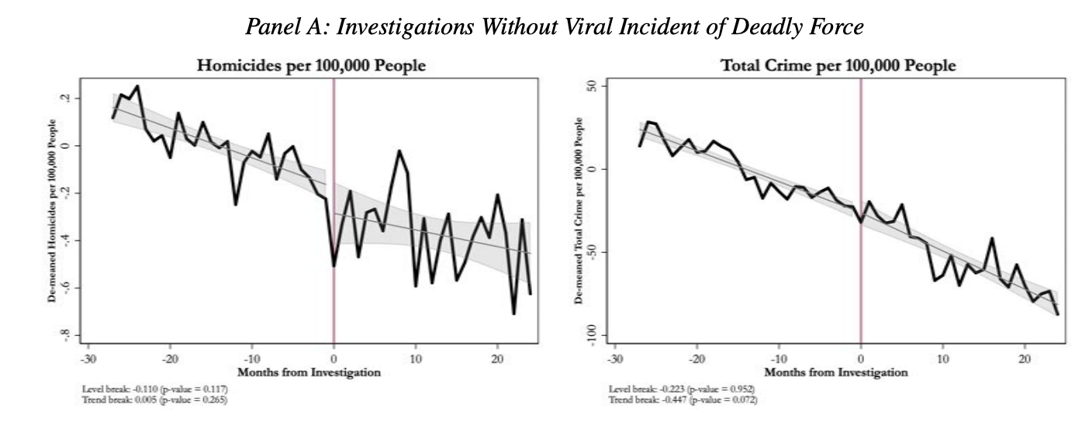
The Aftermath of a Viral Incident
Source: Devi and Fryer (2020)

Slide 118
Even more impressive relative to national trends

Slide 119
And it wasn’t really a crime decline, more so a decline in gun violence

Slide 120
The Setting

Slide 121
The Setting

Slide 122
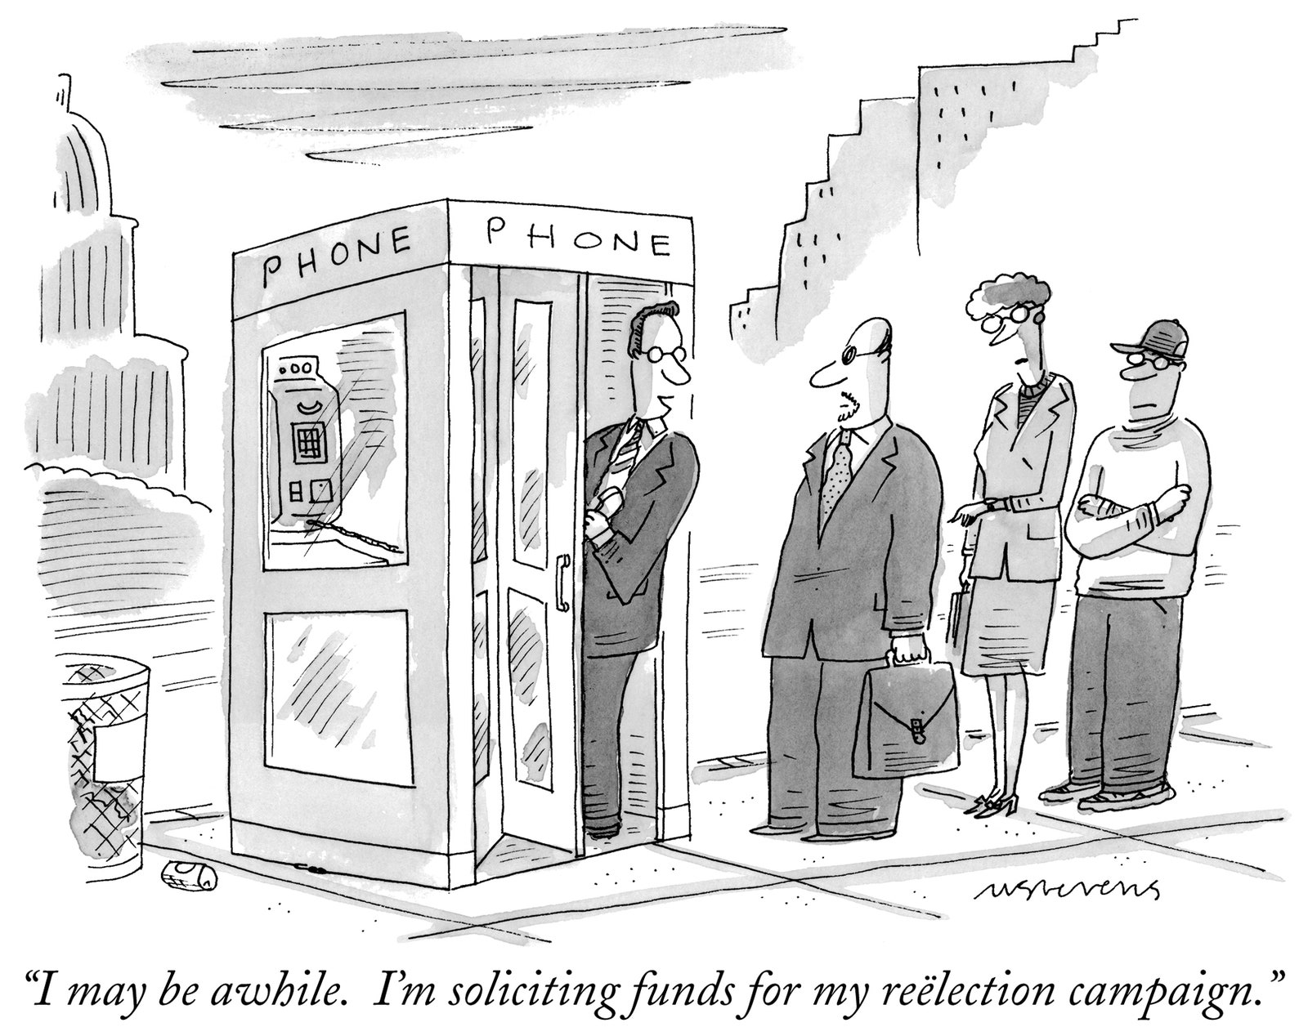
Mayoral Election Cycles
Election years should not, by themselves, be related to crime unless they create cycles of police hiring

Slide 123
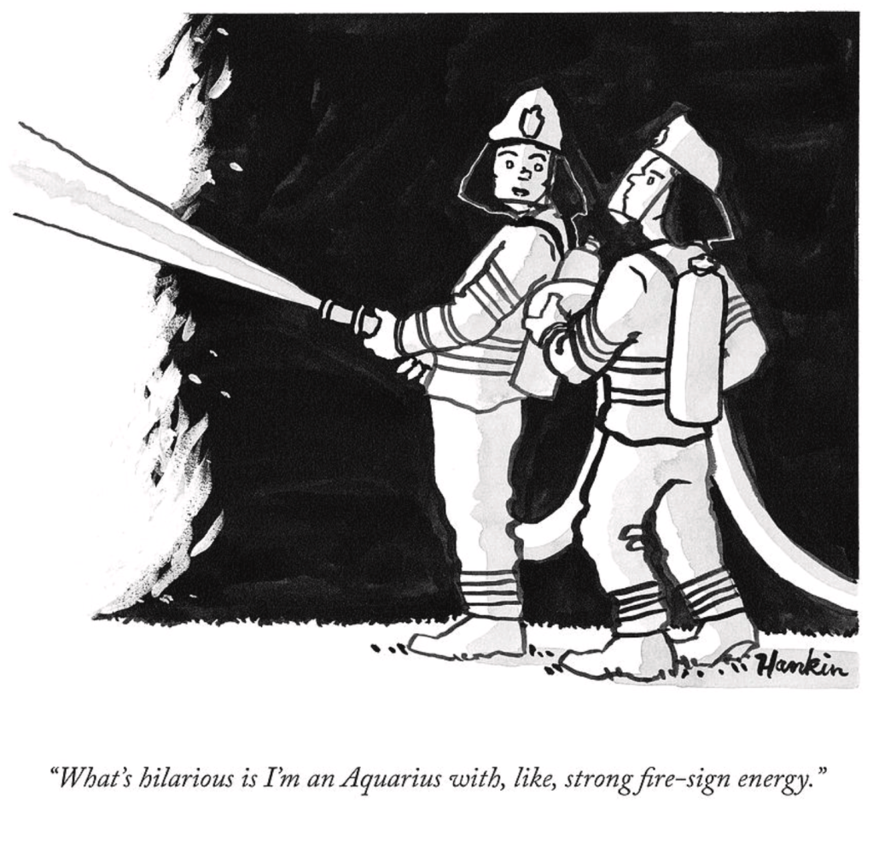
Firefighter Hiring
Police and firefighter hiring are correlated due to union negotiations with city planners, city budgeting, etc.

Slide 124
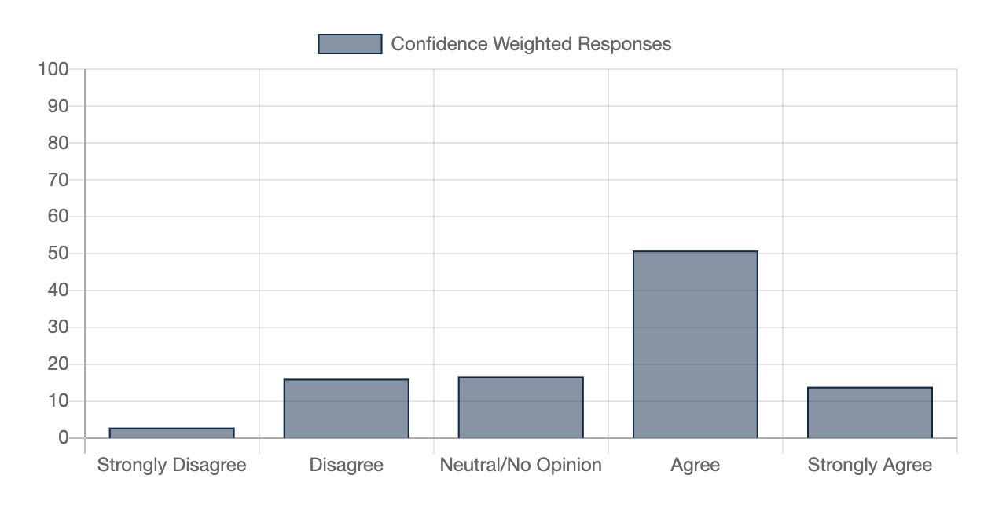
Researcher Consensus

Slide 125
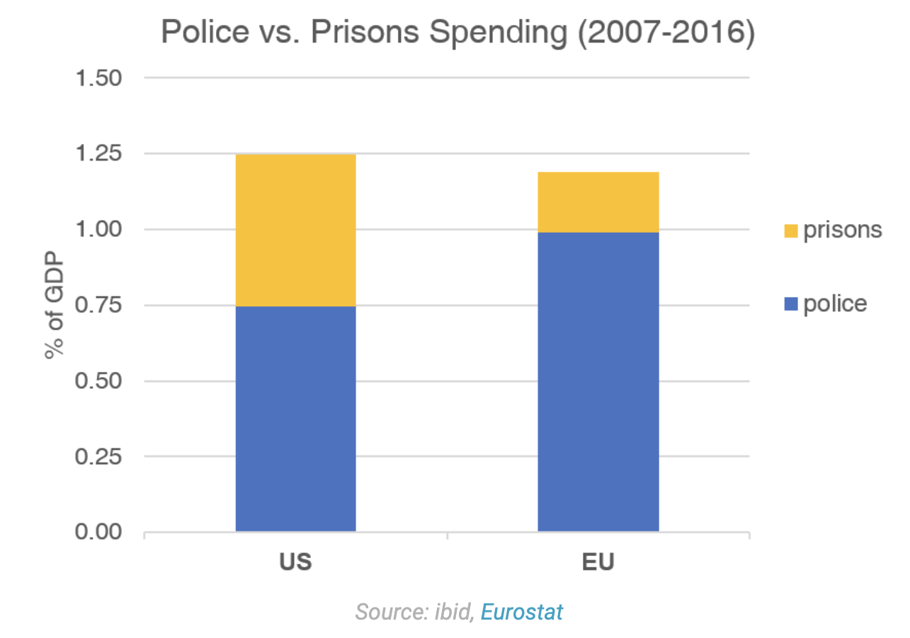

Slide 126

Randomized Experiments
Source: Braga et al (2019)

Slide 127

Source: Chalfin, Mitre-Becerril and Williams Jr. (2022)

Slide 128
Source: Chalfin, Mitre-Becerril and Williams Jr. (2022)

Slide 129
Some neighborhoods experienced a huge drop in stops (> 90%
Others experienced a much smaller drop in stops (10-20%)
Source: Chalfin, Mitre-Becerril and Williams Jr. (2022)

Slide 130

Some neighborhoods experienced a huge drop in stops (> 90%
Others experienced a much smaller drop in stops (10-20%)
Source: Chalfin, Mitre-Becerril and Williams Jr. (2022)

Slide 131


Slide 132
Precision Policing
Focused deterrence
  Leverage group/gang dynamics
  Deliver a credible enforcement threat (the stick)
  Offer social services (the carrot)
  Gang takedowns (focused incapacitation)

Slide 133


Slide 134
Notes:
Everyone is aware of America’s “great crime decline” during the 1990s. NYC which experienced an especially sharp decline in crime during the 1990s is the poster child for the crime drop.

Slide 135
Treatment effect: -36%
Treatment effect: -10%
Notes:
We’ve got lots of tables in the paper for those who’d like to see the regression estimates in tabular form but we can summarize the main results well with a picture. In the period after the development’s initial takedown there is a decline in shootings as well as overall violence.

Slide 136
Treatment effect: -36%
Treatment effect: -10%
Notes:
We’ve got lots of tables in the paper for those who’d like to see the regression estimates in tabular form but we can summarize the main results well with a picture. In the period after the development’s initial takedown there is a decline in shootings as well as overall violence.

Slide 137
Treatment effect: -36%
Treatment effect: -10%
Notes:
We’ve got lots of tables in the paper for those who’d like to see the regression estimates in tabular form but we can summarize the main results well with a picture. In the period after the development’s initial takedown there is a decline in shootings as well as overall violence.

Slide 138
How do we know it was the gang takedowns and not the change in stops?

Slide 139
Some areas experienced larger reductions in stops than others

Slide 140


Slide 141


