Slide 1
An analysis of alcohol-related justice system contacts following introduction of the Northern Territory
Banned Drinker Register
Dr Alana Cook
Criminal Justice Research and Statistics Unit
Department of the Attorney-General and Justice

Slide 2
Overview of the Banned Drinker Register (BDR)
What has happened in first year of implementation?
What type of alcohol-related behaviours do banned drinkers show before and after going on the BDR?
Has BDR reduced frequency of banned drinkers’ contact with justice system?
Impact of the BDR on alcohol-related issues in the justice system

Slide 3
Overview of the BDR

Slide 4
What is the Banned Drinker Register?
An NT wide alcohol harm reduction initiative to improve community health and safety by reducing alcohol-related harms
Temporarily bans individuals from purchasing, possessing or consuming alcohol, combined with denial of sale from take-away alcohol outlets + encourages uptake of treatment/rehabilitation
Enforced by having consumers’ photo ID scanned at point of purchase

Slide 5
How does a person become a banned drinker?
Number of different ways a person can find themselves on BDR including:
  any combination of three alcohol-related protective custody episodes or alcohol infringement notices in two years
  apprehension for an alcohol-related offence
  alcohol prohibition condition on a court or parole order
  self-referral
  referral by an authorized person, family member or carer

Slide 6
How long does a ban last?
Three month ban
Breach
Six month ban
Breach
No breach
Twelve month ban
Breach
No breach
Twelve month ban resets
No breach
No breach
Exits BDR
Exits BDR
Exits BDR
Exits BDR

Slide 7
What has happened in the first year of implementation?

Slide 8
Number of people on the BDR by ban type
Alcohol-related offences and protective custody episodes
(i.e. police bans) are most common reasons for people being on BDR

Slide 9
Number of people on the BDR by sex and Aboriginal status
Unknown: 5%
Non-Aboriginal female: 2%
Non-Aboriginal male: 10%
Aboriginal female: 23%
Aboriginal male: 60%
As of 31 Aug 2018, 70% of people on the BDR identify as male, and 83% of people identify as Aboriginal

Slide 10
What type of alcohol-related behaviours do banned drinkers show before and after going on the BDR?

Slide 11
What we did
Latent class analysis to identify similarities in alcohol-related behaviours banned drinkers showed before and after going on BDR
To analyse patterns of contact before BDR:
  6,234 banned drinkers who received one or more justice system bans
To analyse patterns of contact after BDR:
  3,408 banned drinkers who received one or more justice system bans and spent at least 180 days in community (e.g. out of custody) after being banned

Slide 12
What we used
Four indicators of justice system contact included in analyses:
  Two non-criminal events
  Alcohol-related protective custody episodes
  Alcohol-related infringements
  Two criminal events
  Alcohol-related apprehensions
  Time in prison

Slide 13
What we found: Before BDR (n=6,234)
High frequency
Moderate frequency
Low frequency
Nil frequency

Slide 14
Group 1: Non-criminal events
High frequency
Moderate frequency
Low frequency
Nil frequency

Slide 15
Group 2: Criminal and non-criminal events
High frequency
Moderate frequency
Low frequency
Nil frequency

Slide 16
Group 3: Low frequency criminal events + prison (often parolees)
High frequency
Moderate frequency
Low frequency
Nil frequency

Slide 17
Group 4: Low frequency criminal events + no prison
High frequency
Moderate frequency
Low frequency
Nil frequency

Slide 18
What we found: After BDR (n=3,408)
High frequency
Moderate frequency
Low frequency
Nil frequency

Slide 19
Group A: Criminal events
High frequency
Moderate frequency
Low frequency
Nil frequency

Slide 20
Group B: Criminal and non-criminal events
High frequency
Moderate frequency
Low frequency
Nil frequency

Slide 21
Group C: Non-criminal events
High frequency
Moderate frequency
Low frequency
Nil frequency

Slide 22
Group D: No further events
High frequency
Moderate frequency
Low frequency
Nil frequency

Slide 23
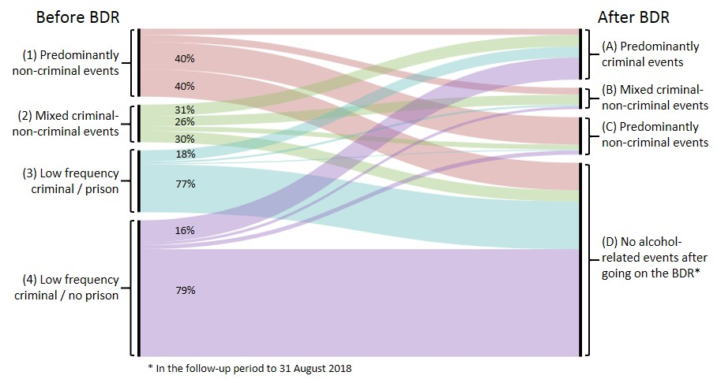
Putting it all together…..

Slide 24
Has BDR reduced frequency of banned drinkers alcohol-related justice system contacts?

Slide 25
What we did
Interrupted time series analysis to determine if frequency of banned drinkers’ alcohol-related contacts with the CJS changed after going on BDR
Analysis included 906 banned drinkers who:
  Had at least four days with alcohol-related events in year before BDR
  Went on the BDR in first six months of operation (e.g. Sep ‘17 – Feb ’18).
  Spent at least 21 consecutive days of first ban in community

Slide 26
What we used
  Rate of alcohol-related events before and after going on BDR was assessed using the number of event days per 100 opportunity days.
Number of persons from sample with alcohol-related event on a given day
100
Number of persons from sample in the community on that day

Slide 27
What we found
One year prior to first ban
(t -365)
First ban commences
(t0)
End of follow-up period
(t +340)
Two months prior to first ban
(t -60)
Two months after first ban
(t +60)

Slide 28
What we found
Before BDR
2.15 event days per 100 opportunity days
After BDR
1.80 event days per 100 opportunity days
One year prior to first ban
(t -365)
First ban commences
(t0)
End of follow-up period
(t +340)
Two months prior to first ban
(t -60)
Two months after first ban
(t +60)

Slide 29
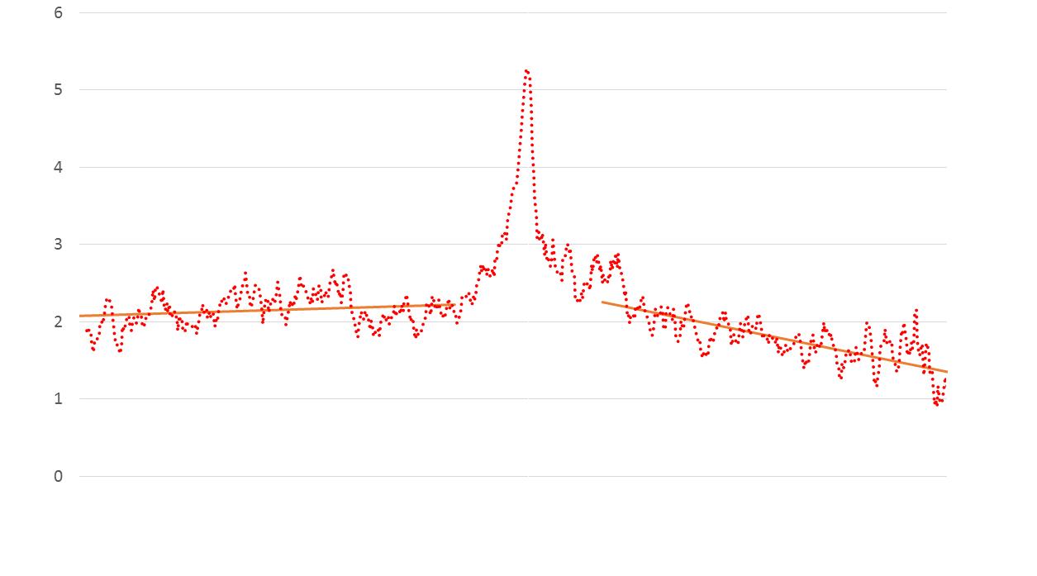
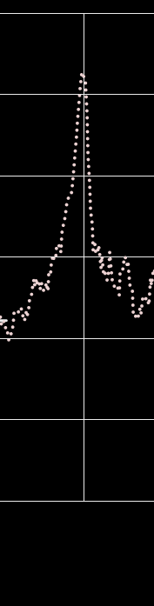
What we found
No immediate impact on event frequency
Non-significant change in slope of line
Statistically significant, gradual decline in follow-up period
One year prior to first ban
(t -365)
First ban commences
(t0)
End of follow-up period
(t +340)
Two months prior to first ban
(t -60)
Two months after first ban
(t +60)

Slide 30
This person shows a reduced frequency of alcohol-related contacts after going on the BDR:
Alcohol-related infringement
Protective custody
On BDR
Notes:
Went from 18.1 event days per 100 opportunity days to 4.3 event days per 100 opportunity days

Slide 31
This person maintained a similar frequency of events while on BDR as they did prior to BDR:
Protective custody
Alcohol-related infringement
On BDR
Prison
Alcohol-related apprehension
Negative alcohol test
Notes:
Went from 2.5 event days per 100 opportunity days to 0.6 event days per 100 opportunity days after BDR.

Slide 32
Impact of the BDR on alcohol-related issues in the justice system

Slide 33
Our analyses showed that:
Alcohol-related contact with justice system is major reason for people being on Banned Drinker Register
Some individuals have no further alcohol-related contact with justice system after BDR, but many of these had infrequent contact before BDR
Main impact of BDR on individuals who have frequent alcohol-related contact with justice system
This group appears to show a reduction in contacts after going on BDR but this reduction is gradual rather than immediate

Slide 34
“The BDR is one of many alcohol harm minimisation policy initiatives, it does not work in isolation. It forms part of the contribution in achieving a healthier and safer community by reducing alcohol related harms.”
– p. 74, Twelve-month evaluation of the BDR

Slide 35
Thank You alana.cook@nt.gov.au
Final report can be downloaded via: https://digitallibrary.health.nt.gov.au/prodjspui/handle/10137/7236

Slide 36
This person shows a reduced frequency of alcohol-related contacts and negative alcohol tests show they haven’t left the NT:
Protective custody
Alcohol-related infringement
On BDR
Alcohol-related apprehension
Negative alcohol test
Prison
Notes:
Went from 2.5 event days per 100 opportunity days to 0.6 event days per 100 opportunity days after BDR.

Slide 37
This person had no alcohol-related events in the year before or after going on the BDR:
Prison
Negative alcohol test
On BDR

Slide 38
This person had criminal + non-criminal events before BDR and no further events after going on the BDR:
Alcohol-related apprehension
Prison
Protective custody
On BDR
2/08/2018

Slide 39
This person had criminal + non-criminal events before and after going on the BDR:
Protective custody
On BDR
Alcohol-related infringement
Alcohol-related apprehension
Prison
Alcohol-related apprehension
1/08/2018

Slide 40
BDR transactions
In first year of the BDR, approximately 0.12% of transactions resulted in refusal of sale due to the person being on the BDR.

