Slide 1





Treatment effectiveness with violent offenders: Intermediary outcomes and long-term behavioural change
BOCSAR Applied Research in Crime and Justice Conference
Sydney, Australia
13–14 February 2019
Nina Papalia, D.Psych., & Ben Spivak, Ph.D.
Centre for Forensic Behavioural Science
Swinburne University of Technology & the Victorian Institute of Forensic Mental Health (Forensicare)
npapalia@swin.edu.au; bspivak@swin.edu.au
Co-contributors: Prof Michael Daffern & Prof James Ogloff AM
This research was prepared by Catalyst, a consortium jointly funded by the Department of Justice and Community Safety Victoria and the Victorian Institute of Forensic Mental Health (Forensicare)
Notes:
Good afternoon everyone, and thanks very much for coming along to this presentation.
My name is Nina Papalia and I work as a post-doctoral research fellow at Swinburne University of Technology in Melbourne, and presenting with me today is my colleague Dr Ben Spivak who is a Lecturer, also at Swinburne University.
Today, we are going to share some of the key findings arising from our recent meta-analysis, which sought to synthesise the best available research evidence for the effectiveness of psychological treatments with violent offenders across correctional and forensic mental health settings.

Slide 2





www.catalystconsortium.com
A Catalyst Consortium for Research Excellence in Reducing Persistent Violence and Sexual Offending
Director | Professor James Ogloff
Deputy Director | Professor Michael Daffern
Research Manager | Dr Rachael Fullam
Key Investigators/Investigators
Associate Professor Troy McEwan | Dr Caleb Lloyd
Dr Rajan Darjee | Dr Stephane Shepherd
Dr Stefan Luebbers | Dr Margaret Nixon
Dr Benjamin Spivak | Dr Ann Brennan
Research Fellows
Dr Ashley Dunne | Dr Nina Papalia
Dr Melanie Simmons | Dr Janet Ruffles
Ms Daveena Mawren | Dr Christine Loft
Notes:
So, this particular research project was prepared by Catalyst, which is a consortium for research excellence that was established in 2017 under the auspices of Swinburne University, with initial funding from a ministerial grant from Corrections Victoria and the Victorian Institute of Forensic Mental Health (Forensicare).

Slide 3



The Catalyst Consortium will systematically address persistent violence and sexual offending
Researchers
Enhance our understanding of the causal factors of violence.
Intervene effectively with people who engage in violence in a manner that will increase community safety.
Precipitate change in those who have engaged, or are likely to engage, in persistent violence and sexual offending, and the agencies that provide services to them
Forensic Mental Health Services
Clinical Leaders
Partnership
Correctional Organisations
Notes:
Just to provide some context, the aim of Catalyst is to develop national and international partnerships that are committed to preventing serious criminal offending, with a particular emphasis on persistent violence and sexual offending. Some of our partners include corrective services agencies, forensic mental health services, non-government organisations, clinicians and researchers.
The overarching goal of Catalyst is to improve community safety by better understanding the causes of violence and sexual offending, and intervening more effectively.

Slide 4
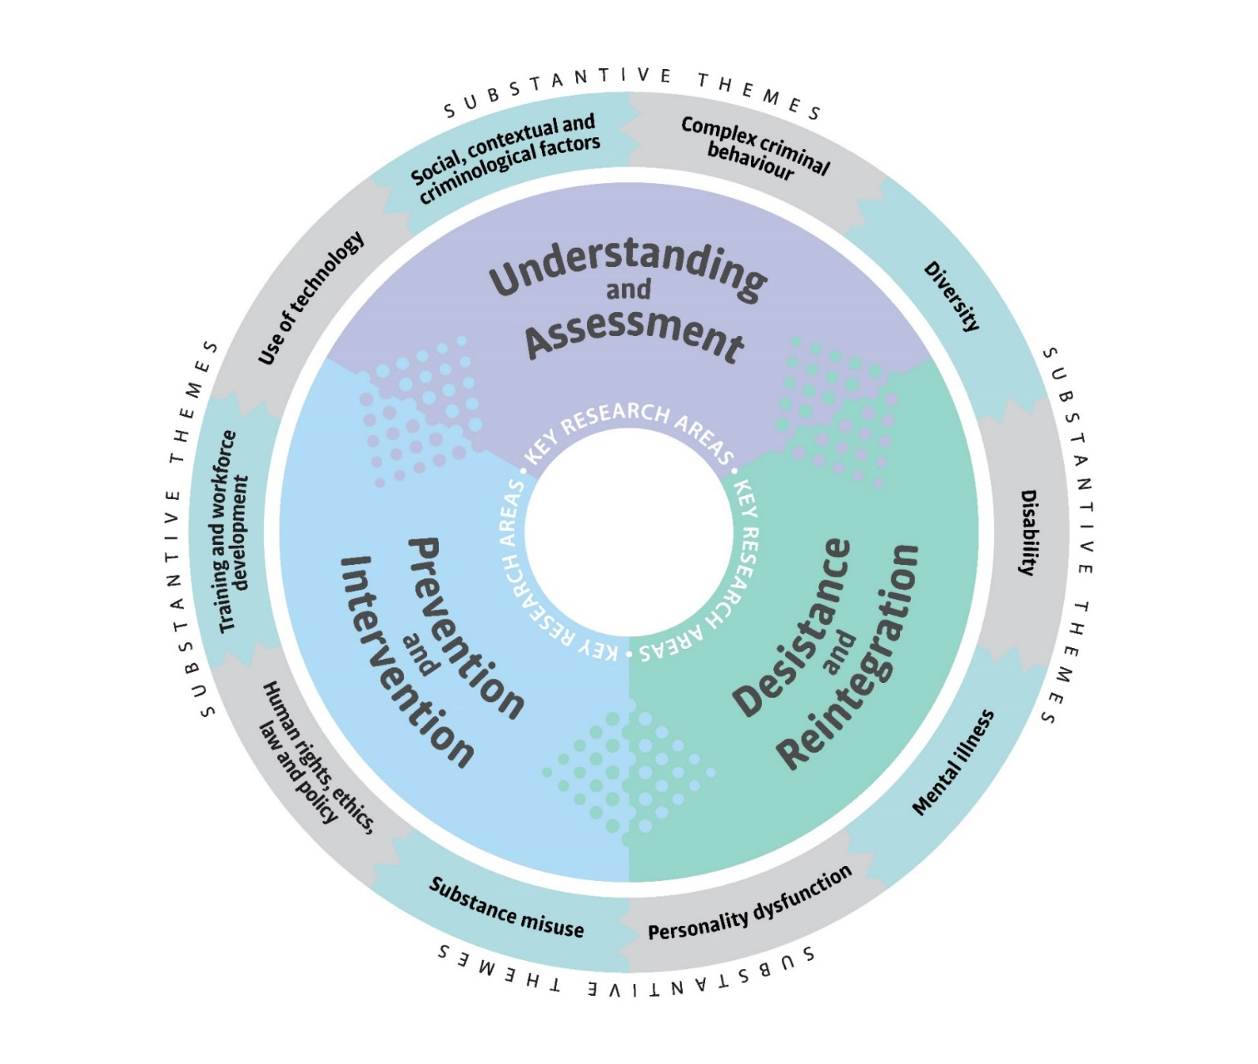
Key Research Areas and Substantive Themes
>>
>>
>>
>>
Notes:
The Consortium has three areas of focus: understanding and assessment, prevention and intervention, and desistance and reintegration. Surrounding each of these three areas of focus are number of substantive themes that will inform the nature of the work undertaken.

Slide 5
Ongoing projects and projects in development
Understanding and Assessment
Pathways to and from Serious Sex Offender Post Sentence Detention and Supervision Orders (DSO).
Pathways to and from Serious Violent Offender Post-Sentence Supervision and Detention Orders
Validity of current risk assessment instruments for the prediction of complex and serious offending
Desistance and Reintegration
The implementation and evaluation of a dynamic risk assessment / case planning tool (the SDAC-21) in serious violent and sexual offenders.
state implementation and evaluation of a dynamic risk assessment / case planning tool (the DRAOR) among case managers who supervise serious violent and sexual offenders
Prevention and Intervention
Post order outcomes in individuals managed under the Crimes (Mental Impairment and Unfitness to be Tried) Act 1997 (Vic)
A randomised controlled trial of the effect of an aggressive script treatment group on the intensity and frequency of aggressive script rehearsal and emotion regulation in mentally disordered offenders
Enhancing the skills of Correctional and Forensic Mental Health staff to work with and manage complex offenders.
Notes:
Aside from the research we will be presenting today, we have a number of other initiatives currently underway, including, for example, commencing a prospective examination of serious violent and sexual offenders on post-sentence orders, developing intervention programs for high-risk complex offenders and training packages for staff working with these groups, as well as implementing and evaluating dynamic risk assessment tools.
We brought with us some Catalyst information packs if anyone is interested in learning more about what we do and how to become involved.

Slide 6
Background
Violent offender treatment effectiveness: There are significant limitations to our knowledge!
Numerous meta-analyses exploring sex offender treatment effectiveness (e.g., Hanson et al., 2009; Losel & Schmucker, 2005; Schmucker & Losel, 2015); only one concerning adult violent offenders (Jolliffe & Farrington, 2007).
Jolliffe & Farrington (2007) review:
  Of 11 studies included, 8 measured treatment effects on violent re-offending
  Two studies reported a significant reduction in violent re-offending (four were in the positive and two were in the wrong direction), with an average difference in percentage reconvicted for violent of 8%
  Offenders with personality and/or mental disorder excluded
Notes:
Ok, so moving on to the research that is the focus of our presentation. As a starting point, it’s important to acknowledge that we have a remarkably limited evidence-base from which to draw definitive conclusions as to how best to intervene with serious violent offenders.
Compared to the sex offender treatment literature, where multiple reviews and meta-analyses exist exploring the effectiveness of treatment with this subgroup, to date there has been only one meta-analysis examining the efficacy of interventions for adult violent offenders.
This single review was completed by Jolliffe and Farrington in 2007, and included 11 studies, 8 of which measured the effects of treatment on violent re-offending
Two of these studies found statistically significant positive treatment effects, four reported reductions in violent re-offending that were not statistically significant, and two reported an increase in violent reoffending among those receiving treatment. This resulted in an overall reduction in violent re-offending of about 8% for offenders receiving intervention, which is reasonably promising.
Now, this review excluded studies involving violent offenders with personality disorder and other mental health disorders, which is interesting given that we know these people are not only overrepresented in violent offender populations but they share a lot of the same criminogenic risk factors and therefore treatment needs as offenders without significant psychopathology.

Slide 7
Our Meta-Analytic Review
Review Questions:
Are psychological treatments with adult violent offenders in correctional and forensic mental health settings effective in reducing institutional misconducts and recidivism?
What factors (methodological, sample characteristics, treatment variables) moderate the efficacy of these interventions?
Do psychological treatments with adult violent offenders in correctional and forensic mental health settings effect change in intermediary outcomes (e.g., trait anger, impulsivity, antisocial cognitions, problem solving and general social skills)?
Notes:
With this in mind, we sought to update and extend the Jolliffe & Farrington review by incorporating studies published over the past decade, and by focussing on evaluations of violent offender treatments in both correctional and forensic mental health settings
In particular, we addressed three questions:
Are psychological interventions with violent offenders in correctional and forensic mental health settings effective in reducing institutional misconducts and community recidivism?

Slide 8
Our Meta-Analytic Review
Review Questions:
Are psychological treatments with adult violent offenders in correctional and forensic mental health settings effective in reducing institutional misconducts and recidivism?
What factors (methodological, sample characteristics, treatment variables) moderate the efficacy of these interventions?
Do psychological treatments with adult violent offenders in correctional and forensic mental health settings effect change in intermediary outcomes (e.g., trait anger, impulsivity, antisocial cognitions, problem solving and general social skills)?
Notes:
What factors might moderate the efficacy of interventions with violent offenders, looking specifically at methodological, sample characteristics, and treatment variables as potential moderators

Slide 9
Our Meta-Analytic Review
Review Questions:
Are psychological treatments with adult violent offenders in correctional and forensic mental health settings effective in reducing institutional misconducts and recidivism?
What factors (methodological, sample characteristics, treatment variables) moderate the efficacy of these interventions?
Do psychological treatments with adult violent offenders in correctional and forensic mental health settings effect change in intermediary outcomes (e.g., trait anger, impulsivity, antisocial cognitions, problem solving and general social skills)?
Notes:
And third, recognising that the first question doesn’t tell us much about the potential mechanisms underlying any behavioural change, the final question was around whether violent offender treatments effect change in more intermediary targets; so, we specifically looked at things like trait anger, impulsivity, antisocial cognitions, problem solving and interpersonal effectiveness or general social skills.

Slide 10
Method
Key Study Inclusion Criteria:
Population:
Adult violent offenders.
Intervention:
Any psychological treatment to reduce violent / aggressive / antisocial behaviour.
Comparator:
Must include a comparable control condition. Comparability could be established by random assignment, matching on a recognised risk variable for offending, or some other demonstration of comparability.
Outcome:
Primary outcomes: (a) violent and general/non-violent recidivism; (b) violent and general/non-violent institutional misconducts; Secondary outcomes: intermediary treatment targets.
Setting:
Correctional environments and forensic mental health settings.
Notes:
Studies were eligible to be included in our review if they examined the effects of a psychological intervention in a sample of adult violent offenders, and relative to a comparable control condition (for example, an untreated group of comparable violent offenders)
The primary outcomes of interest were violent and general community recidivism, as well as violent and general institutional misconducts. Secondary outcomes were those intermediary treatment targets that I just mentioned, which were typically measured using a range of self-report and observer-rated tools.
With respect to study setting, we were interested in studies undertaken in correctional environments (so, violent offenders receiving treatment either in prison or in the community), as well as those conducted within forensic mental health settings (so, for example violent offenders with mental health disorders receiving treatment on an in-patient or out-patient basis).

Slide 11
Method
General Search Strategy (July–Nov 2017):
Comprehensive search strategy involving:
  Database searching
  Hand-searching of key journals
  Screening of existing literature reviews
  Grey literature searching
  Contact with leading experts
Records published prior to 1990 and non-English records excluded.
Study selection, data extraction / coding, and study quality assessment undertaken by two independent reviewers
Methodological quality assessment for each included study assessed using the Maryland Scientific Methods Scale and the Cochrane Collaboration domain-based assessment of bias (e.g., bias in selection, measurement, reporting, etc.).
Notes:
To identify eligible studies, we conducted a comprehensive search of the literature, ranging from electronic database searching through to making contact with leading experts in this area.
To minimise biases introduced throughout the review process, at least two independent reviewers were involved at each stage of the review to ensure balanced and consistent decision-making.
Finally, the methodological quality of each included study was assessed using both the Maryland Scientific Methods Scale, which is a 3-point scale that reflects the level of comparability between the treatment and control conditions, and the Cochrane Collaboration domain-based approach to the assessment of bias.

Slide 12
Results
Notes:
This diagram just shows the flow of records from identification through to inclusion in the review.
You can see that from about 13,000 records identified and screened, we included 24 independent studies in our meta-analyses of primary outcomes and 18 independent studies in the meta-analyses of secondary outcomes.

Slide 13
Results
Descriptive Data: Primary (Behavioural) Outcomes
27 independent studies, published between 1993 and 2017
  20 studies measured recidivism outcomes
Total sample = 7,062 adult violent offenders
Average age = 31.6 years
Average treatment length = 121.6 hours (range: 0.25–470 hours)
Average follow-up length = 22.9 months (range: 1–88 months)
Types of intervention: intensive multi-modal (41%); standard CBT (30%); anger management (18%); 3rd wave CBT (7%); motivational interviewing (4%)
Notes:
We are going to start with the first part of our systematic review which concerned primary outcomes, by which we mean recidivism and institutional misconduct. Following the application of selection criteria we ended up with 27 independent studies of which 20 measured recidivism outcomes and … measured institutional misconduct. As you can see in the slide before you we ended up with around 7000 violent offenders in our sample. The average age of participants was early thirties. It’s important to note that while we utilised fairly restrictive selection criteria, the studies varied considerably in terms of the type of treatment, the average length of treatment and the follow up length used to measure recidivism.

Slide 14
Results
Violent Recidivism
Treatment is effective, with average difference in % reconvicted (violence) of about 10% (95% CI 5%-15%)
General/Non-Violent Recidivism
Treatment is effective, with average difference in % reconvicted (general) of about 11% (95% CI 8% - 15%)
Notes:
Now that we have the sample description out of the way, let’s consider the results of our meta-analysis. Before you, you can see two forest plots. The forest plot shows the effect size associated with each study. The lines around each effect are 95% confidence intervals. We have chosen odds ratios as our effect sizes for the study. The middle line represents an odds ratio of 1 which is equivalent to no difference in the odds of re-offending. Effects below zero, are to the left of the middle line and they represent an effect in favour of treatment, that is a drop in the odds of re-offending for the treatment group relative to controls. Overall the pooled effect for all of the studies suggests that there is an absolute drop of 10% in the percentage of participants reconvicted for violent offending and an absolute drop of around 11% in the percentage of participants reconvicted for non-violent offending. In other words, if we had 50% of participants in our control group re-offending violently the treated group would have a reconviction rate of 40%.
It’s up for debate, but I think that a drop of 10% or 11% is a considerable change. Of course, we ought to remember that the figures here are also estimates and the true value is likely to vary somewhat around these numbers.

Slide 15
Results
General/Non-Violent Institutional Misconduct
Treatment is not significant, with an average difference of -0.04 (95% CI: -0.25, 0.18) standard deviations relative to the control group
Violent Institutional Misconduct
Treatment is not significant, with an average difference of -0.18 (95% CI: -0.38, 0.03) standard deviations relative to the control group
Notes:
Now, what about institutional misconduct. Here, because institutional misconduct tended to be measured in counts rather than proportions, the effect size we used was hedge’s g, which is equivalent to the difference between the control and treatment groups in standard deviation units. Once again, effects to the left of the middle line are effects in favour of treatment. Overall, the pooled effects for btoh forms of misconduct were non-significant and small by conventional interpretation. The lack of significance is down to two things here. The first is variability in the effect. You will see that in the first plot for general/non-violent institutional misconduct that the effect is all over the place. The second thing is sheer lack of numbers. You can see with both outcomes, we ended up with very few studies to analyse, meaning we needed a pretty large consistent effect in order to attain statistical significance. Ultimately, we need more high quality studies before we can say anything meaningful about these two outcomes. So, for the remainder of the talk I will focus more on the re-conviction outcomes.

Slide 16
Results
Meta-analysis
The meta-analysis of primary outcomes suggests that treatment is associated with reduction in the proportion of people who are subsequently convicted of an offence.
A number of questions arise in relation to this finding:
  1. What methodological characteristics are associated with effective treatment?
  2. Is treatment more effective for certain populations?
  3. What are the psychological mechanisms driving the treatment effect?
Notes:
So, the evidence suggests a modest reduction in the proportion of violent offenders who are subsequently convicted of an offence. But, this raises a number of further questions; 1) to what extent are methodological characteristics associated with studies that report effective treatment- for example do high quality randomised control trials report better effects for treatment than matched groups and vice versa. Is treatment more effective for certain populations such as forensic mental health inpatients or prisoners and finally, if a real effect is present what are the psychological mechanisms driving the treatment effect.
The first two questions we addressed through moderator analysis, and while we found significant effects at the .05 level, we subsequently increased the alpha level and found that we had no significant effects. Nevertheless, there were some interesting trends that I want to show you.

Slide 17




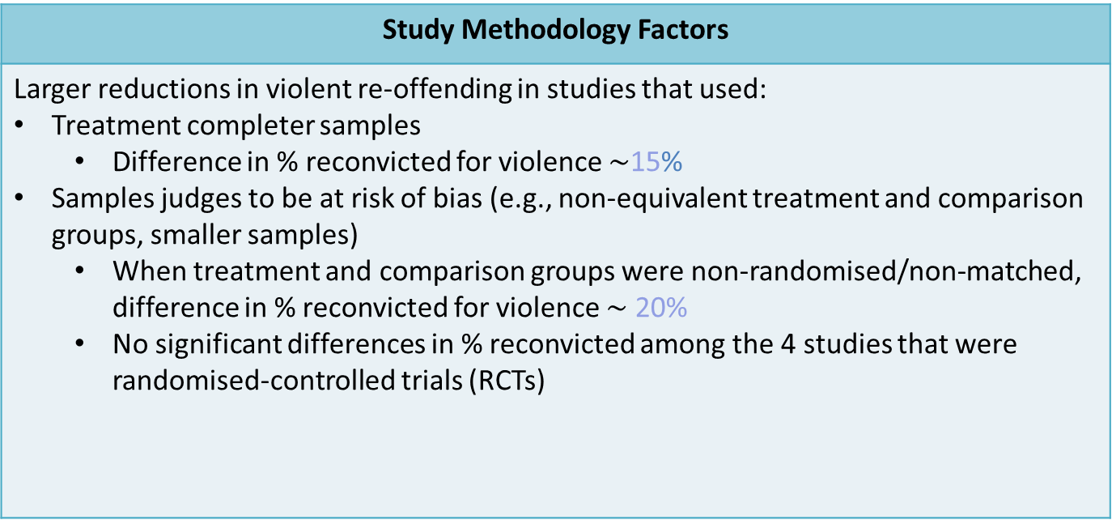
What Factors Influence Treatment Effectiveness?
Study Methodology Factors
Larger reductions in violent re-offending in studies that used: Treatment completer samples Difference in % reconvicted for violence $\sim$15% Samples judges to be at risk of bias (e.g., non-equivalent treatment and comparison groups, smaller samples) When treatment and comparison groups were non-randomised/non-matched, difference in % reconvicted for violence $\sim$ 20% No significant differences in % reconvicted among the 4 studies that were randomised-controlled trials (RCTs)
Other variables examined that do no not significantly influence treatment effectiveness: publication type; type of control condition; year of publication; geographic location; length of follow-up.
Notes:
So, let’s start with the first question around methodology. Here we found, perhaps not surprisingly, that studies that only included participants that completed treatment had greater effects in favour of the treatment group with a reduction of 15% in the percentage reconvicted for violence. Also, when we looked at the effects associated with RCTs and non-RCTs we did find a difference, with a large effect for non-RCTs and a trivial effect for studies that were conducted with RCTS. This suggests that the better the quality of the study, the weaker the effect which might in turn suggest that the estimates provided earlier are an overestimate of the true effect of treatment on re-offending.

Slide 18
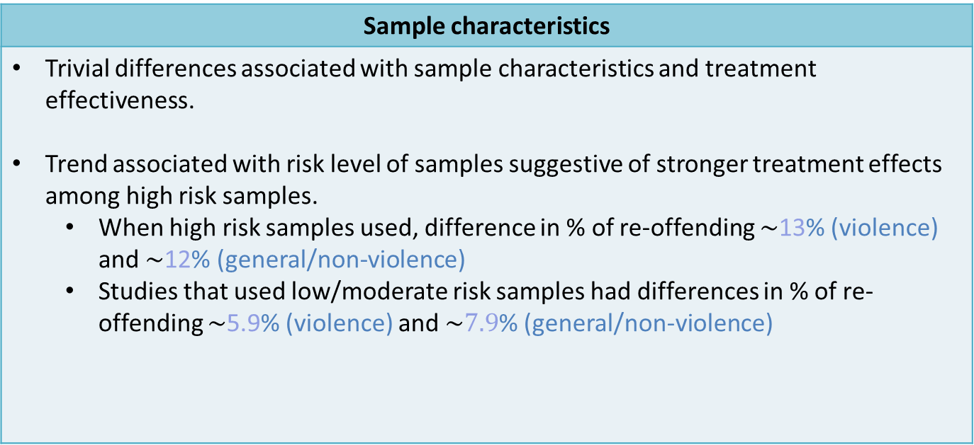
What Factors Influence Treatment Effectiveness?
Sample characteristics
Trivial differences associated with sample characteristics and treatment effectiveness. Trend associated with risk level of samples suggestive of stronger treatment effects among high risk samples. When high risk samples used, difference in % of re-offending $\sim$13% (violence) and $\sim$12% (general/non-violence) Studies that used low/moderate risk samples had differences in % of re-offending $\sim$5.9% (violence) and $\sim 7.9$% (general/non-violence)
Variables unable to be examined due to insufficient variability / information: gender; personality disorder; baseline motivation / readiness to change; types of violent offenders (e.g., expressively vs. instrumentally violent)
Notes:
What about characteristics of the populations under study? Here, we found that sample characterstics such as ethnicity and age were not strongly associated with treatment effectiveness. However, there was an interesting trend with differences in the risk level of samples. Consist with the risk-needs-responsivity model we did see greater treatment effects associated with high risk samples.

Slide 19
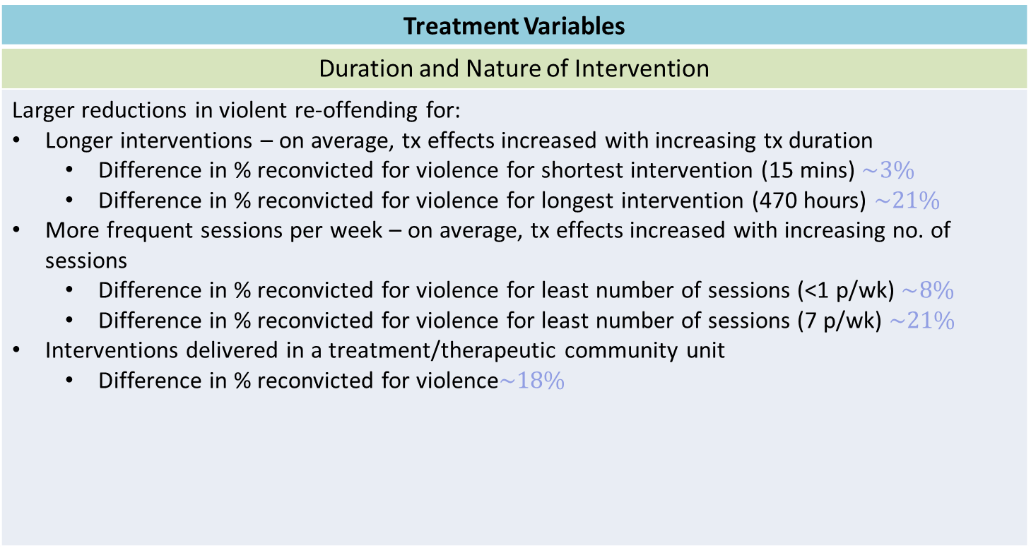
What Factors Influence Treatment Effectiveness?
Treatment Variables
Duration and Nature of Intervention
Larger reductions in violent re-offending for: Longer interventions – on average, tx effects increased with increasing tx duration Difference in % reconvicted for violence for shortest intervention (15 mins) $\sim 3\%$ Difference in % reconvicted for violence for longest intervention (470 hours) $\sim 21\%$ More frequent sessions per week – on average, tx effects increased with increasing no. of sessions Difference in % reconvicted for violence for least number of sessions (<1 p/wk) $\sim 8\%$ Difference in % reconvicted for violence for least number of sessions (7 p/wk) $\sim 21\%$ Interventions delivered in a treatment/therapeutic community unit Difference in % reconvicted for violence$\sim 18\%$
Notes:
In terms of the duration of interventions, the general pattern was that longer and more frequent interventions tended to be associated with greater treatment effectiveness. For example, our shortest intervention was just 15 minutes and here the treatment effect was equivalent to a 3% reduction, whereas the longest intervention was 470 hours and the treatment effect was equivalent to a 21% drop in recidivism. We see similar effects for the frequency of sessions. The least number of sessions was less than one per week and the treatment effect associated was an 8% drop, contrast this with the % reconvicted for the study with the greatest number of sessions which was 21%.
We also found that studies that were delivered in therapeutic community unit, in which all patients live and are treated together was associated with greater reductions in re-conviction.

Slide 20
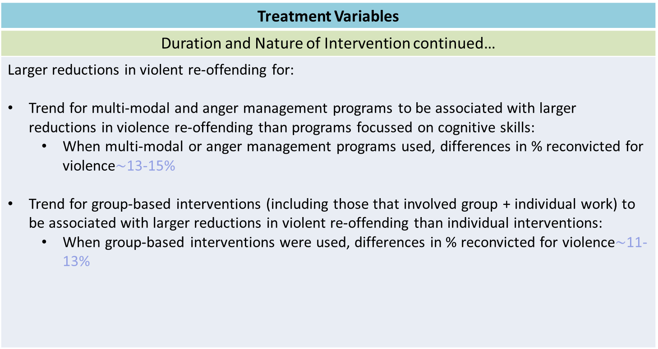
What Factors Influence Treatment Effectiveness?
Treatment Variables
Duration and Nature of Intervention continued…
Larger reductions in violent re-offending for: Trend for multi-modal and anger management programs to be associated with larger reductions in violence re-offending than programs focussed on cognitive skills: When multi-modal or anger management programs used, differences in % reconvicted for violence$\sim$13-15% Trend for group-based interventions (including those that involved group + individual work) to be associated with larger reductions in violent re-offending than individual interventions: When group-based interventions were used, differences in % reconvicted for violence$\sim$11-13%
Other variables examined that do no not significantly influence treatment effectiveness: session duration (hours); total treatment duration (weeks); facilitator profession.
Notes:
In terms of types of treatment, multi-modal cbt and anger management programs were associated with greater reductions in re-offending than standard CBT or motivational interviewing. Group based interventions which included treatment involving group and individual work were also associated with a drop in re-offending.

Slide 21
What Factors Influence Treatment Effectiveness?
Treatment Variables
Intervention components
Larger reductions in violent re-offending when: Relapse prevention addressed Role play included Homework included Basic life skills (e.g. literacy/numeracy) not included Larger reductions in non-violent/general re-offending when: Emotion regulation addressed Role play included Homework included Basic life skills (e.g. literacy/numeracy) not included
Other variables examined that do no not significantly influence treatment effectiveness: intervention component addressing motivation; intervention component addressing empathy
Notes:
Finally, we also considered treatment components. Relapse prevention, role play and homework were associated with larger reductions in violent re-offending. Interestingly, we found that interventions that did not include a component focused on basic life skills were also associated with reductions in re-offending.
For non-violent/general re-offending the results were similar, but here relapse prevention was not strongly associated with reductions in re-offending, in its place we found that emotional regulation had a considerable effect.

Slide 22
What Factors Influence Treatment Effectiveness?

Slide 23
Results
Contemporary knowledge appears to suggest that psychological interventions with serious violent offenders may be effective in reducing further (violent) offending when they are intensive in nature:
250+ total hours of structured intervention
3–4+ sessions p/week of structured intervention (2–4 hours p/session)
Delivered within a designated treatment / therapeutic community unit
Delivered to high-risk offenders
Incorporate group-based interventions
Are multi-targeted, incorporating:
  Relapse prevention, role playing, homework activities, anger control & interpersonal skills
Notes:
That was a lot to go through, but to summarise [read off slide]

Slide 24
Results
Descriptive Data: Secondary Outcomes
22 independent studies, published between 1990 and 2017
Total sample = 1969 adult violent offenders
Average age = 34 years
Average treatment length = 54 hours (range: 16–300 hours)
Types of intervention: standard CBT (64%); anger management (27%); 3rd wave CBT (9%)
Notes:
Now, we get to the second part of our systematic review, which focused on secondary outcomes or treatment targets. Obviously, psychologists require some causal model of offending to work with that involves a psychological component. In fairly basic terms, a person treating would expect that a change in some psychological attribute would be associated with a reduction in re-offending. As nina, mentioned we chose 5 treatment targets to include in our review – trait anger, impulsivity, general social skill, problem solving and anti-social cognitions.
Before you, you can see the descriptive data for this part of the review. The first thing to notice is that the sample is quite small, individual studies tended to use fairly small sample sizes. The average age was slightly older than studies utilised in our review of primary outcomes and as with the first part of the review we see considerable variation in treatment type and length.

Slide 25
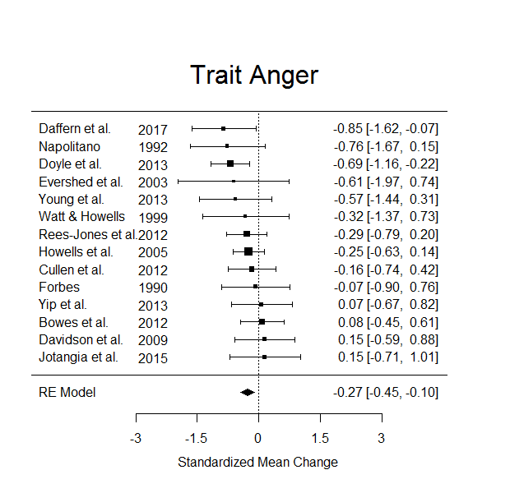
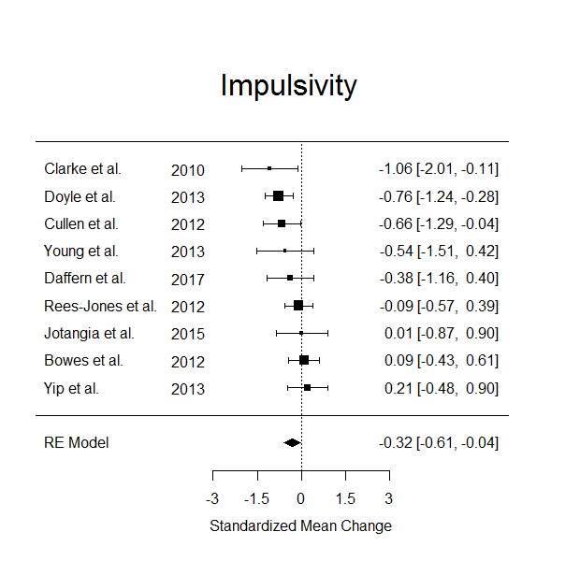
Results
Treatment is effective, with average difference between control and treatment groups amounting to -0.27 (95% CI: -0.45, -0.10)
Treatment is effective, with average difference between control and treatment groups amounting to -0.32 (95% CI: -0.61, -0.04)
Notes:
Once again, forest plots and the effect size we used was standardized mean change. For trait anger and impulsivity effects to the left of the line represent effects in favour of treatment. Here we see that for both outcomes there were significant effects in favour of treatment that were small in size by conventional interpretation. In other words, treatment appears to reduce trait anger and impulsivity on average.

Slide 26
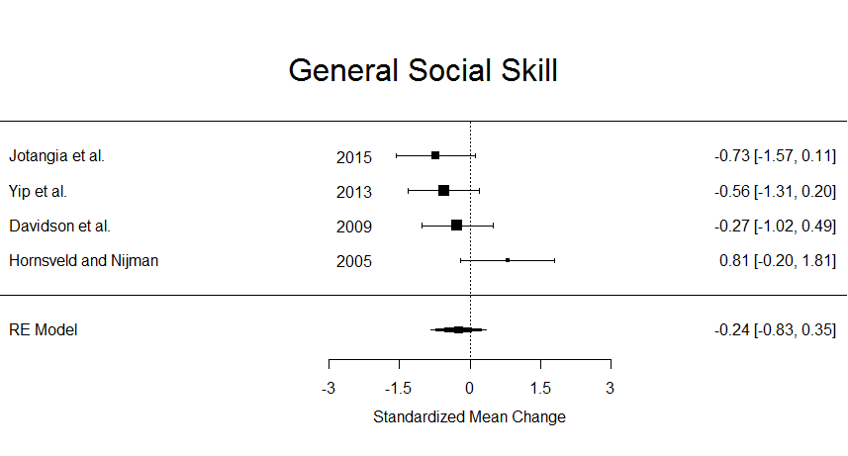
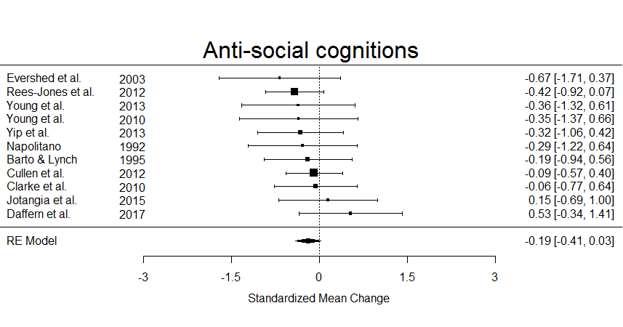
Results
Treatment is not significant, with an average difference of -0.24 (95% CI: -0.83, 0.35) standard deviations relative to the control group
Treatment is not significant, with an average difference of -0.19 (95% CI: -0.41, 0.03) standard deviations relative to the control group
Notes:
With general social skill and anti-social cognitions, we found non-significant treatment effects. Though, they were in the right direction.

Slide 27
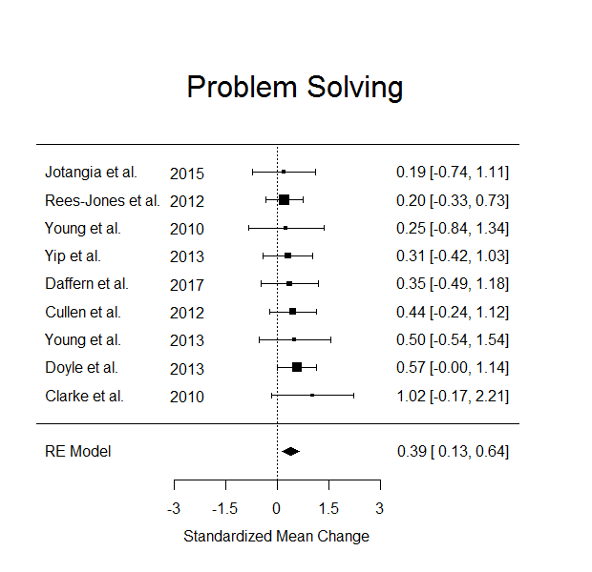
Results
Treatment is effective, with average difference between control and treatment groups amounting to 0.39 standard deviations (95% CI: 0.13, 0.64)
Notes:
Finally, we come to problem solving which had the greatest treatment effect which was moderate in size. Here we want an increase in problem solving for the treatment group, so effects in favour of treatment are to the right of the line.

Slide 28
Results
Treatment appears to be effective in reducing trait anger and impulsivity and improving problem solving skills
Less certainty around the effects for general social skill and anti-social cognitions
  However, effects appear to be in the right direction
Overall, secondary outcomes appear to generally follow the pattern that would be expected if they were associated with reductions in primary outcomes (recidivism).
Study limitations prevent us from investigating whether changes in secondary outcomes (e.g. a reduction in trait anger) are associated with reductions in primary outcomes (e.g. a reduction in violent recidivism) at the individual study level.
Notes:
So, summing up. Treatment appears to be effective in reducing trait anger and impulsivity and improving problem solving skills.
The effects of general social skill and anti-social cognitions are non-significant, but in the direction we would expect.
Overall, the treatment targets appear to generally follow the pattern that would be expected if they were associated with reductions in recidivism, but we can’t really say much about that relationship because very few studies that examined recidivism as an outcome included measures of the treatment targets that they were aiming to change.

Slide 29
Limitations
A relatively small number of high-quality studies were identified
Few studies were conducted in community and forensic mental health settings
Moderating effects do not necessarily reflect causal relationships
Determining factors that impact treatment effect was restricted by the level of detail described in each study
Outcome measures such as frequency of re-offending, severity or time to re-offending were unable to be examined due to insufficient data
Notes:
There were a number of limitations to this meta-analysis. Firstly, there were very few high quality RCT type studies identified, only 5 for our primary outcomes and four for our secondary outcomes. Very few studies conducted in community settings and forensic mental health settings, which prevented detailed moderator analysis.
While we saw trends in our moderator analysis that were interesting, they do not necessarily reflect causal relationships. Indeed, given the lack of studies we were only able to include one moderator at a time which prevented us from looking at how two different variables (such as risk level and treatment components) interact to influence treatment effectiveness.
Finally, we were only able to consider the proportion of participants who re-offended, but could not consider other equally important outcomes such as frequency of re-offending and time to re-offending due to insufficient data.

Slide 30
Conclusions
The review conducted suggests that there is a small to modest effect of therapeutic treatment for violent offenders in terms of:
  Reducing violent recidivism
  Reducing general/non-violent recidivism
Improving the effectiveness of treatments requires better understanding of the relationship between treatment and outcome
  More well-designed studies (RCT, larger sample sizes)
  More hypothesis driven research (e.g. inclusion and testing of mediating variables thought to causally influence outcomes)
  Inclusion of different measures of recidivism (e.g. time to recidivism, counts of offences)
Notes:
Overall, the review suggest that there is a small to modest effect of therapeutic treatment for violent offenders in terms of reducing recidivism.
However, the review also points to a number of areas to consider moving into the future. The first is that we need more studies that are well designed in order to get better estimates of the treatment effects associated with recidivism. The second is that we need more hypothesis driven research that relates treatment targets to the outcomes that mental health professionals working in this area are ultimately hoping to effect. Theoretical work and the inclusion of variables thought to mediate the effect of treatment on recidivism would be useful in determining how best to structure treatment to reduce re-offending.
Finally, we ought to start using different measures of recidivism in these studies. While the proportion of individuals re-offending is interesting, it is equally important to understand the effect of treatment on the overall frequency of offending and the time to recidivism.
Thanks.

