Slide 1
Costing Indigenous and non-Indigenous offending trajectories
Troy Allard and Molly McCarthy

Slide 2
Overview
Importance and prior findings
Queensland Birth Cohort (1983/84)
Latent Class Growth Modelling
Costing Approach and Estimates
Next Steps and Conclusions
Notes:
So in terms of what today’s presentation will focus on.
First I’ll talk about the importance of understanding the costs of offending trajectories, and some of the findings of prior research.
I’ll then provide an overview of the 1983/84 Queensland Birth Cohort, before handing over to Molly who will discuss the modelling that was undertaken.
I’ll then provide an overview of the costing approach, and Molly will outline how we developed our cost estimates.
I’ll then provide an overview of our next steps, before concluding.

Slide 3
Importance
Evidence to promote good decision making:
  Promote long-term thinking
  Economically efficient decisions
  Advocate for change (i.e.: programs, justice reinvestment)
Lack of Australian research:
  Detailed criminal justice system costs
  Few have assessed costs based on key cost drivers
  Few have assessed the longitudinal cost of offenders to the criminal justice system, and none based on Indigenous status
Notes:
Why on earth would anyone be interested in understanding the longitudinal costs of offending trajectories. That is, the cost of individuals to the criminal justice system based on the offences and types of contacts that they have.
One of the main justifications for the project is that determining the cost of individual’s on different offending trajectories would provide evidence to assist good decision making. Understanding the longitudinal cost of offenders promotes long-term thinking about offending and appropriate responses to offending. It promotes rational use of public resources and economic efficiency. It can also be used to advocate for change, such as the greater use of rehabilitation programs or to advocate for a ‘justice reinvestment’ policy framework.
There’s also a lack of Australian research in a few areas.
There’s a lack of detailed estimates about the cost of the criminal justice system. Those in this space would know that current top-down estimates for the system as a whole are pretty broad-brushed, such as based on the Report on Government Services or the AIC’s Counting the Costs of Crime report.
Few have explored costs based on key cost drivers. Such drivers may include offence type and whether the offender is diverted by police or progressed to court; whether there is a trial; and location.
Finally, there is no previous published research that has assessed whether the costs of offending over the life-course differ based on Indigenous status. One may Indigenous Australians may be more costly, given findings indicating that they initiate earlier, have more frequent or sustained contact with the system, and are over-represented in detention and prison populations.
By examining the costs, it is hoped that an evidence-base will be developed that will help those tasked with developing appropriate responses to reduce Indigenous over-representation.

Slide 4
Prior Research
Differences between studies impact on findings
  Costs included and how assessed - direct criminal justice system, victim, fear, and lost productivity from offenders
  Wide ranging cost estimates
  Sample
Early research – selected or created categories
  Costs resulting from “life of crime” US$1.5m to $1.8m (Cohen, 1998)
  Prisoners with 30+ convictions $US1.14m (Delisi & Gatling, 2003)
  10% of sample with most offences $US800,000 (Welsh et al., 2008)
More recent research – trajectory modelling
    About one-quarter of individuals offend
    Most have one or two offences
    Small group of chronic offenders account for a large proportion of costs
Notes:
In terms of research that has been done in this space, most of the international research has included a broad array of costs, such as criminal justice system costs, victim costs, and costs associated with fear.
Earlier research involved selecting samples or categories of individuals based on characteristics that would naturally make them more costly.
Studies by Cohen and Delisi indicated that the costs resulting from a ‘life of crime’ or those with a large number of convictions amounted to an average of over $1m. These studies included victim costs, criminal justice system costs and the cost of foregone earnings by offenders.
A study by Welsh indicated that chronic offenders cost an average of $800,000 in victim costs at the time of publication.
More recent research has used modelling to differentiate offending patterns over-time, and then applied costs. Of the many studies that have modelled offending trajectories, findings typically indicate that:
There are 3 to 5 groups
There are at least two groups, an adolescent peaked and chronic group
There’s typically a late-onset chronic group
And there’s a low-rate, high-rate and moderate declining group
Studies that have applied costs to trajectories have different cost estimates, which are related to the nature of the study.
Some important differences between studies impact on the findings.
1. Follow-up time frame – longer follow-up time-frame should produce higher costs
2. Differences in types of offences included and how costed – some have costed all offences, or have only applied costs to some offence types. Some have included tangible costs, while some have also attempted to include intangible costs. Wide variation in how much offences are estimated to cost. For example, assault has been estimated to cost between $16,000 and $85,000, while homicide has been estimated to cost up to $5 million.
3. Location of study impacts on the costs produced, as there is considerable variability. For example, the average cost of prison per year in Australia is 3x as much as in the US.
Nevertheless, there are some consistent findings:
About 5% account for 40% of costs
Most individuals have 1 or 2 offences
Individuals in chronic offending trajectories cost, on average, significantly more than individuals in low offending trajectories. While estimates vary based on what cost categories have been included, from $250,000 to over $1m at the time various studies we conducted, each chronic offender costs 10 to 20 times as much as offenders in low offending trajectory groups.
There is limited research examining the cost of offending trajectories in Australia, and no previous studies have explored Indigenous and non-Indigenous offending trajectories separately and assessed their costs.

Slide 5
Research Questions
How do offending trajectories differ for Indigenous and non-Indigenous Australians?
Can we develop better estimates about the direct criminal justice system costs of offending?
Notes:
Moving on to the research questions that we will address today:
How do offending trajectories differ for Indigenous and non-Indigenous Australians?
Can we develop better estimates about the direct criminal justice system costs of offending?
We are yet to apply our costs to the trajectories, but will wrap-up by examining how contacts vary across the offending trajectories to give an indication of how costs might work out.

Slide 6
Queensland Birth Cohort (1983/84)
Data linkage by Queensland Government Statistician’s Office for all individuals born in QLD during 1983/84 and contacts to 2014 (aged 10 to 32)
Key datasets:
  RBDM – Births
  QPS - Cautioning and referral to conferencing
  YJ – Community-based orders and detention
  JAG – Court finalisations
  QCS – Community-based orders, remand and imprisonment
Notes:
Our data for this project is a subset of data from another project, which involved data linkage of 14 government datasets – including the ones used in this project - RBDM, QPS, YJ, JAG and QCS.
These data were linked using probabilistic data linkage, using names, date of birth and sex; both within agency datasets and across; with each individual given a master link key. In total, there were over 260,000 individuals in these data, and over 2.1 million records.
It is no easy feet undertaking an exercise like this, and would like to thank all of the representatives from Queensland Government agencies who supported the linkage of these data and the Queensland Government Statistician’s Office in particular, who undertook the data linkage for us. This included manual validation of a sample of 200 individuals to ensure the quality of the data linkage, that is, the proportion of links that should not have occurred. Based on this, error was estimated at between 0 and 3.6%.

Slide 7
1983-1984 Queensland cohorts (n=83,371)
    22,687 (27.1%) offended (M=2.8, SD=14.4, excluding traffic offences)
    233,164 offences
  Indigenous status (Multi-Stage Median Algorithm)
    n=2,295 Indigenous, 80.3% offended, M=26.8, SD=44
      N=1,252 Male, 87.5% offended, M=38.1, SD=51.8
      N=1,043 Female, 71.8% offended, M=13.4 offences, SD=26.9
    n=81,076 non-Indigenous, 25.7% offended, M=2.12, SD=11.9
      N=41,694 Male, 36.6% offended, M=3.3 offences, SD=15.3
      N=39,373 Female, 14.2% offended, M=0.8 offences, SD=6.3
Notes:
After these data were linked, we had a record of every contact that individuals in the birth cohorts had with the criminal justice system.
In total, there were over 83,000 individuals born in Queensland during 1983 and 1984, of which just over one-quarter offended.
To determine Indigenous status, we investigated several different ways of resolving conflicting and missing information within and across the datasets.
We ended up using the multi-stage median algorithm, within and across the datasets, which involved:
If a person only has missing records, derived status is missing
If a person has only one non missing record this is the derived status (either Indigenous or non-Indigenous)
Two non-missing records and if one is Indigenous, derived status = Indigenous
Three or more non-missing records and two or more are Indigenous, derived status is Indigenous.
When we look at offending based on Indigenous status, 80% of Indigenous peoples had at least one recorded offence with Indigenous males more likely to offend than Indigenous females. On average, Indigenous males had 38 offences while Indigenous females had 13 offences.
About one-quarter of non-Indigenous people offended, with about one-third of males and 15% of females offending. On average, non-Indigenous males had 3 offences and non-Indigenous females had
[Gender missing for 9 non-Indigenous ]
[When compared with ever Indigenous for assigning status, there were slightly fewer Indigenous peoples who offended. 72.7% of Indigenous offended, compared with 24.4% for non-Indigenous]

Slide 8
Research Question 1
How do offending trajectories differ for Indigenous and non-Indigenous Australians?
Notes:
So having described the cohort, we will now move on to addressing our first research question:
How do offending trajectories differ for Indigenous and non-Indigenous Australians?

Slide 9
Trajectory Analysis
Dataset
  Annual number of offences for each of the 83,371 individuals born in Queensland 1983/84 (incl. non-offenders)
Latent Class Growth Modelling
  Modelled biennial offence frequency from 10 to 31 years of age
  Capped at 50 offences biennially
  Separate models for Indigenous and non-Indigenous
  Goodness of fit estimates and entropy to determine best model from two to five classes
  Optimum model for both Indigenous and non-Indigenous cohort had 3 groups

Slide 10
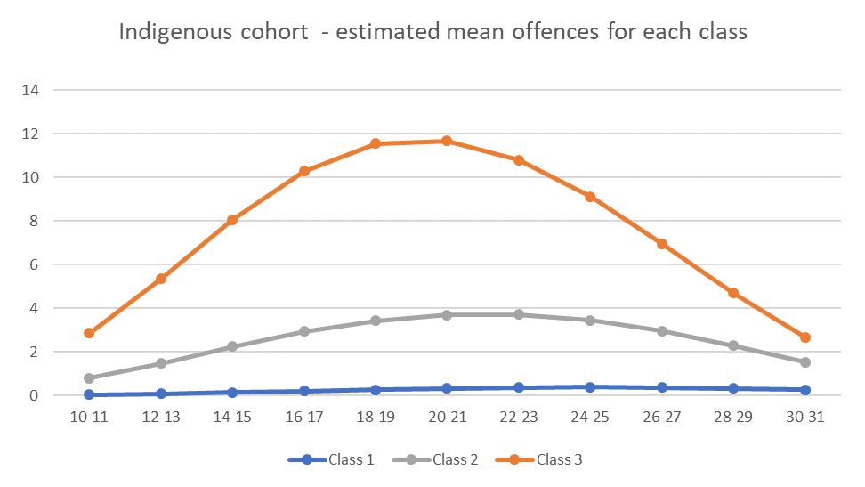
Trajectory Analysis – Indigenous cohort (N=2295)
Low rate and non-offenders
Adolescent onset (moderate)
Early onset (chronic)
Class 3 = 12.8%
Class 2 = 37.4%
Class 1 = 49.8%
Notes:
GoF
AIC = 100199.99
BIC = 100280.33
Sample size adjusted BIC = 100235.85
Lo-Mendell_Rubin Likelihood ratio for test 2 (Ho) versus 3 class, -53106.49, p =.0012
Parametric Bootstrapped likelihood ratio test for 2 (Ho) versus 3 class - -53106.49, p <.00001
Entropy = .945
Class 1 has an estimated mean of zero but includes some people who had one to four offence at certain time points.
In terms of gender for Indigenous peoples:
Low rate and non-offenders – 38.2% male
Adolescent onset (moderate) – 67.7% male
Early onset (chronic) – 79.9% male
For females, 67.8% are low rate and non-offenders, 26.6% are adolescent onset moderate, and 5.7% are early onset chronic
For males, 34.9% are low rate and non-offenders, 46.4% are adolescent onset moderate, and 18.7% are early onset chronic.

Slide 11
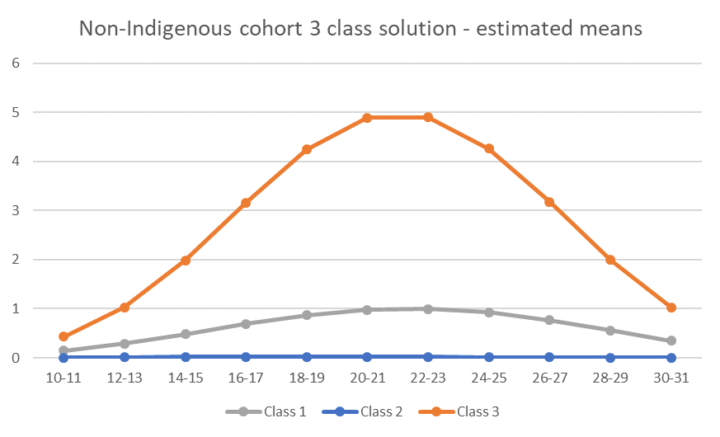
Trajectory Analysis – Non-Indigenous cohort (N=81,076)
Low rate and non-offenders
Adolescent onset (low)
Early onset (chronic)
Class 3 = 1.9%
Class 1 = 14.1%
Class 2 = 84.1%
Notes:
AIC = 530190.941
BIC = 530321.185
BIC sample adjusted = 530276.69
VUONG-LO-MENDELL-RUBIN LIKELIHOOD RATIO TEST FOR 2 (H0) VERSUS 3 CLASSES = -292737, p = .0061
PARAMETRIC BOOTSTRAPPED LIKELIHOOD RATIO TEST FOR 1 (H0) VERSUS 2 CLASSES = -292737, p <.0001
Entropy = 0.91
In terms of gender for non-Indigenous:
Low rate and non-offenders – 46.5% male
Adolescent onset (moderate) – 77% male
Early onset (chronic) – 78.5% male
For females - 92.5% are low rate and non-offenders, while 6.7% are adolescent onset low and 0.8% are early onset chronic.
For males – 76.1% are low rate and non-offenders, while 21.1% are adolescent onset low and 2.9% are early onset chronic.

Slide 12
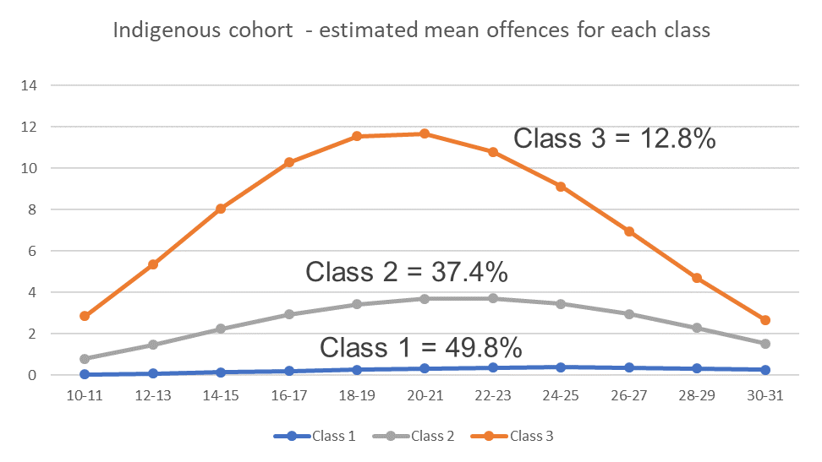
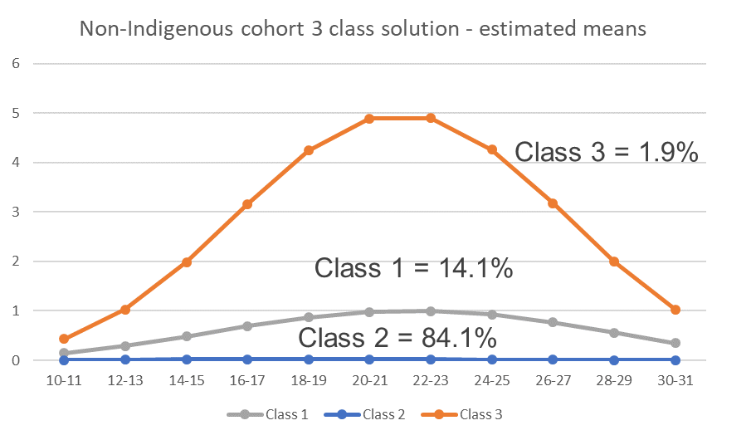
Trajectory Analysis – comparison
Low rate and non-offenders
Adolescent onset (moderate/low)
Early onset (chronic)
Notes:
Note: In both groups, Class 1 in Indigenous and Class 2 in Non-Indigenous includes some people who have a low number of offences at given time points, but the mean is zero within the class at each time point.
Indigenous cohort have greater proportion of population in offending groups (almost 6 x as many in the early onset chronic group) and these groups have greater volume of recorded offences (almost twice as many at multiple time points across the trajectory
0

Slide 13
Research Question 2
Can we develop better estimates about the direct criminal justice system costs of offending?
Notes:
We will now move on to address our second research question
Can we develop better estimates about the direct criminal justice system costs of offending?

Slide 14
Costing Approach
Direct criminal justice system cost – police, courts, youth justice and corrections (2016-17 dollars)
Key cost drivers considered in unit cost estimates
  whether diverted by police
  offence type
  trials
  location (metro v regional/remote)
Upper bound and best estimate determined using top-down and bottom up costing approaches
Upper bound estimate – reflects long run impacts of demand
  all non-central costs directed to service delivery (excludes capital works expenditure but includes asset maintenance, depreciation etc.)
Best estimate – focuses on short run impacts on demand
  Direct staff time spent responding to offenders
Notes:
The costing approach used focused on direct criminal justice system costs – so the costs of police, courts, youth justice and corrections.
Key cost drivers we considered included: whether diverted by police, offence type, whether there was a trial and location.
We are estimating both upper bound and best estimates using top-down and bottom-up approaches.
Our upper-bound estimate, which we are focusing on today, reflects the long run impacts of demand.

Slide 15
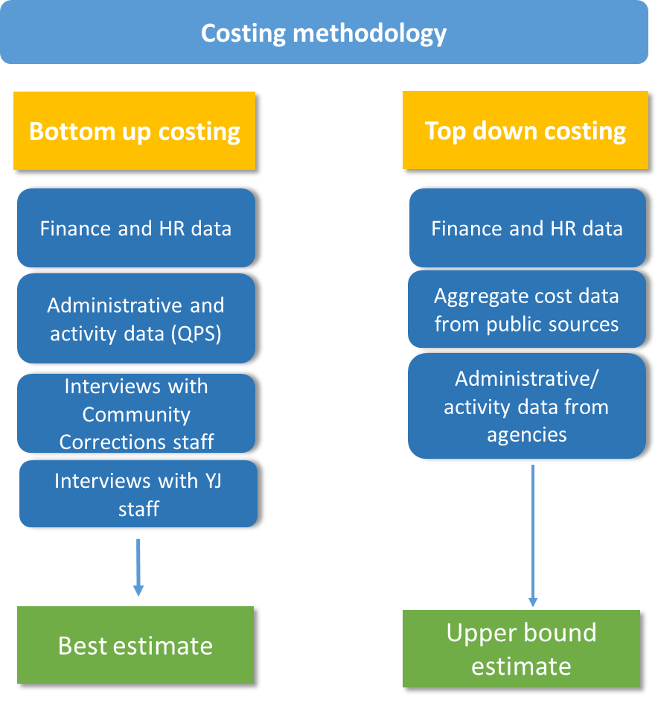
Costing Approach
Unit costs estimated
Police
  Cost per offending incident (most serious offence)
Courts
  Cost per most serious charge finalised
Youth Justice and Corrections
  Cost per custody day
  Cost per community corrections day by key orders
Notes:
Our overall framework for our top down costing approach involved gathering finance and HR data from the agencies
Aggregate cost data from public sources
And administration/activity data from the agencies.
We also undertook interviews with corrections and YJ staff about their roles and how long various activities took, which we have used to disaggregate costs.
Our cost units estimated include:
For police, cost per offending incident – based on the most serious offence
For courts, cost per most serious charge finalised –
For youth justice and corrections
Cost per day of custody
And cost per community corrections day for key order types.
I’ll now hand over to Molly who will run through how the costs were estimated for each agency

Slide 16
Police costing approach
Offending event – all offences linked to an individual in an occurrence (excluding traffic offences)
Cross-sectional police data – estimated number of offending events with different outcomes – caution, conference, court and other
Relative time and focus of police operational activity used to apportion budget for regional operations (general duties and CPIU/CIB) and specialist operations budgets (excl. community engagement and road policing expenditure)
General duties activity leading to different outcomes and across different offences based on ITAS data; time inflated to reflect relative EFT of CPIU/CIB
For offending events leading to court, relative EFT of Specialist Services used to apportion Specialist Operations budget across specific offences
Expenditure added to specific offences types was then divided by the volume of offending events within those offence types
Costs estimated:
  Cost per police activity resulting in caution/conference
  Cost per offence leading to court
Notes:
Offending event – all offences linked to an individual occurrence (excluding traffic offences)
Cross-sectional police data – estimated number of offending events with different outcomes – caution, conference, other and court
Estimated mean general duties time (ITAS) and inflated by ratio of CPIU and CIB EFT to general duties EFT – estimate of general duties and investigative time for each outcome
For court outcomes, examined mean general duties time by offence and inflated by ratio of CPIU and CIB EFT to general duties EFT
For specific offences, additional costs allocated reflecting relative EFT of specialist services (homicide, serious and organised crime, forensics, etc)

Slide 17
Estimated police costs
Offending event
Notes:
Costed at offending event level, for most serious offence according to the outcome of that offending event
So those leading to cautioning and conferencing, we have a single cost
For those leading to court, we have costs based on most serious offence type.
e.g., Homicide – homicide
Child safety and sex crime – sexual assault
Drug and serious crime – Illicit drug offences
Fraud and cyber crime – fraud, deception and related
Forensics and state intelligence – across all offence types

Slide 18
Court costing approach
Number of court matters finalised by offence type (excluding transferred to another court; ABS, 2018)
  Time devoted to trials, taking into account proportion that had trials and length of trials (Wan and Weatherburn, 2017)
  Time devoted to court attendances (total time less time for trials)
Estimated total court time for offences calculated based on trial and attendance time
Overall expenditure (ROGS, 2018) disaggregated by relative proportion of time across offences and divided by volume of matters finalised per most serious offence
Notes:
Proportion that go to trial differs based on offence type – 33% homicide, 20% sexual offences and 6% acts intended to cause injury go to trial. Is the proportion that are acquitted/guilty finding by court out of total trials

Slide 19
Estimated court costs

Slide 20
Youth justice costing approach
Youth justice orders were grouped according to relative resource intensiveness:
  Community Service Order & Graffiti Removal Order;
  Probation and Supervised Release Orders;
  Conditional Release Orders and Conditional Bail Programs
Relative time allocated to orders (weighting) estimated based on five interviews with Youth Justice service area Managers/Supervisors
Relative time weighting applied to the estimated annual number of young people on each order type and the average length of the orders (total order days), to allocate total expenditure on youth justice orders (ROGS, 2018) across the order types
Allocated expenditure for specific order types divided by estimated annual days across order types to get cost per day
Detention and conferences estimated by disaggregating overall budgets for detention centre and conferencing expenditure based on number of days detention / number of conferences held

Slide 21
Estimated Youth Justice costs
Notes:
Community-based orders – estimated using a combination of volume of total days on orders weighted by the relative time spent on orders, as estimated from the bottom up costing approach. Orders weighted as CSO & Graffiti 0.04, Probation and Parole 0.09 and Conditional Release Orders and Conditional Bail Program 0.87 based on interviews held with staff (includes youth worker and case worker time with pre-sentence reports, intake, assessment, and ongoing contacts). Weightings developed taking into account average duration of orders, average daily number of young people on orders and total average daily number of young people on orders. Total expenditure for Probation and Parole (from RoGS) disaggregated on this basis.
YJ Conferencing – estimated from total expenditure directed towards RJ conferences (ROGS, 2018), divided by number of conferences held.
Custodial – estimated from total expenditure and number of bed days in 16/17 for BYDC. Similar to what is reported in RoGS.

Slide 22
Queensland Corrective Services costing approach
Overall expenditure for community correction regions and correctional centres allocated to location (major city or regional/remote)
  Custodial – correction centres expenditure divided by annual number of custodial days across locations to get estimated cost per day
  Community-based orders – orders organised into groups based on resource intensiveness:
    Community Service Orders
    Probation and Parole
    Intensive Correction Orders
  Relative time intensiveness of orders estimated based on interviews with 5 case workers from different QLD locations (weighting also based on location)
  Community corrections expenditure allocated across orders by applying the relative time weighting to total order days across order types, and divided the resulting expenditure by total days within each order type
Notes:
*Annual number of custodial days estimated by average daily number multiplied by 365
Budgets provided by QCS
Length of orders and annual daily number of young people on orders and in detention provided by QCS

Slide 23
Corrections cost estimates
Notes:
Estimated using a combination of volume of total days on orders across regions weighted by the relative time spent on orders across major city and regional/remote areas, as estimated from the bottom up costing approach (see below). For major city, relative time across orders was estimated as ICO =.45, CSO = .11 and Probation and Parole =.27. In regional/remote areas, relative time across order types was estimated as ICO = 0.56, CSO = .12, Probation and Parole = .31. Costs provided by QCS were aggregated on the basis on classification as major city area or regional/remote area (ABS). Total costs per location were allocated according to volume of order, and relative resource allocation across order types.
Incarceration costs were estimated by dividing total correctional centre expenditure by total incarceration days, split by location of the correctional centre (major city v regional/remote)
Bottom up costing approach for community based orders – estimated based on interviews with community corrections staff in metropolitan and regional and remote areas. Includes direct staff time spent on induction, assessment, intervention contact, administration and liaison with other services (including collateral checks), with reference to the proportion of clients displaying different levels of risk across the order types. We also estimated average time per month spent on serious breaches (25% assumed per order would seriously breach), average time spent travelling and in court. Supervisor and district manager time was also estimated as a ratio of case-manager time spent with offenders on probation and parole orders and ICOs. It was assumed that Supervisor and District and Regional Manager time would be allocated to clients in proportion to case-manager time spent with clients (i.e. higher risk clients would be allocated more time by supervisors and regional and district managers).

Slide 24
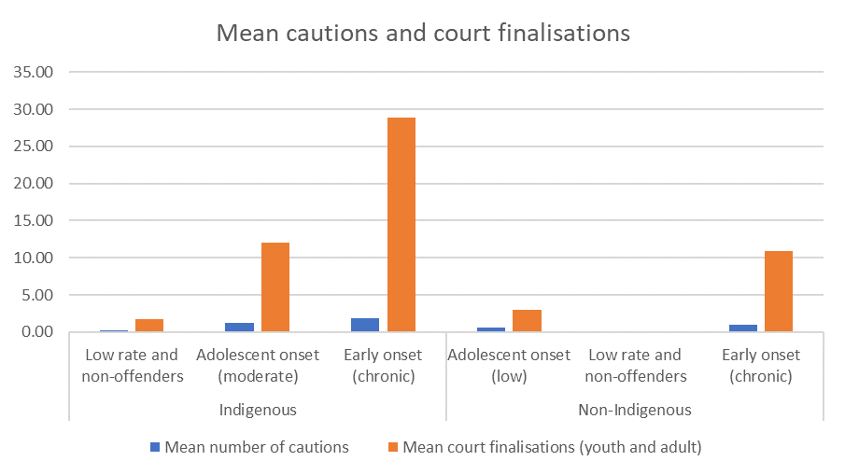
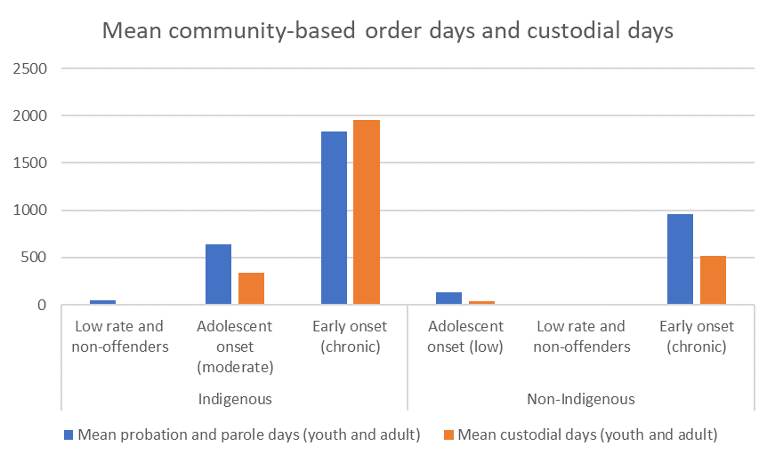
Distribution of mean criminal justice system contacts across the life-course
3x
2x 4x
4x
5x
10x
Notes:
While we are yet to apply the costs to the trajectories, we will finish up by giving a sense about how the costs may play out.
These graphs show the distribution of mean contacts across the trajectory groups for Indigenous and non-Indigenous Australians. The graph on the left relates to cautions and court finalisations, whereas the graph on the right relates to probation and parole and custodial days.
It is apparent that:
When looking at the adolescent onset groups, the Indigenous cohort had 4 times as many court finalisations, 5 times as many days on probation and parole and 10 times as many custodial days as those in the non-Indigenous cohort.
When looking at the early onset chronic groups, Indigenous members had nearly 3 times as many court finalisations, nearly twice as many days on probation and parole, and nearly 4 times as many days in custody.
Therefore, Indigenous peoples in the adolescent onset and early onset chronic groups are likely to cost significantly more than non-Indigenous peoples in these groups.

Slide 25
Next steps
Finalise top down estimates and calculate bottom up estimates
Validate with agencies
Apply costs to patterns of contacts from linked cohort data, and project as future costs (e.g. estimate for a cohort who were aged 10 in 2016/17)
Costs discounted at 7% annually and estimate a net present value of future costs for each offending class
Notes:
In terms of the next steps:
We are in the process of finalising our top down estimates, and calculating our bottom-up estimates.
We then need to validate these with the agencies and apply them to patterns of contacts from the linked cohort data, to project future costs. That is, we will estimate for a cohort who were aged 10 in 2016/17. In applying the costs, we will discount at 7% annually and net present value of future costs for each offending class estimated.

Slide 26
Conclusions
Indigenous peoples have a much higher rate of contact with the criminal justice system (80% vs 26%)
Offending groups for Indigenous (adolescent onset moderate and early onset chronic) have a much higher relative volume of contacts with the criminal justice system over their early life-course
Considerable variability in costs based on offence type, types of community-based orders and location of criminal justice system contact
Costs of trajectory groups are likely to vary considerably given large variation in mean volume of contacts with the criminal justice system
Notes:
To conclude:
Our research shows that Indigenous peoples have a much higher rate of contact with the justice system.
The offending groups for Indigenous have a much higher relative volume of contacts with the justice system
There is considerable variability in costs based on offence type, types of community based orders and location
And the costs of trajectory groups are like to vary considerably given the large variation in mean volume of contacts with the criminal justice system

Slide 27
Thank you!

