Slide 1

New South Wales District Criminal Court Backlog Simulation
Hamish Thorburn

Slide 2
Criminal Courts in NSW
Case heard in Local Court
Penalty < 2 years prison
Pleads not guilty
Pleads guilty
Committed for trial in District Court
Committed for sentence in District Court
Remains in Local Court
Penalty >= 2 years prison

Slide 3
Trial delay in NSW
Trial delay: time between committal and finalisation in the District Court
Median trial delay has risen from 234 days in 2011 to 348 days in 2015
Number of cases awaiting trial in the NSW District Criminal Court (DCC) in December 2015 was 2014 – up from 1017 in January 2011

Slide 4
Problems with trial delay
More stressful to defendants/victims
Cost of holding defendants in remand
Cost imprisonment is $292/day
Prison population is at record numbers

Slide 5
Relationship with case backlog
Case backlog/pending caseload: Number of cases awaiting trial in the NSW DCC
Linked to trial delay

Slide 6
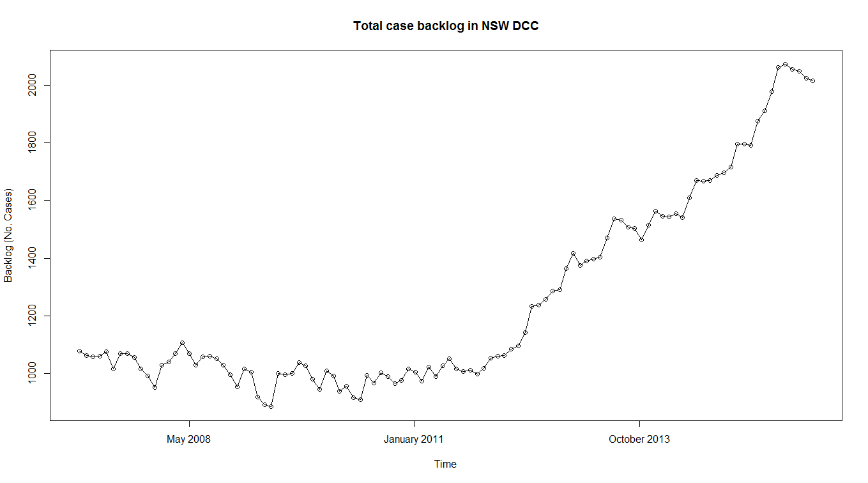
Case backlog

Slide 7
Data
Numbers of pending, registered and finalised cases by month and registry (Jan 07-Jul 16)
Trial lengths by registry (Jan 11 – Jun 16)
Other data obtained through published court statistics/personal communication

Slide 8
Model fitting
Create the model to test various policies for reducing court delay
Only fit the model for the registry of Sydney
Easier to fit the model with the larger number of cases
Covers approximately 33% of all trials
Fit the simulation from 2012

Slide 9
Model process
Trial cases lodged each month
39% trial proceeds
34% plead guilty
Assigned to an available judge
18% adjourn
5% Aborted/hung juries.
95% Finalised
9% other disposals
CASE DISPOSED/FINALISED
Notes:
Proportions at each stage add up to the proportion that went in

Slide 10
Other assumptions
A trial is always ready to be heard when needed
No change in registrations/trial lengths over time (apart from seasonal variation).
No variation in ‘trial day outcome’ probabilities
Judges get leave
Judges sometimes have to work on short matters

Slide 11
Model validation
Arrival distribution assumed to be normal for each month
Feb-Nov pass Shapiro-Wilk test for normality
Not enough points to check for December, January

Slide 12
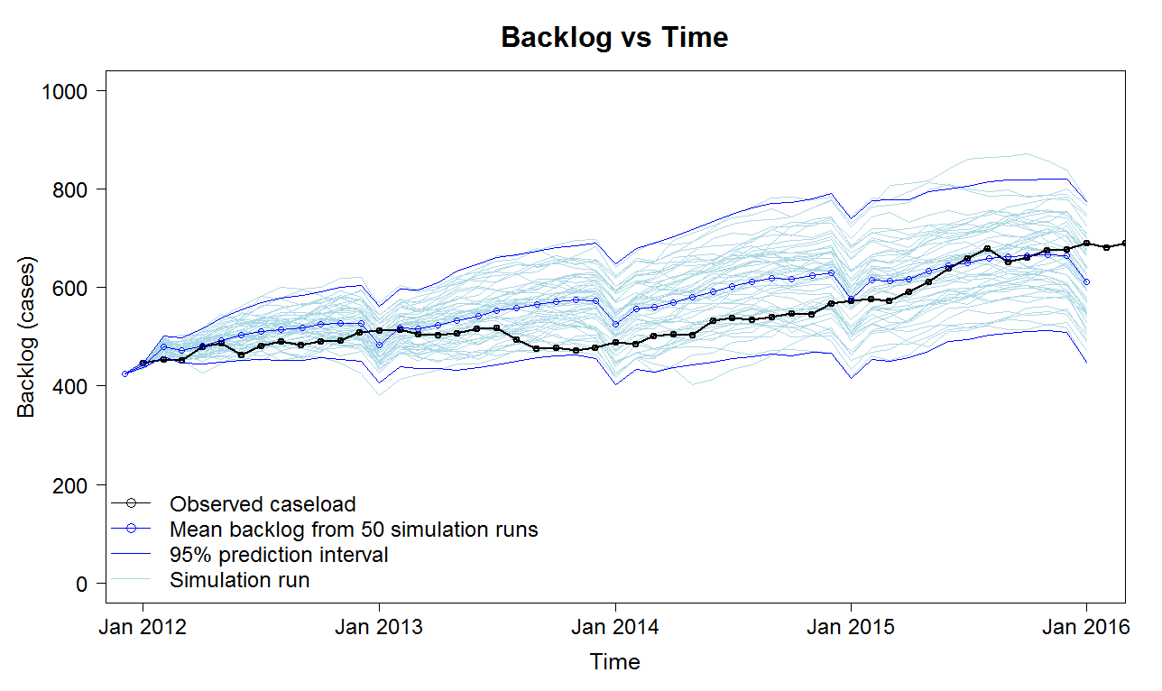
Model validation - backlog

Slide 13
Model interventions
Examples of scenarios we can test:
Increasing court time (i.e. number of judges)
Changing the number of trial-day guilty pleas
Change the number of cases requesting adjournments
Remove the mid-year court ‘vacation’ period

Slide 14
Model interventions
Target: Backlog to 430 cases (Jan 2012 level) by December 2019
Would reduce trial delay to roughly 220 days

Slide 15
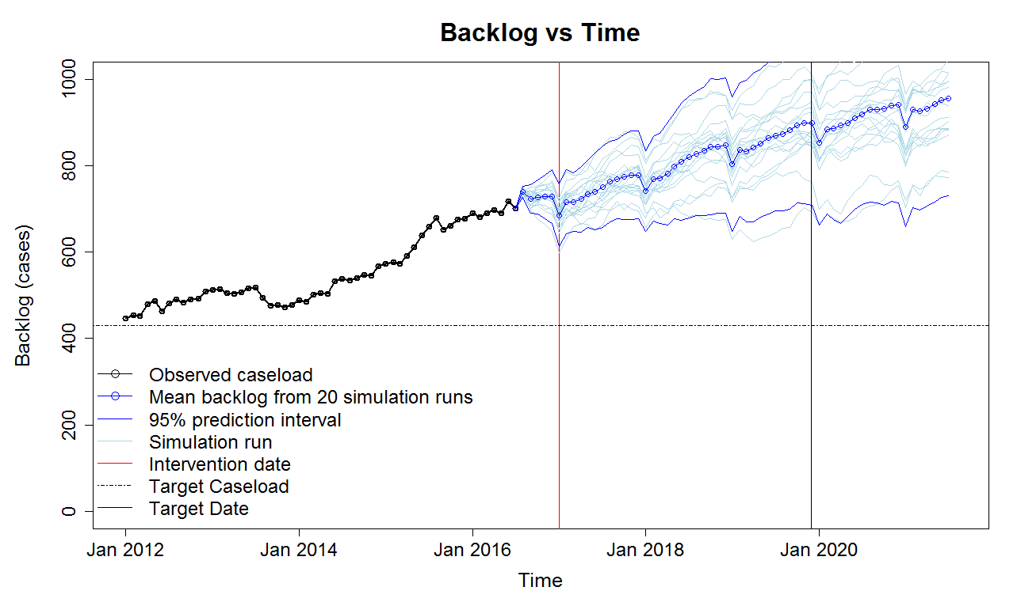
Baseline case

Slide 16
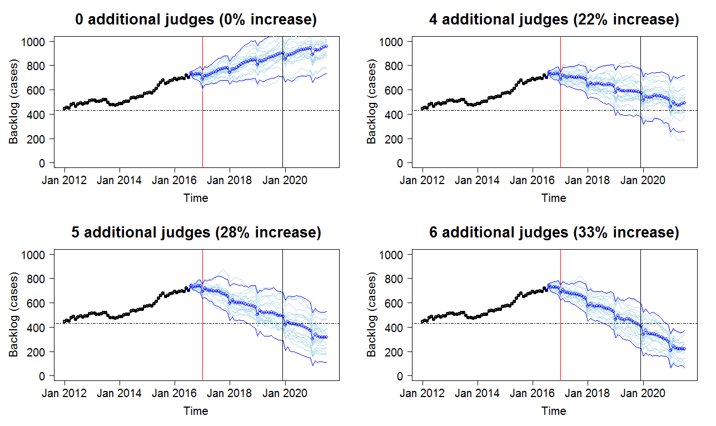
Increasing judges

Slide 17
Decreasing late guilty pleas
Modelling a reform to encourage pleas before committal in the Local Court, rather than close to trial

Slide 18
Decreasing late guilty pleas
Case heard in Local Court
Penalty < 2 years prison
Pleads not guilty
Pleads guilty
Committed for trial in District Court
Committed for sentence in District Court
Remains in Local Court
Penalty >= 2 years prison

Slide 19
Decreasing late guilty pleas
Trial cases lodged each month
39% trial proceeds
34% plead guilty
Assigned to an available judge
18% adjourn
5% Aborted/hung juries.
95% Finalised
9% other disposals
CASE DISPOSED/FINALISED
Notes:
Proportions at each stage add up to the proportion that went in

Slide 20
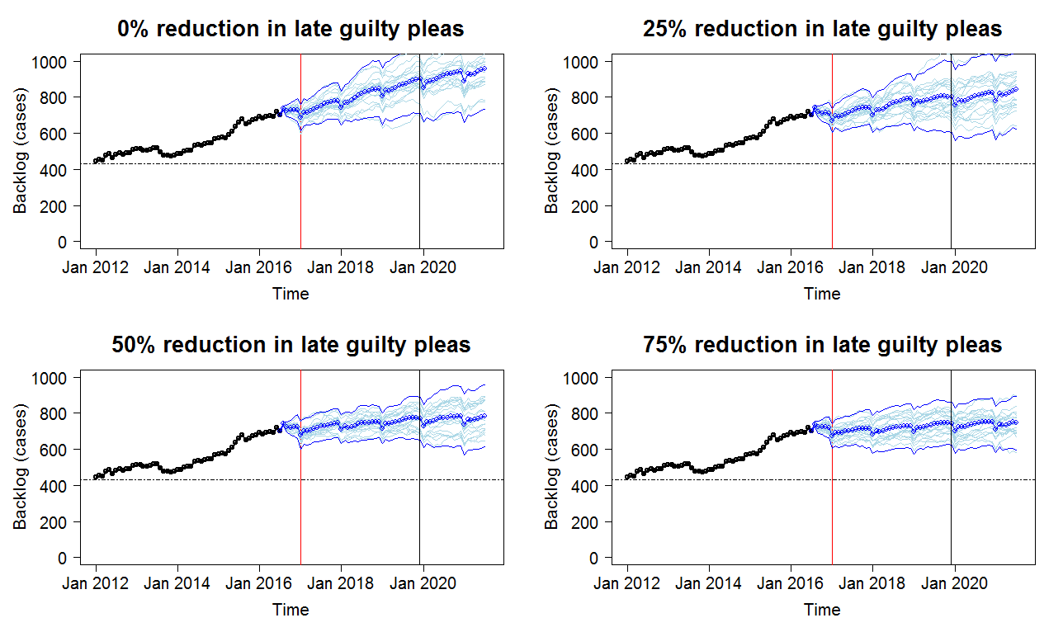
Decreasing late guilty pleas

Slide 21
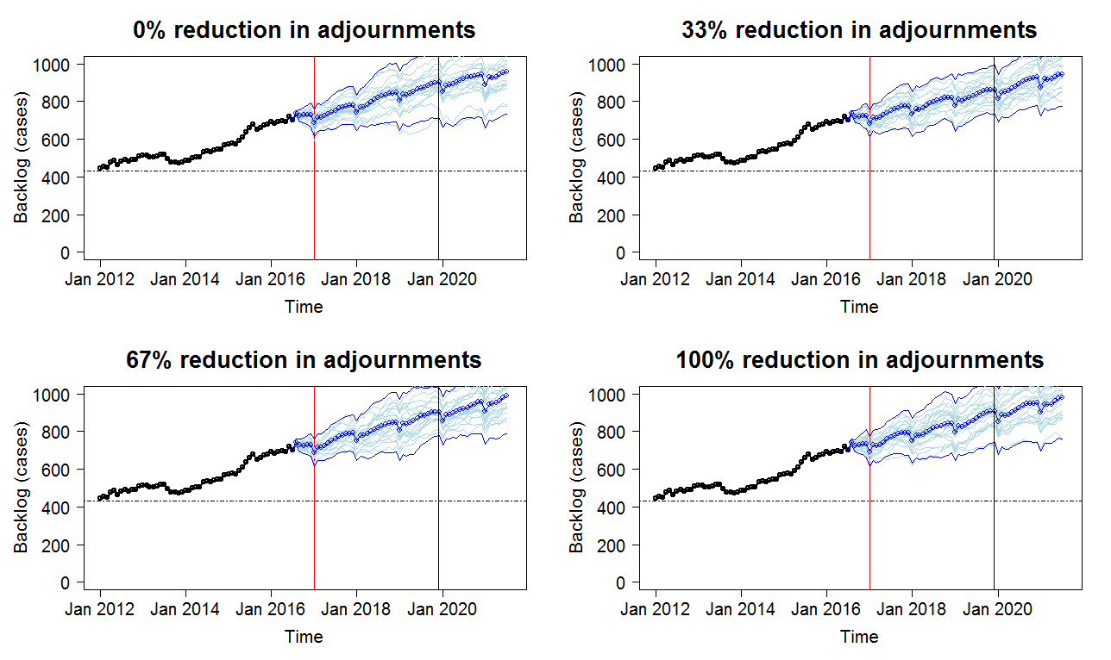
Decreasing adjournments

Slide 22
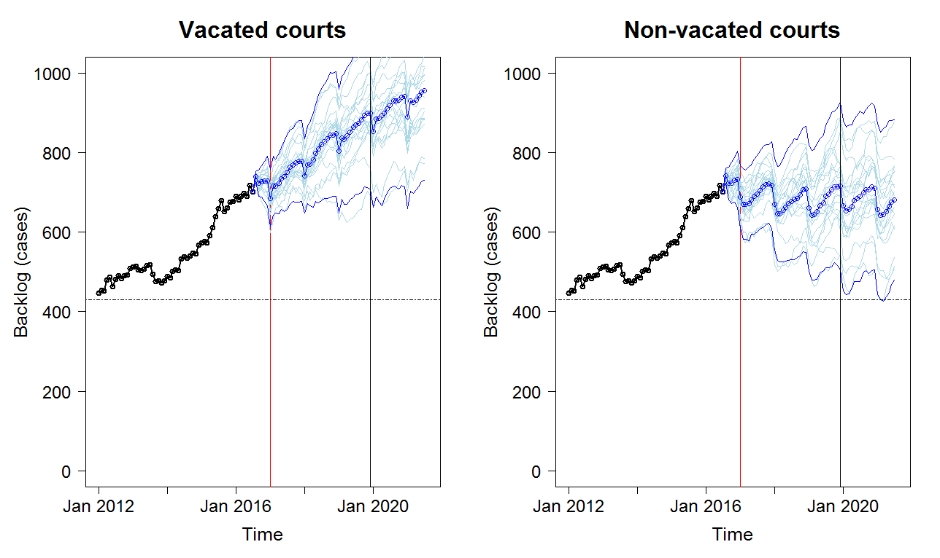
Removing the court vacation period

Slide 23
Combined interventions
It may be more feasible to implement small interventions across different areas rather than one large intervention
We try implementing the following interventions
2 additional judges
50% reduction in late guilty pleas
33% reduction in adjournments

Slide 24
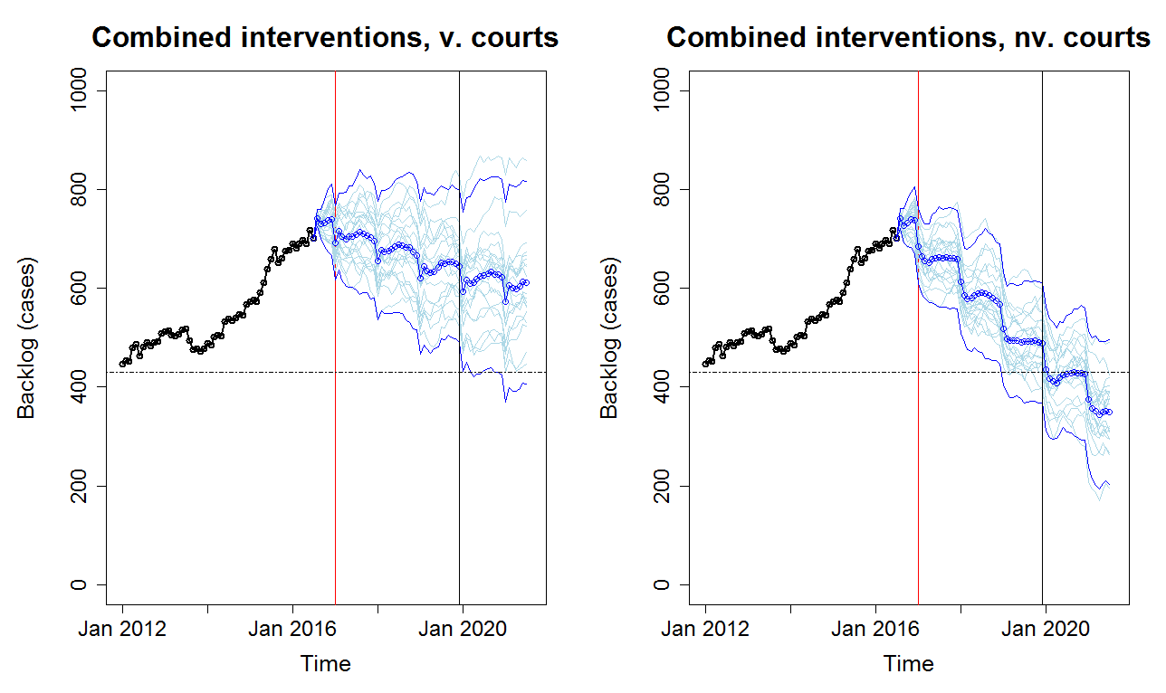
Combined interventions

Slide 25
Other Possible Interventions
Interventions we can currently perform | Interventions we can easily incorporate
Changes to the number of judges (step and gradual) Changes to the proportion of cases going to trial Changes to the distribution of trial day outcomes Probability that judges work on short matters Changes to the mean number of registrations each month | Changes to judges leave/sitting time

Slide 26
Cautions
This is only for Sydney, not NSW as a whole
Some arrival/trial length assumptions may not hold for other registries
Parameter estimates are just estimates (especially around trial-day outcome probabilities)

Slide 27
Summary
Trial delay is a big problem in NSW
DCC simulation model can be used to test various scenarios
Most effect policies are increases in court time
Through additional judges or non-vacated courts

Slide 28
Questions?

