Slide 1


  Child sexual abuse in historical perspective: what did the law know and how did it act?
Mark Finnane, Amanda Kaladelfos, Yorick Smaal
prosecutionproject.griffith.edu.au

Slide 2



Table 1. Criminal law provisions for offences against children
 | NSW | Victoria | Qld | WA
Infancy | Mandatory death sentence for ‘carnal knowledge’ of girls under 10 (until 1955) | Mandatory death sentence for ‘carnal knowledge’ of girls under 10 (until 1949) | 1899: Life imprisonment for ‘carnal knowledge’ of girls under 12 | 1892: life imprisonment for ‘carnal knowledge’ of girls under 13
Age of consent (Female) | 14 (1883) 16 (1910) | 16 (1891) | 14 (1891) 17 (1913) | 16 (1892)
Incest and relational offences | Fathers, teachers (1883:aoc 16; 1924: aoc 17) | Incest (1891) Schoolteachers and guardians (1891) | Incest (1891) | Incest (1892) Guardians, schoolteachers (aoc:17)
Boys | Nil special provisions | Optional death sentence for sodomy of boys under 14 (with violence)(1890) Age of consent 16 for indecent assault (1919) | ‘Indecent dealing’ with boy under 14 (1899) | ‘Indecent dealing’ with boy under 14 (1902)

Slide 3
Table 2: Prosecution of sexual offences, % of total in selected jurisdictions
 | Vic 1861-1911 | Vic 1921-1961 | WA 1830-1910 | WA 1911-1961 | NSW 1870-1915 | Qld 1870-1910 | Qld 1911-1930
Above age of consent | 51.2 | 41.1 | 66.7 | 67.4 | 43.6 | 63.8 | 32.8
Identified below age of consent | 48.8 | 59.9 | 33.3 | 32.6 | 56.4 | 36.2 | 64.2
Total n | 281 | 443 | 363 | 943 | 257 | 945 | 748
Source: Prosecution Project data, from court records in four jurisdictions: sexual offences make up 10-11% of all offences charged for all jurisdictions

Slide 4
Table 3: Most frequent offences charged, ‘below the age of consent’
Victoria |  | WA |  | NSW |  | Qld
Charge | % | Charge | % | Charge | % | Charge | %
Carnally knowing girl between 10 and 16 | 32.5 | Incest | 17.9 | Indecent assault on girl under 14 | 19.3 | Carnal knowledge girl under 17 | 15.2
Indecent assault on a girl under 16 | 9.4 | Indecently dealing with a girl under the age of 13 years | 14.2 | Carnally knowledge of girl between 10 and 14 | 13.1 | Incest | 11.6
Indecent assault on a girl | 8.9 | Unlawful carnal knowledge | 5.1 | Rape | 7.6 | Indecent dealing girl under 12 | 8.6
Indecent assault | 5.4 | Indecently dealing | 3.7 | Buggery | 4.1 | Indecent dealing girl under 17 | 8.4
Indecent assault male under 16 | 5.2 | Rape | 2.8 | Indecent assault | 4.1 | Indecent assault | 5.6
Total n = | 406 | Total n = | 430 | Total n = | 145 | Indecent dealing boy under 14 | 5
 |  |  |  |  |  | Total n = | 833
Source: Prosecution Project data, from court records in Vic and WA

Slide 5
Table 4: Prosecution of sexual offences, gender of complainants (% of number of cases)
Identified below age of consent | Vic 1861-1911 | Vic 1921-1961 | WA 1830-1910 | WA 1911-1961 | NSW 1870-1915 | Qld 1870-1910 | Qld 1911-1930
Male | 10.3 (29) | 21.2 (113) | 10.8 (37) | 34.9 (86) | 45.7 (46) | 53.1 (49) | 70.0 (60)
Female | 88.4 (146) | 94.5 (238) | 84.4 (109) | 90.7 (226) | 58.8 (211) | 74.3 (307) | 81.2 (260)
Missing n | 106 | 92 | 217 | 631 | 0 | 589 | 428
Source: Prosecution Project data: in brackets n of total sexual offences cases for each sample. Highlighted data suggests significant underestimate of number of under-age boys in the data.

Slide 6
Table 5. Verdicts for sexual offences, all samples.
 |  | Above age of consent |  | Identified below age of consent
 |  | Frequency | % | Frequency | %
Not guilty |  | 565 | 33.3 | 434 | 28.5
Guilty |  | 861 | 50.8 | 883 | 57.9
 | Guilty plea/verdict | 307 | 20.8 | 349 | 27.8
Guilty partial plea |  | 125 | 7.4 | 89 | 5.8
Jury disagree |  | 41 | 2.4 | 32 | 2.1
Nolle |  | 80 | 4.7 | 61 | 4.0
Postponed |  | 24 | 1.4 | 25 | 1.6
Total n = |  | 1696 | 100.0 | 1524 | 100.0
Source: Prosecution Project data, from court records in each jurisdiction: Vic, NSW and Qld (1911-30), significantly more likely guilty verdict in child cases

Slide 7
Table 6. Sentencing outcomes in sexual offences cases, all samples
 | Above age of consent |  | Identified below age of consent
 | Frequency | Valid Percent | Frequency | Valid Percent
Imprisonment | 850 | 82.0 | 785 | 80.9
Mean length of imprisonment (SD) | 977.59 (1017.19) |  | 943.09 (1027.91)
Bond | 86 | 8.3 | 113 | 11.6
Life imprisonment | 10 | 1.0 | 9 | 0.9
Fine | 23 | 2.2 | 10 | 1.0
Death | 38 | 3.7 | 15 | 1.5
Lashes | 29 | 2.8 | 38 | 3.9
Total | 1036 | 100 | 970 | 100
Source: Prosecution Project data, from court records in four jurisdictions, Vic, NSW, WA, Qld; majority of death sentences commuted]?

Slide 8
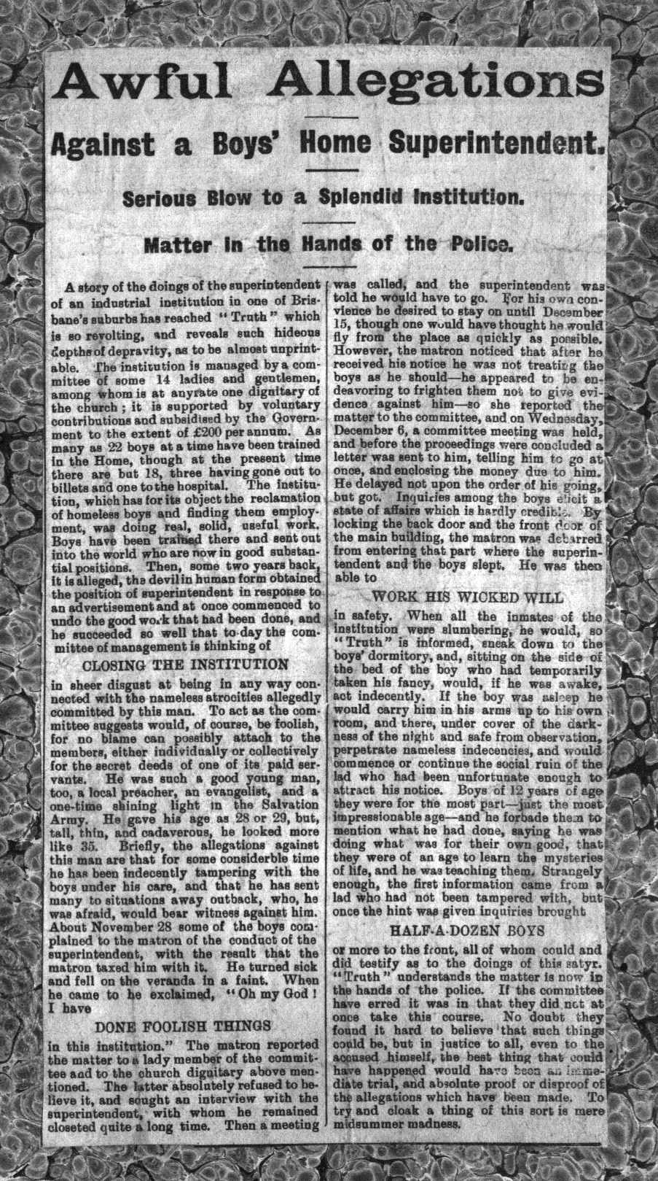
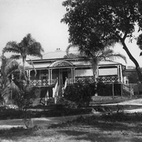
The Brisbane Boys Home

Slide 9
  Child sexual abuse in historical perspective: what did the law know and how did it act?
With thanks to Lauren Vogel for assistance with the statistics and the Prosecution Project researchers and volunteers for their assistance with data
prosecutionproject.griffith.edu.au

