Slide 1


The Australian Cross Border Justice Scheme
Rick Sarre
Law School
University of South Australia

Slide 2
The research team
Dr Judy Putt, University of Tasmania / University of New England
Professor Rick Sarre, University of South Australia
Dr Emma Rowden, University of Western Sydney
Ms Gillian Shaw, Bowchung Consulting

Slide 3
Background to the CBJS
1999 Suicide of a 15 year old Aboriginal girl at the Swan Valley Nyoongar Community
2001 Inquiry (Gordon Committee)
2002 published report: Putting the Picture Together: Inquiry into Response by Government Agencies to Complaints of Family Violence and Child Abuse in Aboriginal Communities (The Gordon Report)

Slide 4
Found:
No fewer than thirteen agencies had been providing services to the girl
A lack of clarity as to which agency was doing what
No one was leading the process
Highlighted a lack of coordination of policy and practice

Slide 5
History of the CBJS
Sparked a discussion to link up services in the Anangu Pitjantjatjara Yankunytjatjara lands (APY Lands) in the north-west of South Australia, the Central Reserves of Western Australia, and the NT south of Alice Springs
Collectively referred to as the Ngaanyatjarra Pitjantjatjara Yankunytjatjara (NPY) Lands
CBJS formally launched 1 November 2009

Slide 6
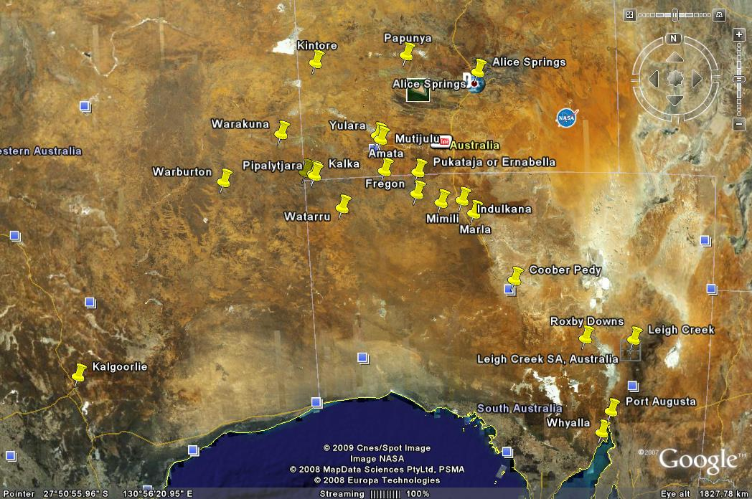

Slide 7
Cross Border Justice Scheme boundaries
Police Stations with Cells . . . . . . . . . . . .
P
Police Administration – No Facilities . . . .
P
P
PAPUNYA
P
Communities . . . . . . . . . . . . . . . . . . . . . .
KINTORE
Northern Territory
Western Australia
P
YULARA
P
IMANPA
WARAKURNA
P
MUTITJULU
P
KULGERA
P
FINKE
P
P
WARBURTON
P
BLACKSTONE
Pipalyatjara
P
P
MURPUTJA
AMATA
(MUSGRAVE PARK)
P
PUKATJA (ERNABELLA)
P
UMUWA
Kaltjiti
(Fregon)
P
Indulkana
(Iwantja)
MIMILI
P
MARLA
South Australia
Scale in Kilometres
100
50
0
100
500
© Peter Rossini

Slide 8
The CBJS
Police, sheriffs / magistrates and correctional officers from each jurisdiction would now be able to exercise cross-border powers / hear cross-border matters regardless of where the offences are alleged to have taken place.

Slide 9
Objectives of the evaluation
Review funded by SA AGs department 2012-2013
To determine the strengths and weaknesses of the CBJS
To examine the impact of the CBJS on police, courts, service providers, and the community within each jurisdiction
To determine the level of satisfaction with the CBJS from the perspective of the key justice agencies and community groups.

Slide 10
Methodology
Review of legislation, literature and program/policy information
Scan of monthly/quarterly reports on activities and costs
Review of characteristics of the region
Scan of criminal justice administrative data collection and analysis
Key stakeholder consultations: interviews and surveys
Consultations: interviews and workshops

Slide 11
Methodology
124 people in 10 communities interviewed
50 local justice service providers participated in an online survey
35 key stakeholders participated in face-to-face or telephone interviews
Census compiled (Dec 2012) of current police warrants, community corrections cases and prisoners
Court and police data were reviewed
Demographic profile of the region updated, based on 2011 ABS statistics

Slide 12
Methodology
Frustrations:
more police were appointed to the APY lands by the SA government in the lead-up
the Federal government’s Northern Territory intervention continued to unfold (from 2008)
Both factors led to many offenders leaving the region for Alice Springs and Darwin.

Slide 13
Flow diagram
Aim
to minimise the effects of state and territory borders on law enforcement and justice services in cross-border region
Legislative framework
Service level agreements
Mechanisms in practice?
Ongoing and productive collaboration
Coordination
Improved community safety
Timely justice
Effective justice
Meaningful justice
Other factors? More police / the intervention?

Slide 14
Characteristics 2001-2011
Population of Indigenous persons in the region
2001: 6,075 persons
2011: 5,601 persons
Population of non-Indigenous persons in the region
2001: 3,497 persons
2011: 1,327 persons

Slide 15
Characteristics 2001-2011
Formal education of adult Indigenous persons in the region
2001: No formal education: 15%
Completed Year 10: 70%
2011: No formal education: 8%
Completed Year 10: 79%

Slide 16
Characteristics 2001-2011
Labour participation rates
2001: 35%
2011: 40%

Slide 17
General overview of findings
The Scheme has been implemented fully.
There was good political will, and high level, cross-sectoral commitment to the Scheme.
Yet there are many who are still unsure about how it works.
There is a need to streamline and clarify administrative arrangements.

Slide 18
Findings
Although the Scheme was appropriately designed and planned, it is still not well known in the region.
There was an expectation that many offenders would be affected by the scheme. But the actual numbers are very low.
So budgets have not been impacted greatly.

Slide 19
Findings
The heightened levels of communication and cooperation required to implement the Scheme have resulted in a diffusion of benefit across a range of justice agencies; namely inter-agency cooperation and collaboration has been strong.

Slide 20


Slide 21
Findings
It is difficult to determine whether the Scheme has operated to reduce the fear of crime in the region due to the fact that, over the period of the Scheme’s implementation, there have been additional policing resources stationed in the region.
It was always a stretch to claim that the community would be ‘safer’.

Slide 22
Findings
The Scheme is necessary but not sufficient to deliver the justice outcomes sought by the initial proponents of the Scheme.
Nevertheless it is the view of the evaluators that the Scheme should continue to be supported by the respective governments.

Slide 23


Slide 24
Recommendations
Public awareness must be improved through tailored communication strategies for key target groups
Stakeholder knowledge must be enhanced and experience communicated
Any current administrative burdens should be identified, lifted and lessened
A monitoring framework should be implemented

Slide 25
Recommendations
Aboriginal legal services must be encouraged to come on board
Parole boards and criminal appeals should be added to the Scheme’s remit
An efficient process must be identified and implemented for the payment of fines, whether through the CBJS or another mechanism
Resources should be maintained for the task.

Slide 26
